Slide 1


From Diagnosis to Follow-Up:
Designing and Implementing Asynchronous
and Experiential Learning in DBP Education
Tori Foster, PhD, BCBA; Laleh Bahrami, MD; Ryan Coleman, PhD; Jeffrey Hine, PhD, BCBA; Ella Kielmeyer, BA; Cara Miller, MD; Holly Miller, MSN, APRN, CPNP-PC;
Tara Minor, PhD; Anna Kathleen Spitler, BS; Gabija Zilinskaite, BM

Slide 2

Disclosure Information
Drs. Hine, Bahrami, Coleman, and Foster have the following relevant relationships to disclose:
  Grant/Research support from: NIH, DOD
Presenters will not discuss off label use or investigational use in this presentation.
Permission has been obtained for use of all photos/videos.

Slide 3
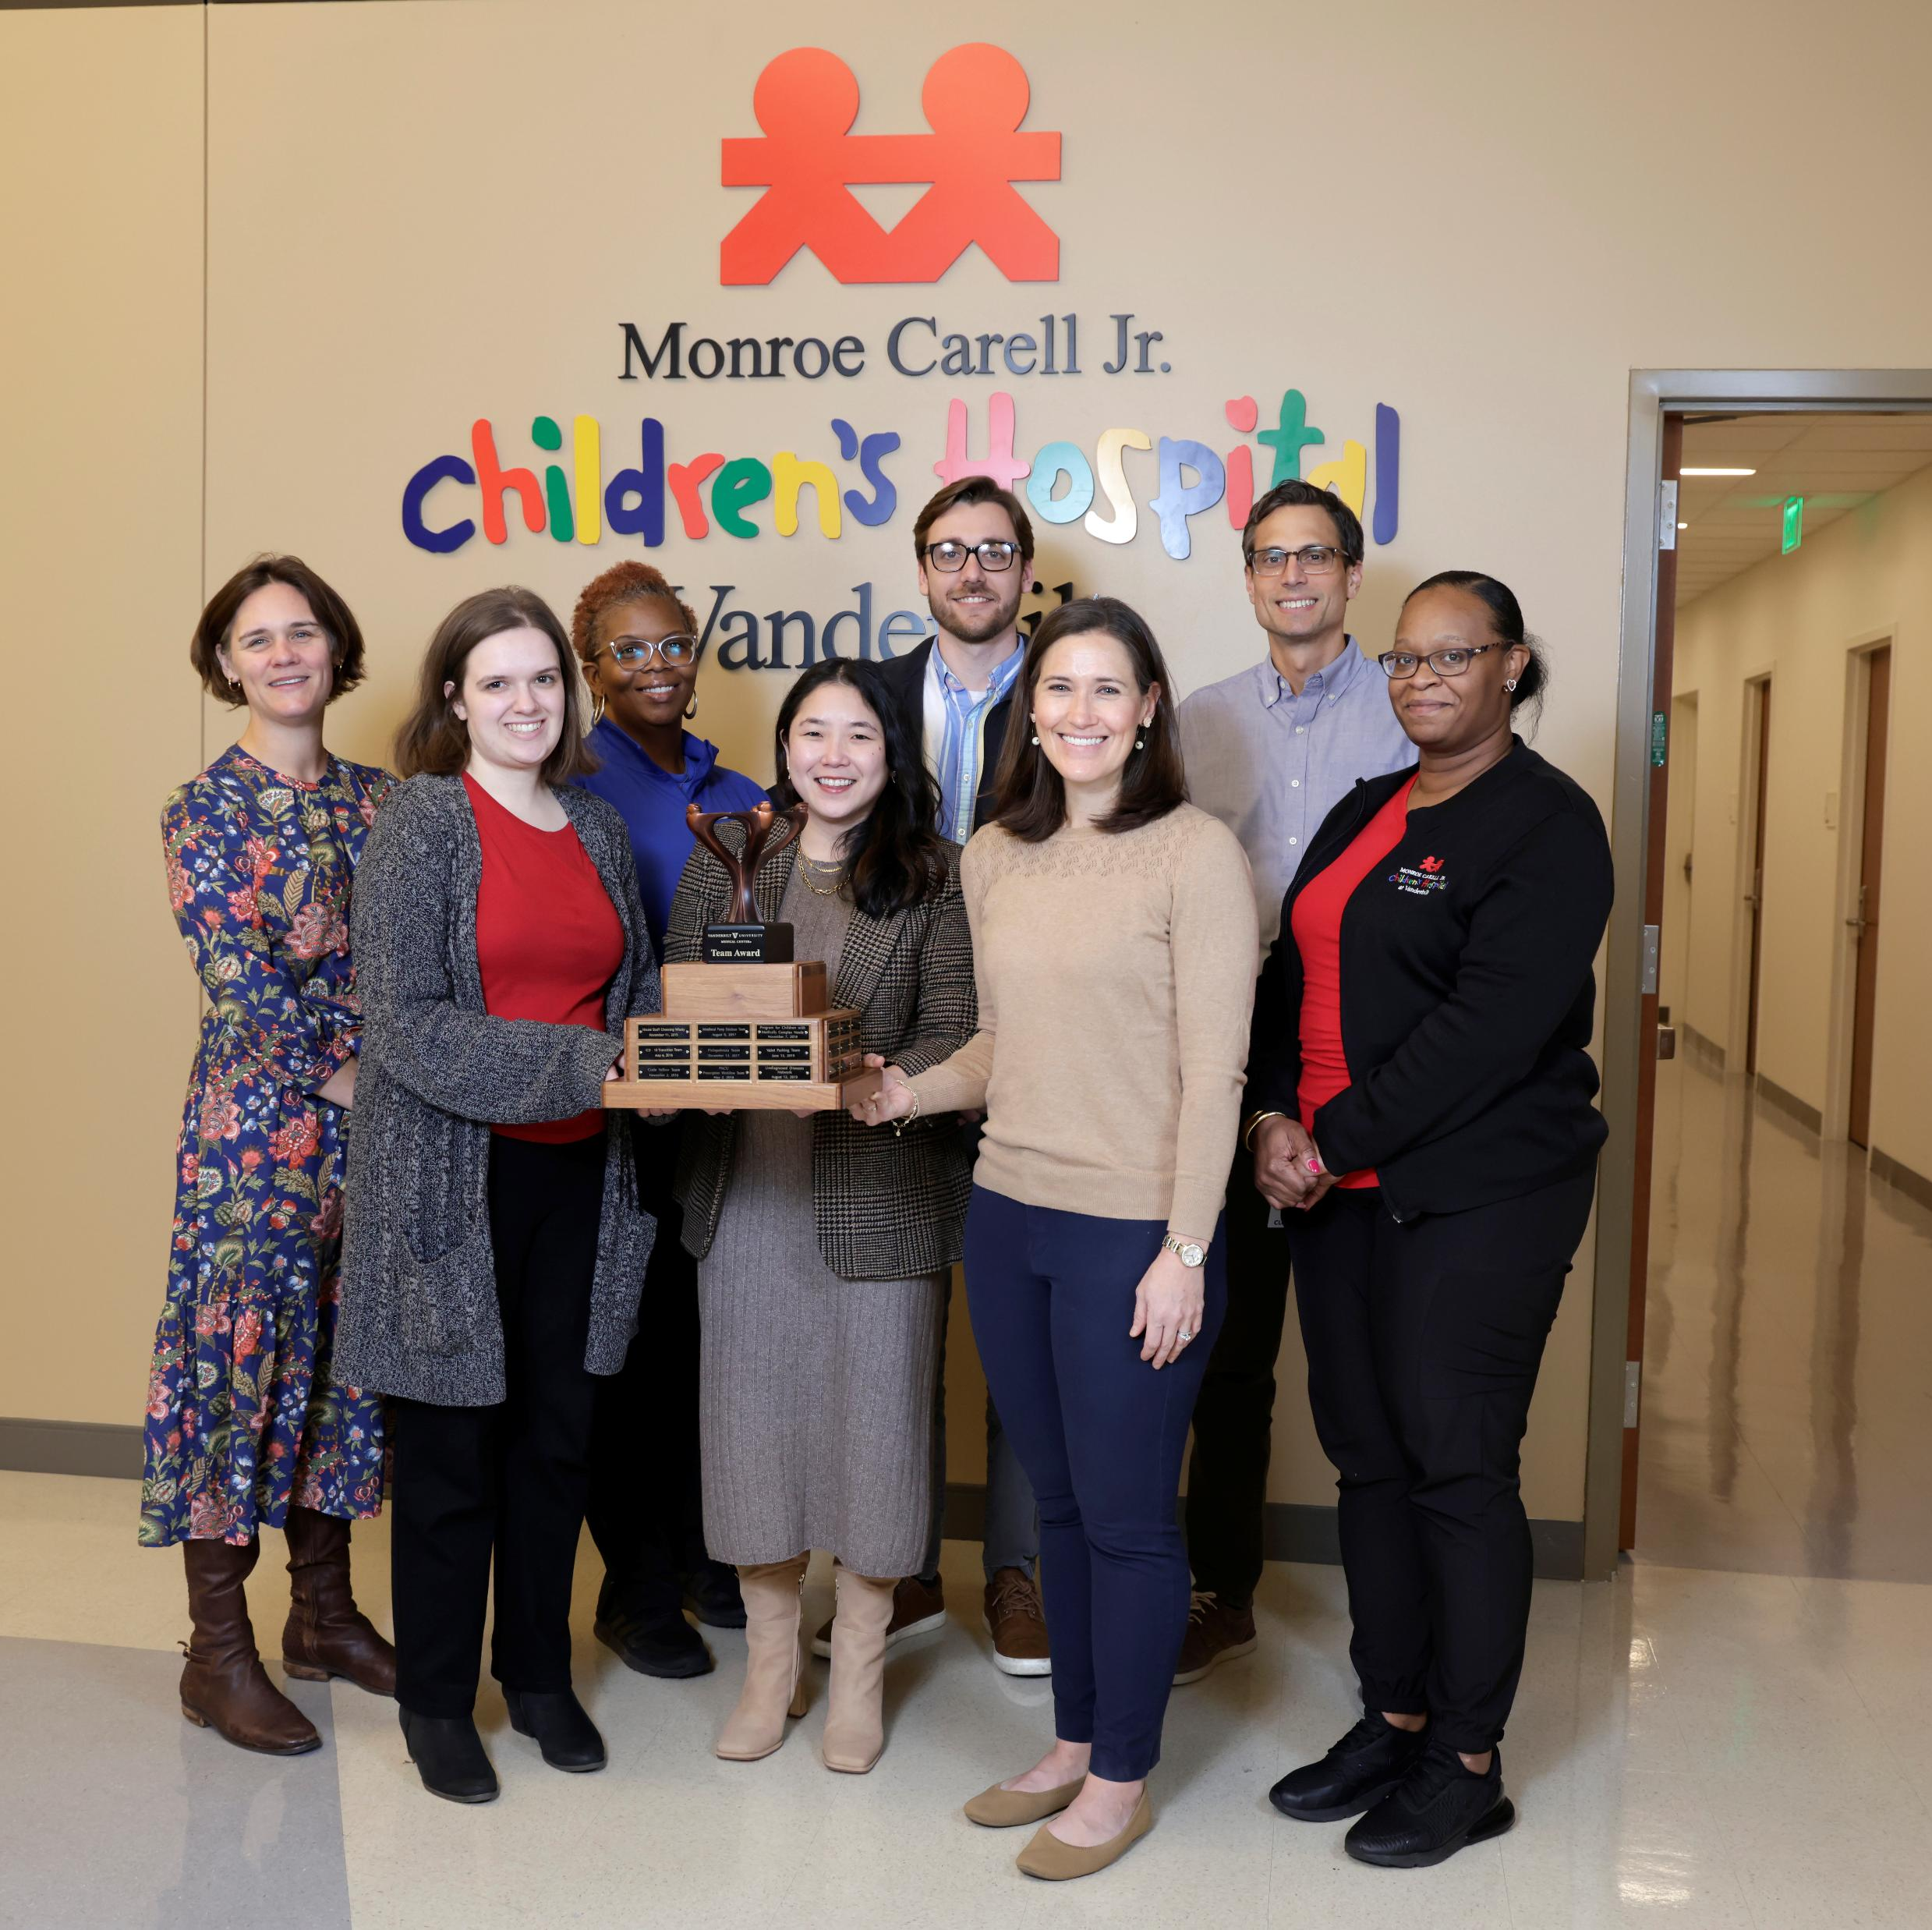

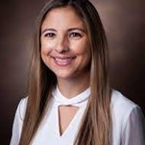
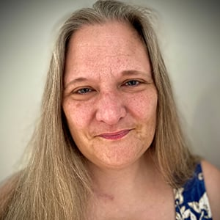
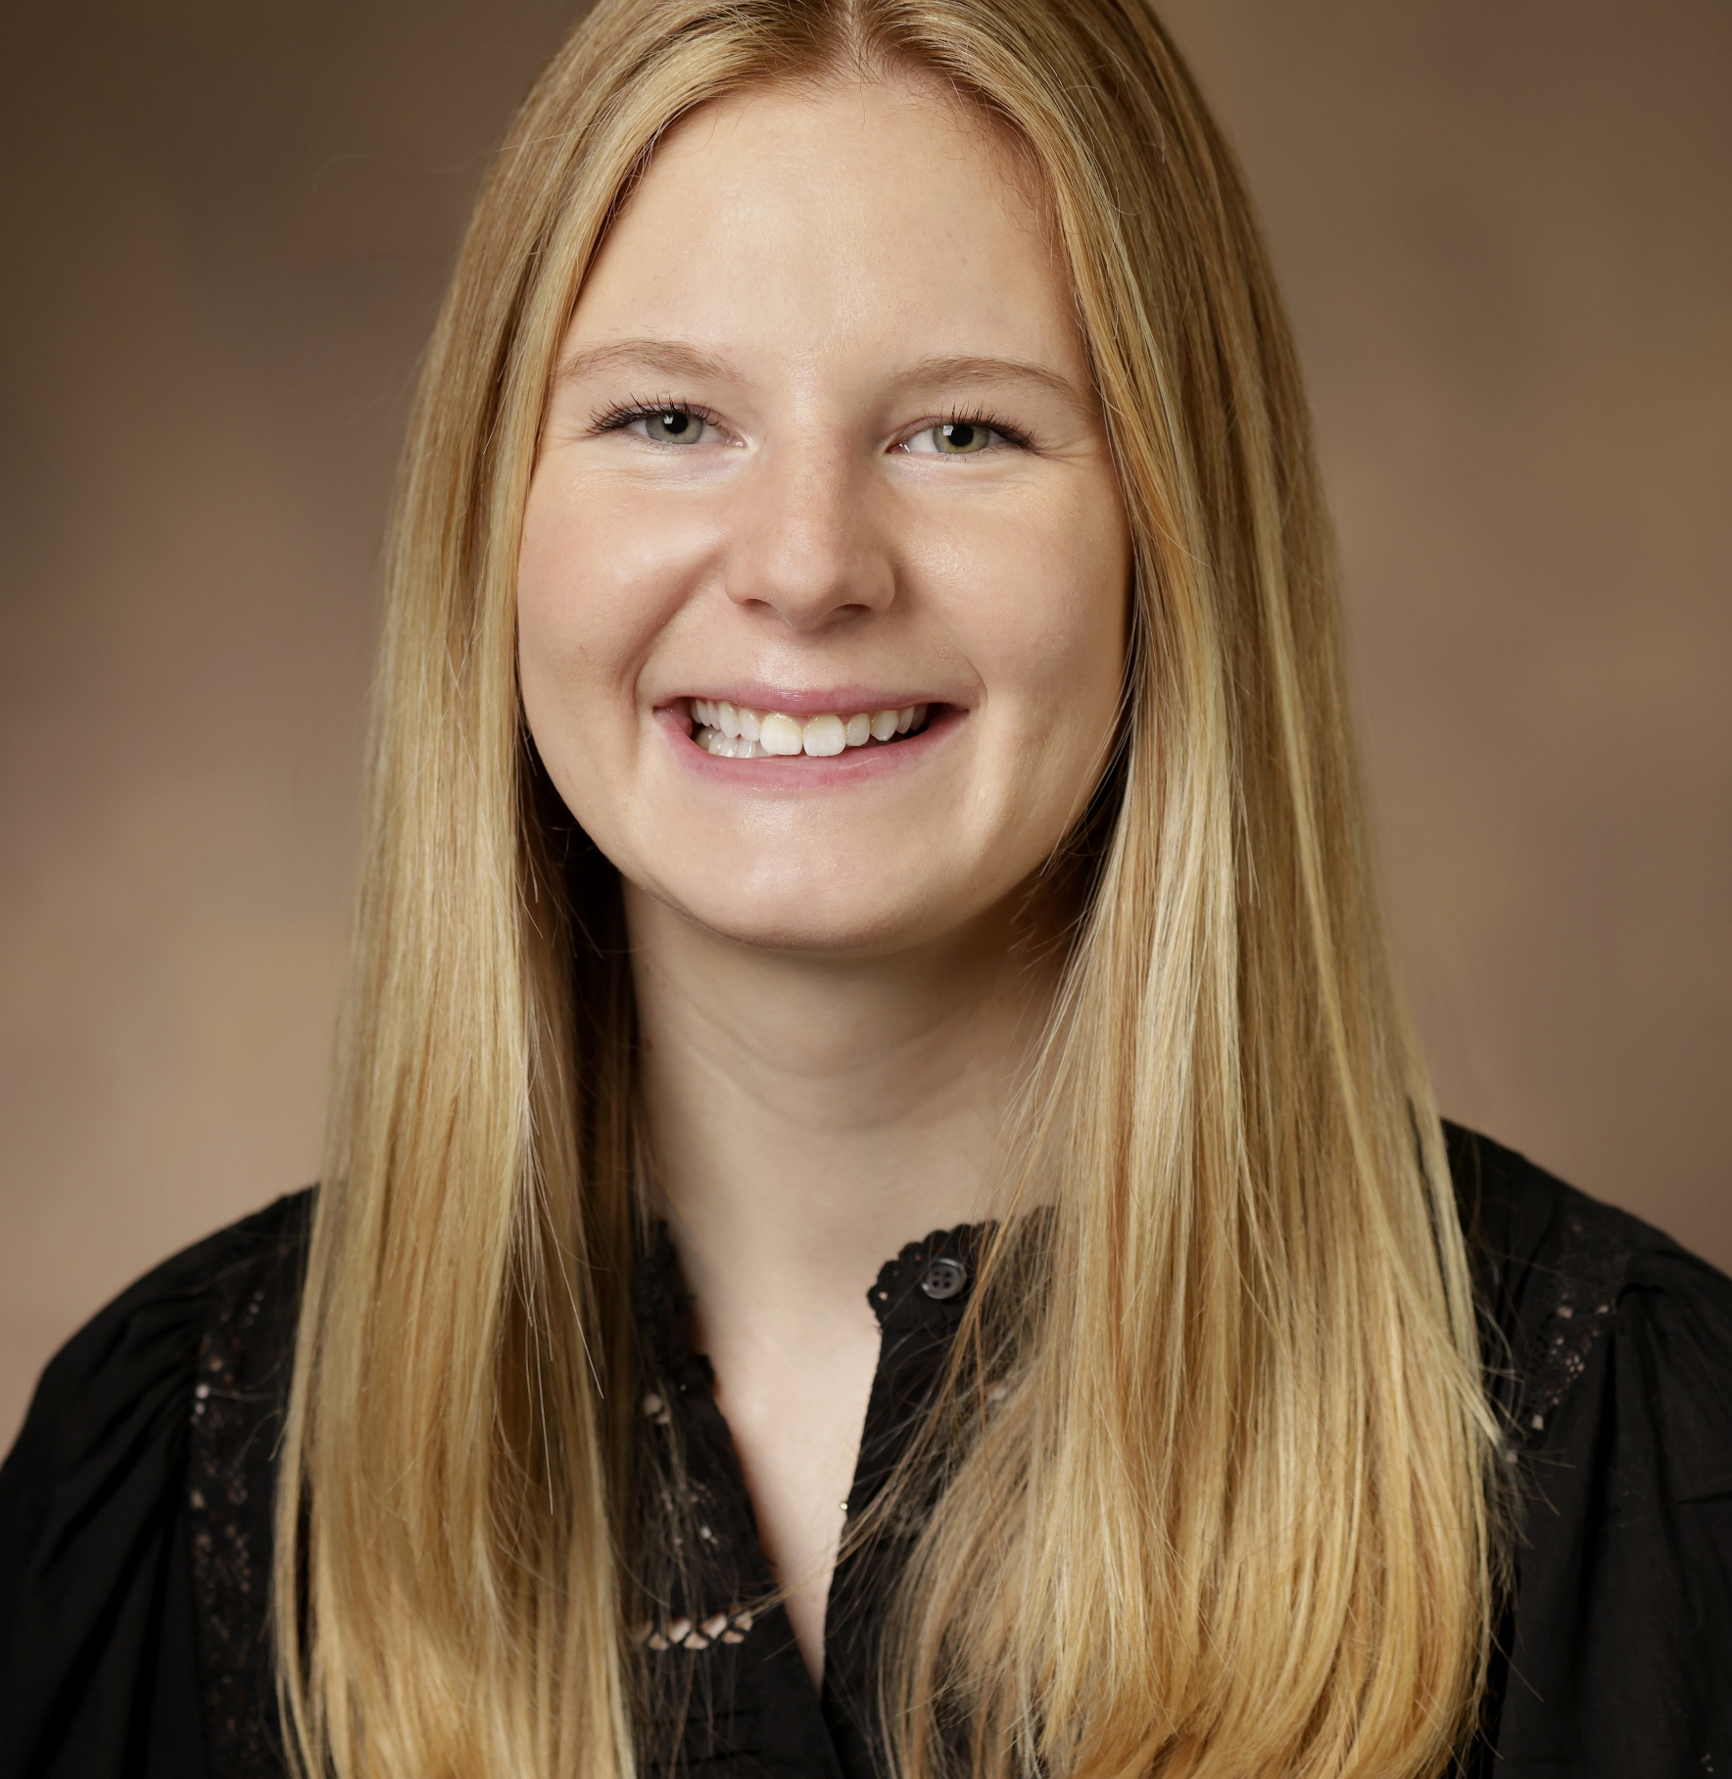

Team Introduction & Participant Polls
*Mentimeter Polls:
What is your professional background and setting?
What types of trainees/learners do you work with?
Notes:
Just like them, mixed backgrounds and settings but united by our practice and projects in primary care setting

Slide 4
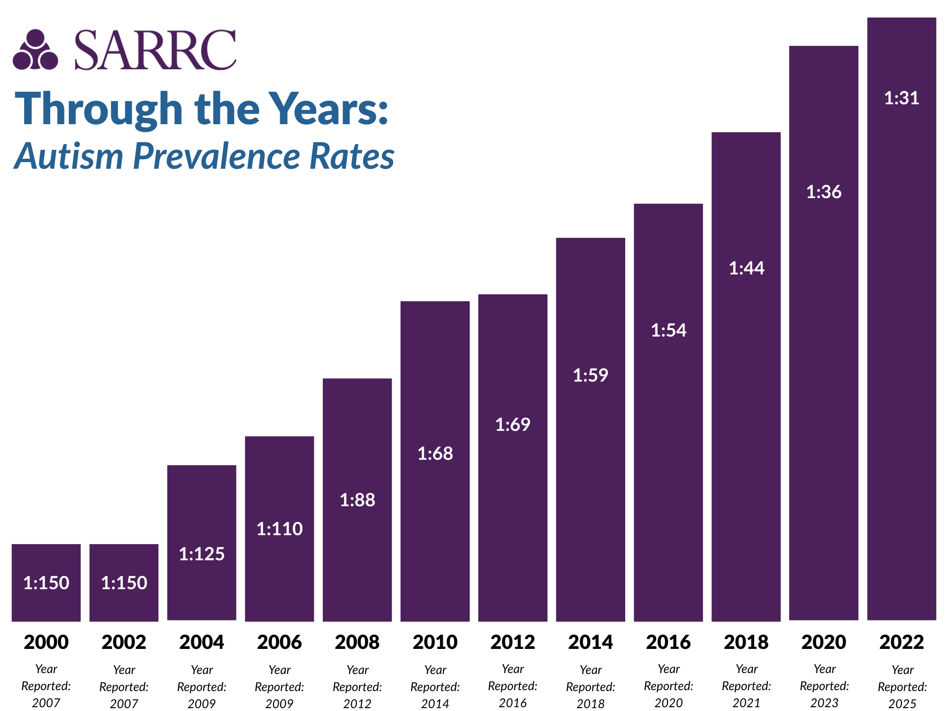
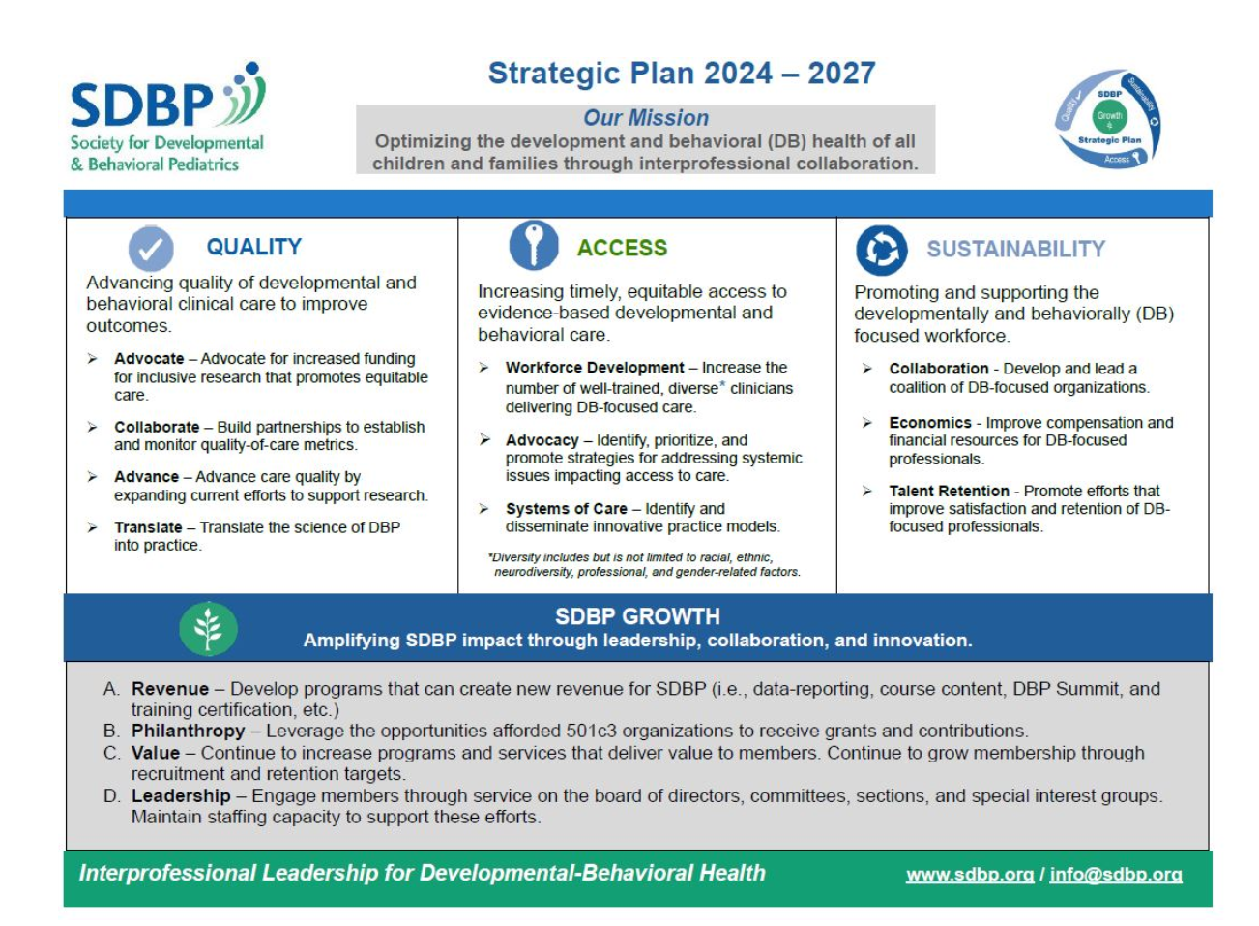

Our Focus
Notes:
Team’s focus is on increasing access to autism care
Push for broadening access and training/building more diverse workforce due to service bottlenecks/delays

Slide 5


Our “Learners”
Developmental-behavioral pediatrics fellows
Psychology fellows and graduate students
Learners/trainees with interest in development (e.g., LEND, medical students, special education students)
Pediatric residents (e.g., categorical Peds, Med-Peds, Child Neurology, Combined Pediatrics Medical Genetics)
PNP students
Community providers (e.g., general pediatricians, advanced practice providers, EI providers, therapy professionals, social workers)
Notes:
Related to this focus and just like you, we work with a variety of learners… (DBP/psych fellows and trainees with special interest in development, but also residents, PNP students, and community providers in general pediatrics given push for expanding to primary care)
With this in mind, we wanted to develop educational content and accompanying implementation/application supports that would be broadly useful for this variety of providers and learners, with an overarching emphasis on helping support families navigating the autism diagnostic process and post-diagnostic care.

Slide 6

Plan for Today
“Show and Tell” with Resources (End Products)
Development Process:
- Identifying Focus and Source Material
- Structuring Content for Effectiveness and Practicality
- Promoting Practical Application
- Measuring Learning Outcomes
- Action Planning (for each section)
Wrap-Up / Getting Started
Resource Toolkit
Notes:
First, going to show you what we created, both to put things in context and to show you resources you might be able to use in your own teaching
We’re going to throw all of this at you at the beginning, but then we’ll break it down and walk you through how we got to these end products
We will go through each step in the development process and guide you through how you can do something similar on your own
Throughout, we will lead you through action planning for each step, and then at the end, we will wrap up and set some priority action steps
Toolkit (folder of resources)

Slide 7
“Show and Tell” with Resources

Slide 8
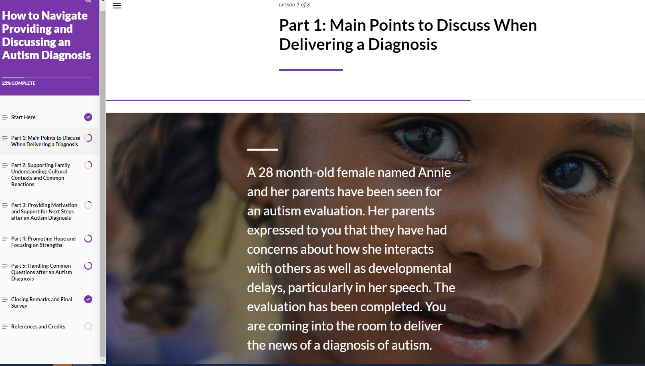
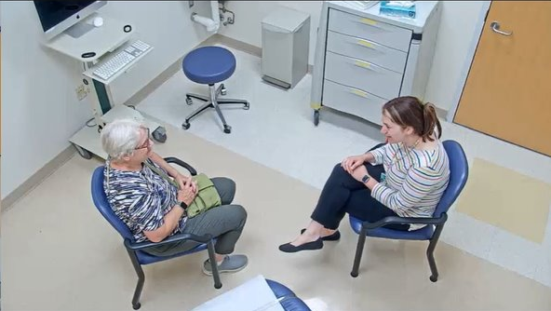
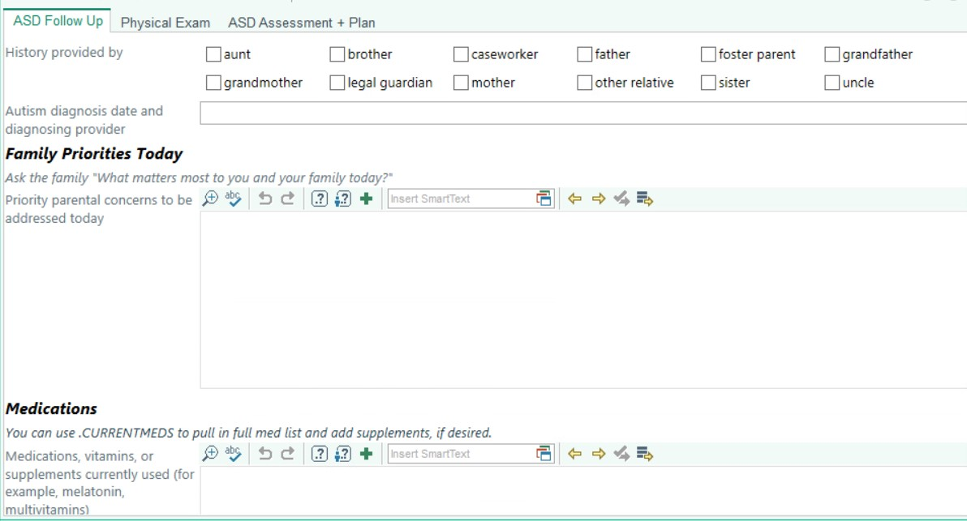
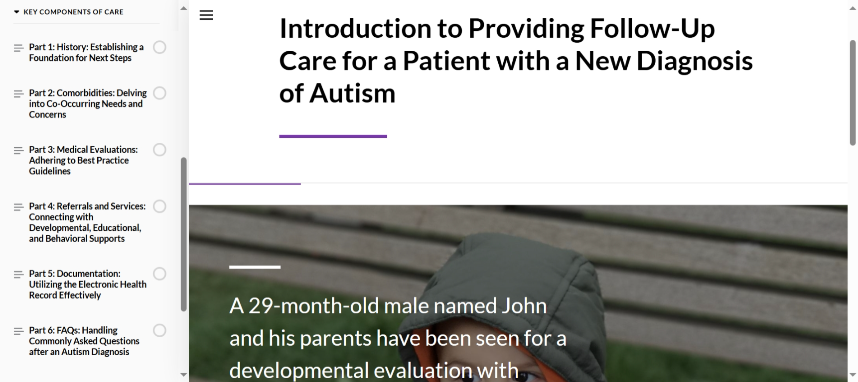
Video Walkthrough of Our Resources
Notes:
Will show screen recording videos as a “hook” and to give context for the rest of the presentation (show what pieces look like and consist of) - These videos will also include detailed voiceover highlighting the key features (to also ensure digital accessibility):
Overall structure of diagnostic module and variety of elements/OTR in it
Short clips of simulation and tools/materials to go with it
Overall structure of post-diagnostic module and variety of elements/OTR in it
Brief SmartSet example
(Not meant to be exhaustive tour through resources or to mention every detail, but to give them a snapshot and make things more concrete)
These are open access and we want them to be shared/used as widely as possible → So during this workshop, we want you to think about how you might want to utilize them and we also want to walk you through developing resources of your own using our process as a guide (useful for both levels of people who need premade things they can use OR people who have the resources to create new tools – since SDBP attendees will vary from residency/fellowship directors at academic medical centers to community DBPs who work with trainees)

Slide 9
*Note to Reviewers*
Action Planning windows will involve participants filling out a piece of their Action Plan handout, which will include ~3 very specific and simple questions/prompts (shown in slides) for each section. Each of these windows will be short, about 3-5 minutes, and they will do them at their tables and discuss with their table if they have time. Teammates will float around and help answer questions/facilitate/help them with their ideas.

Slide 10


Action Planning #1:
Utilizing Existing Resources
  How can you utilize these resources and materials within your own role/program?
    What parts can you use?
    Who can you share it with?
  Are there any other pre-existing resources that you have been wanting to incorporate into your curricula?
Notes:
For #2: acknowledging that we know there are a lot of other great resources out there besides ours (main idea being to think about existing materials that have elements you like and want to incorporate without having to create them yourself)

Slide 11
Development Process
Identifying Focus and Source Material
Structuring Content for Effectiveness and Practicality
Promoting Practical Application
Measuring Learning Outcomes
Notes:
Now that you’ve seen our end products and thought about how you might utilize them, we’ll shift to what we did to get to there.

Slide 12
Identifying Focus and Source Material

Slide 13


Notes:
As we mentioned before, our focus is on autism specifically and on empowering a range of diverse clinicians to provide autism-related care, and we are working to increase provider confidence and comfortability in providing diagnostic/follow-up visits for children with ASD.
When we considered existing training resources related to autism, we recognized that there are already a lot of wonderful materials out there focused on teaching learners what autism is and its characteristics in general and we didn’t need to recreate the wheel, but needed to make distinct training materials for our specific goals.

Slide 14

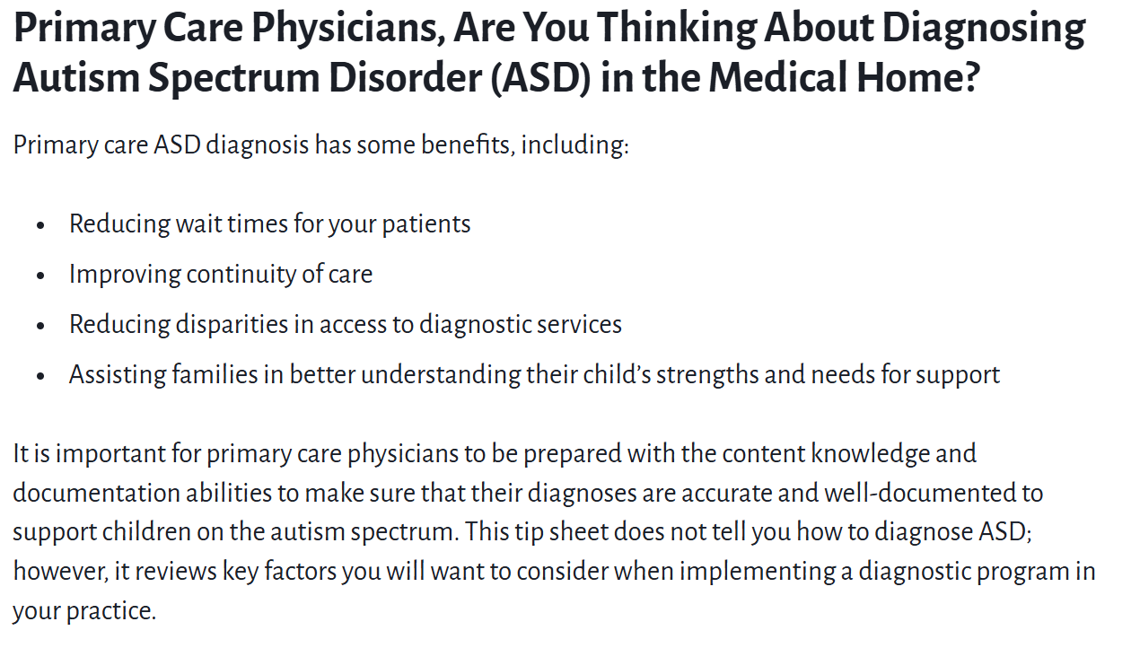
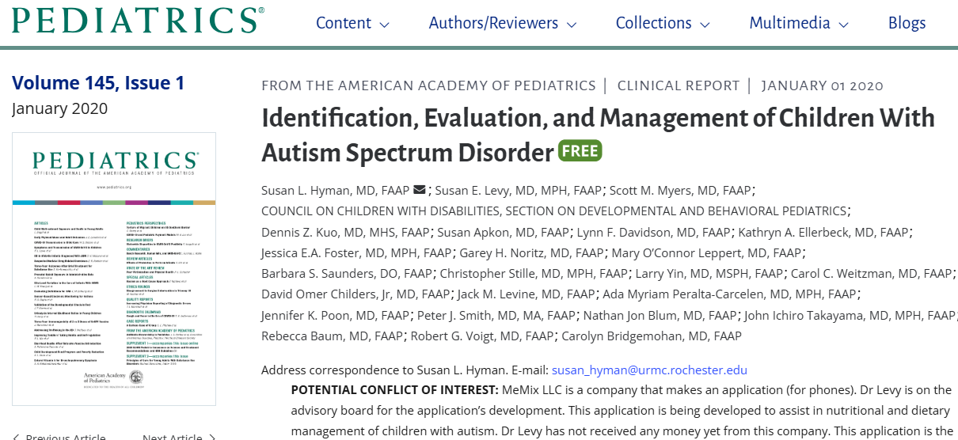
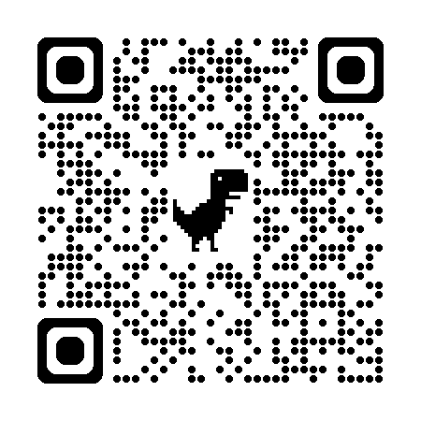
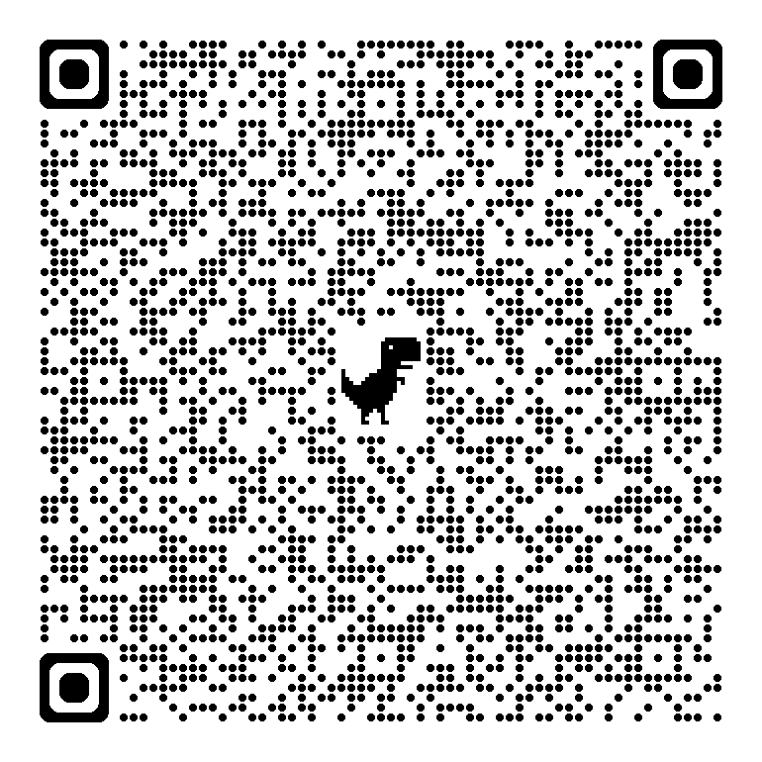
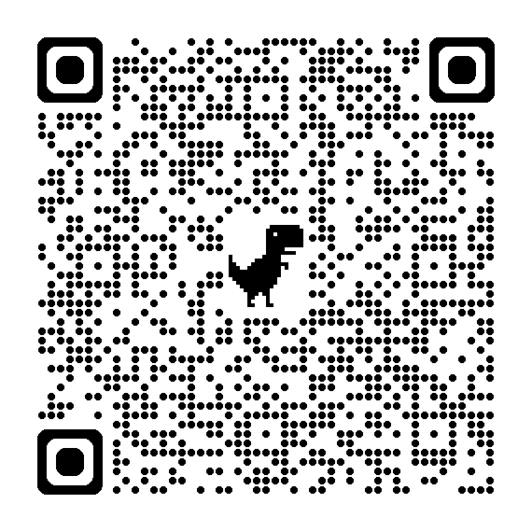
Existing Resources for Primary Care Providers
Notes:
Checklist of steps to take and key factors to research and consider (geared toward PCPs)
For AAP members… Online course containing information on neurodiversity, autism characteristics, and common co-occurring concerns, and
General strategies and overview on appropriate care for children with autism

Slide 15
Our Identified Focus
Distinct Goals:
  Practical implementation and clinical skills pertinent to pediatric providers vs. basics on autism characteristics
  Comprehensive, step-wise guides for busy providers, with resources compiled together in one place
  Relevance and accessibility for a variety of learners and providers (including the mix of groups we train)
Notes:
In addition, we identified a distinct focus on
practical implementation and clinical skills vs. what is autism itself
creating comprehensive/step-wise guides for busy providers with resources for both them and families all pulled together in one place
making resources that would be relevant and FREELY accessible for the variety of learners and providers we train and not behind a paywall or membership

Slide 16


How did we determine this?
Identified needs of target learners and community members
Identified resource and training gaps

Slide 17
Identifying Needs of Providers and Community Members
Surveys sent to ~1200 past training participants (STAT-MD model)
Interviews and focus groups with ~30 PCPs practicing within our state
Iterative feedback from clinicians and pediatric residents at our institution
Focus groups with autistic self-advocates and caregivers of children with autism regarding gaps in their care
Notes:
And importantly, this work has been grounded in research on provider and community perspectives, including:
(1st) … past participants in workshops on streamlined autism assessment using the STAT, or Screening Tool for Autism in Toddlers & Young Children

Slide 18
Focus Groups
Logistics
  Length: 1 hour
  Location: Virtual
  Group size: 3-9 participants
  Compensation: $100 Amazon gift card
Participants
Self-advocates | 12
Caregivers | 9
Providers | 8
Total | 29
Notes:
To determine focus of educational project using needs assessment - including both needs of target learners and community members, we did focus groups with residents/providers, autistic individuals, and families

Slide 19

Overarching Themes/Needs
Providers need more knowledge, training, and understanding specific to autism
Providers with demanding workloads need training and supports designed specifically for the realities of their settings (e.g., resources embedded in the EHR)
Providers need guidance on how to frame discussions and counsel families (e.g., strengths-based)
Families need better care coordination and connection to high-quality resources after autism diagnosis
Autism-specific counseling should occur in addition to (and not take time away from) routine care
Practices should take steps toward making clinical visits more autism-friendly (accommodations, time/resources)

Slide 20
Identifying Training Gaps
Providers report inadequate training and low-levels of competence in caring for children with autism (Broder-Fingert et al., 2014; Carbone et al., 2010)
Families report limited confidence in providers’ abilities to provide autism-specific counseling and care (Carbone et al., 2013)
Most residents complete their DBP rotation without adequate preparation for developmental-behavioral focused care (Ghaderi & Watson, 2019; Soares et al., 2014; Stein, 2017)
Training programs vary significantly in their rigor and scope and often involve passive or didactic learning as opposed to hands-on training and clinical skills (Hine et al., 2019, 2021; McMillan et al., 2016)
Focus on targeting clinical skills and practice behaviors relating to autism-specific counseling and care coordination
Notes:
known limitations with DBP education (e.g., see intros in papers like: Need for Pediatric Resident Training in Autism Spectrum Disorder: Preparation for Primary Care | Psychological Disorders and Research | Science Repository | Open Access & Enhancing developmental-behavioral pediatric rotations by teaching residents how to evaluate autism in primary care – PubMed)
Carbone PS, Behl DD, Azor V, Murphy NA (2010) The medical home for children with autism spectrum disorders: parent and pediatrician perspectives. J Autism Dev Disord 40: 317-324. [Crossref]
Carbone PS, Murphy NA, Norlin C, Azor V, Sheng X et al. (2013) Parent and pediatrician perspectives regarding the primary care of children with autism spectrum disorders. J Autism Dev Disord 43: 964-972. [Crossref]
McMillan JA, Land M, Leslie LK (2016) Pediatric residency education and the behavioral and mental health crisis: a call to action. Pediatrics. 139: e20162141. [Crossref]

Slide 21
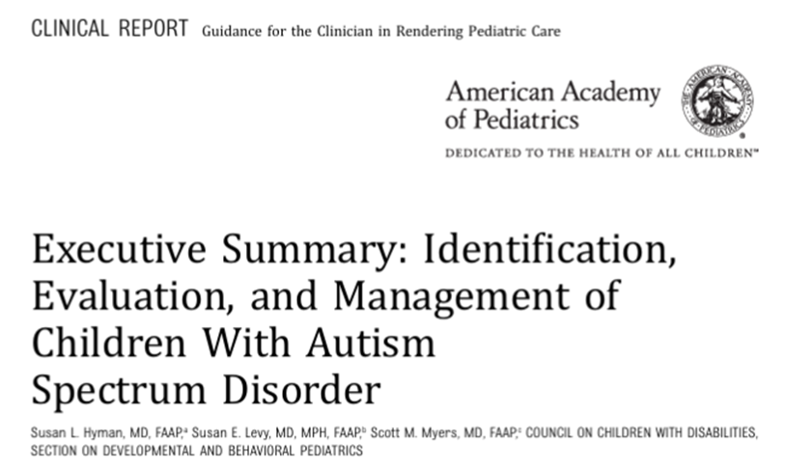
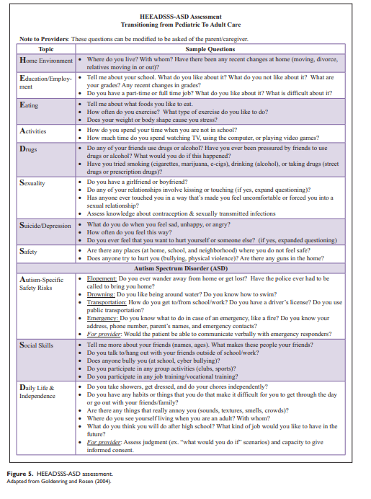
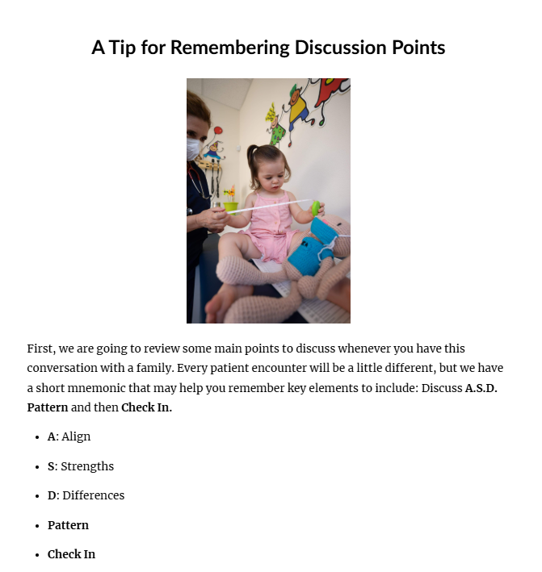
“Source Material”
Best practice recommendations
Clinical experience/conventions
Collaboration with/materials from other disciplines or subspecialties
Published literature
Existing resources (e.g. what you identified in Action Planning #1)
Harris et al., 2021
Notes:
We also considered: What do we already have that we can draw from + what do we still need?
Follow-up: AAP, Up to Date, and recommendations/collaboration with medical providers within Developmental Medicine

Slide 22
Action Planning #2:
Identifying Focus and Source Material
  How will you identify needs? Whose perspectives do you want to get?
      Learners
      Providers
      Self-advocates
      Family members
  What resource and training gaps are you trying to fill?
  What “source material” can you pull from?
  Based on the questions above, what is one area your content could focus on?
Notes:
Give caveat of: During this workshop, we want you to think less about what you have funding/time/resources to be able to do and more what would want to consider in doing it (don’t get sucked into the weeds too much during our time together) → can go back when you have more time or resources to expand off of your action plan (This is more of an initial “thought document” – to capture your big picture ideas and the main things to make sure are a part of your content, and you can continue to figure out the “how” more later)

Slide 23
Structuring Content for Effectiveness and Practicality

Slide 24

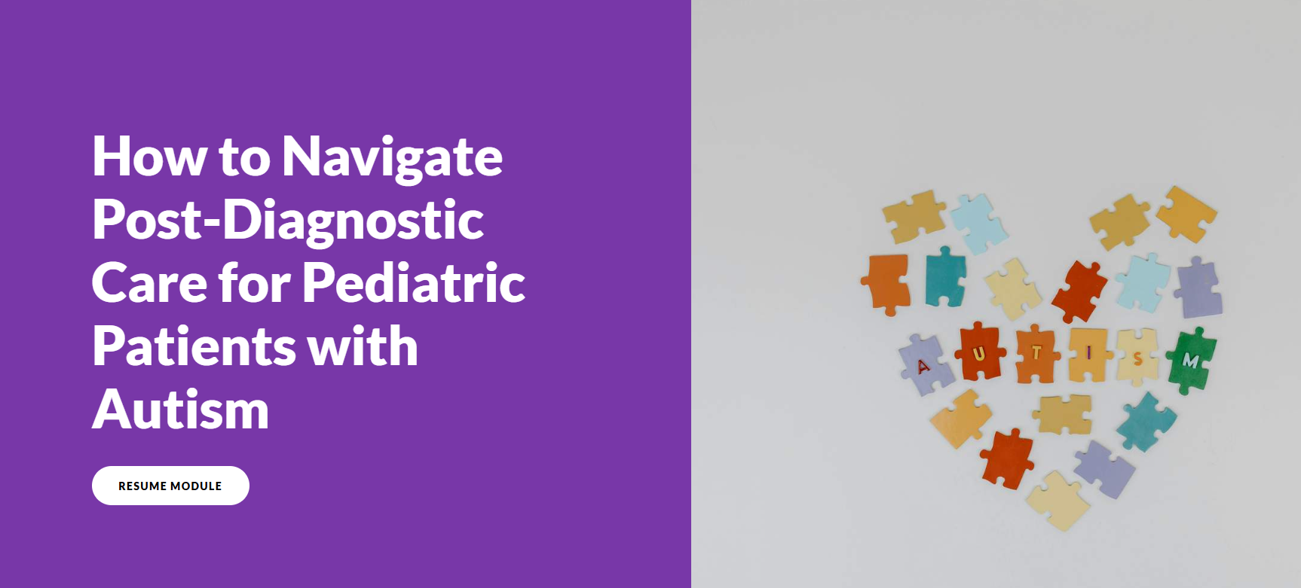
Our Focus

Slide 25
Tailoring Content to Support Adult Learners:
Moving beyond “one size fits all…”
Considering needs, experiences, and learning preferences
Effectiveness
  What do we know about adult learning?
  Evidence-based strategies
  Relevance and value
Practical Considerations
  Availability/scheduling
  Resources at your disposal
  Incentives and ways to encourage use
  Access (making content readily usable)
Effective
Practical
Notes:
Not going to be one best approach that’s right for all scenarios and audiences, but want to make sure that considering needs (like we’ve discussed already) and taking into account adults’ experiences, preferences, ways they learn best, and ways to ensure they can actually access and use the resources you’re creating

Slide 26

Principles of Adult Learning (Knowles et al., 2015)
Relevance and Utility
Self-Direction
Active Engagement
Purposeful Micro-Learning
Integration with Knowledge and Experience
Goal-Oriented Structure
Notes:
Guided by principles of adult learning conceptualized by Malcolm Knowles, who is considered the “father” of adult learning (andragogy) and his colleagues.
Knowles, M.S., Holton, E.F., Swanson, R.A. (2015). The adult learner: The definitive classic in adult education and human resource development. 8th Ed. Routledge
*Ella, I’m thinking we want all of these to be the same part of speech, so I switched them all to be nouns. See what you think, if you think they’re clear and fit. Would you mind updating them on the other slides like this + the titles on the individual ones? I also updated the reference to be the one Verity used just since her notes were based on that edition + to put “Knowles”’s name first since he’s the well-known person to reference. I changed Practical to Utility (as a synonym) to try to differentiate since we will go into practicality separately.

Slide 27
Principles of Adult Learning (Knowles et al., 2015)
Relevance and Utility
Self-Direction
Active Engagement
Purposeful Micro-Learning
Integration with Knowledge and Experience
Goal-Oriented Structure

Slide 28
Relevance and Utility
Problem-oriented and rooted in a clear identified “why”
  We designed our content to specifically address identified needs and gaps in training (in terms of scope, target skills, and hands-on training)
Providers report inadequate training and low levels of competence in caring for children with autism (Broder-Fingert et al., 2014; Carbone et al., 2010)
Providers need guidance on how to frame discussions and council families (e.g. strengths-based)
Families need better care coordination and connection to high-quality resources after autism diagnosis
Training often involves passive or didactic learning as opposed to hands-on training and clinical skills (Hine et al., 2019, 2021; McMillan et al., 2016)

Slide 29
Principles of Adult Learning (Knowles et al., 2015)
Relevance and Utility
Self-Direction
Active Engagement
Purposeful Micro-Learning
Integration with Knowledge and Experience
Goal-Oriented Structure

Slide 30
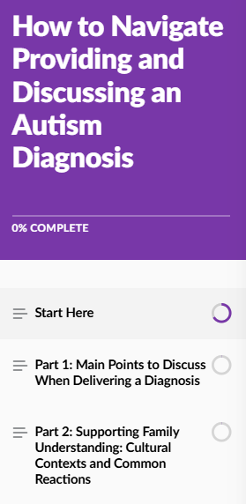
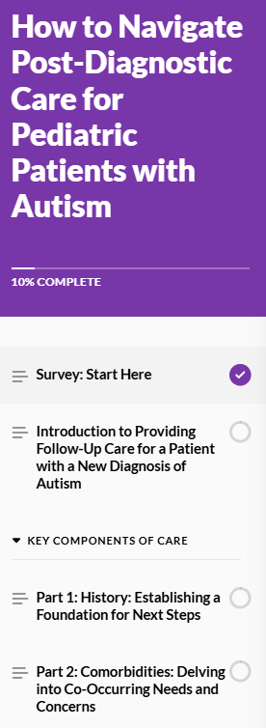

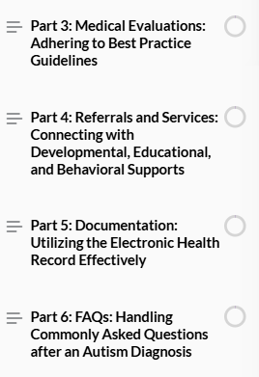
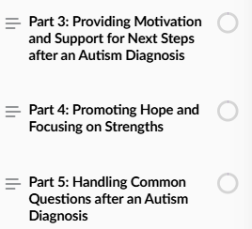
Self-Direction
Content for adult learners should respect their autonomy and flexibly accommodate their busy schedules
Modules are asynchronous, self-paced, and freely navigable
Notes:
As opposed to instruction/teaching that is set or fixed and must be experienced live, in person, or the same way each time
Modules are structured in clear sections/parts and “menu” is always available on the left-hand side so learners can click around to whatever they want, whenever they want in a flexible way

Slide 31
Principles of Adult Learning (Knowles et al., 2015)
Relevance and Utility
Self-Direction
Active Engagement
Purposeful Micro-Learning
Integration with Knowledge and Experience
Goal-Oriented Structure

Slide 32

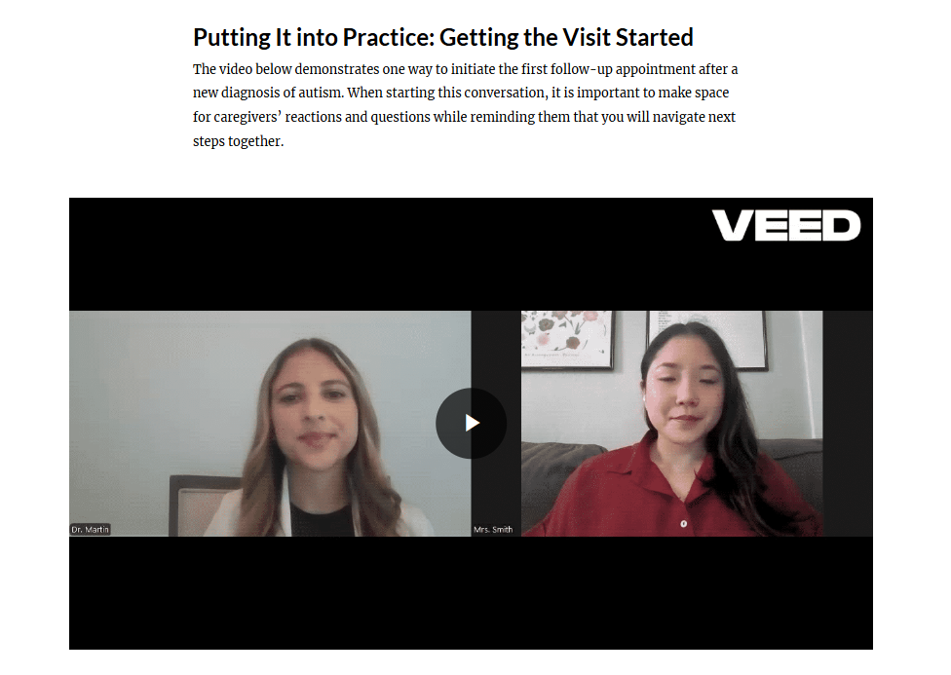
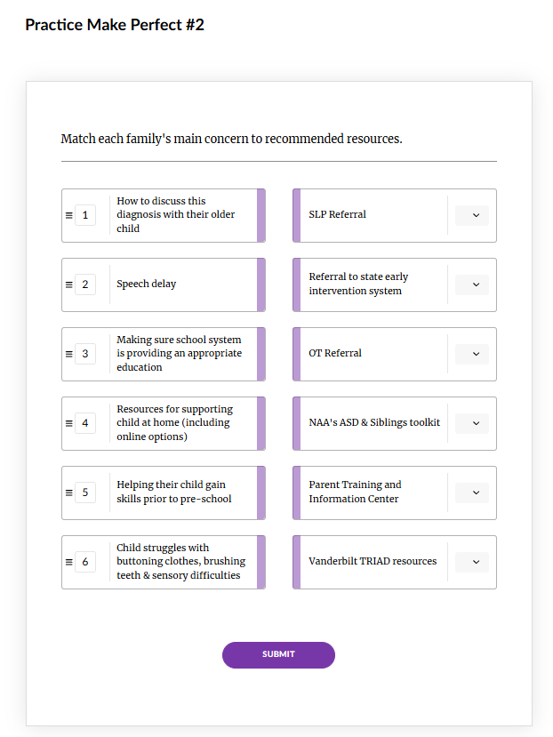
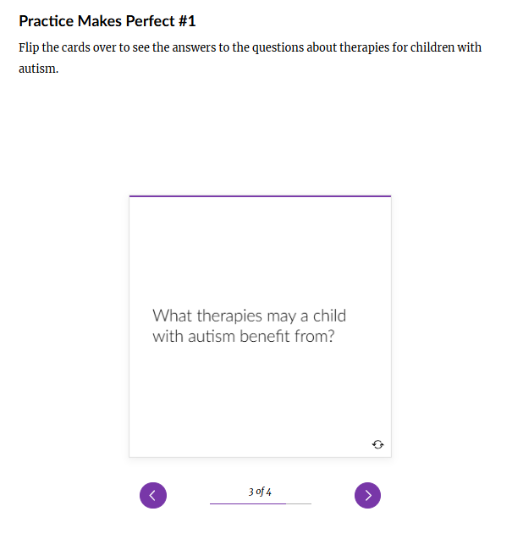
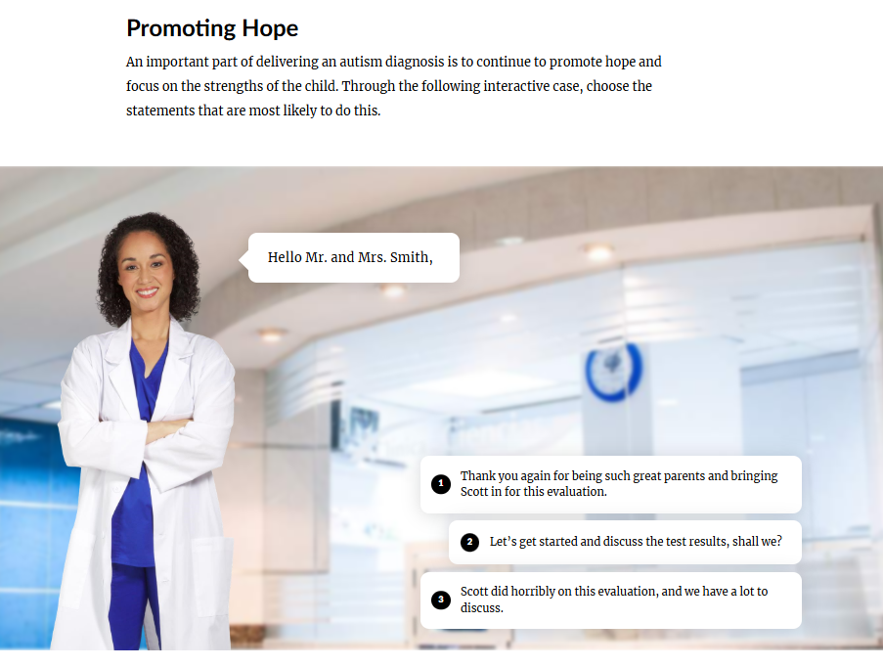
Active Engagement
Frequent opportunities for interaction with content
Varied formats and elements/activities to engage users with diverse learning preferences
Case scenarios
Audio/video models
Matching activities
Flashcards
Role-playing activities

Slide 33
Principles of Adult Learning (Knowles et al., 2015)
Relevance and Utility
Self-Direction
Active Engagement
Purposeful Micro-Learning
Integration with Knowledge and Experience
Goal-Oriented Structure

Slide 34
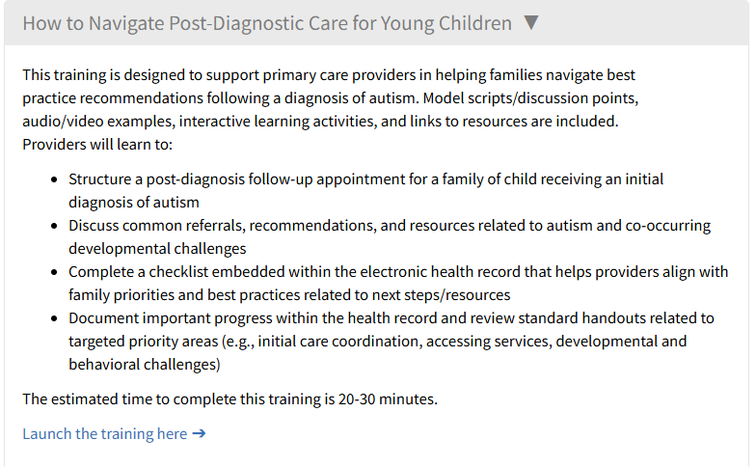
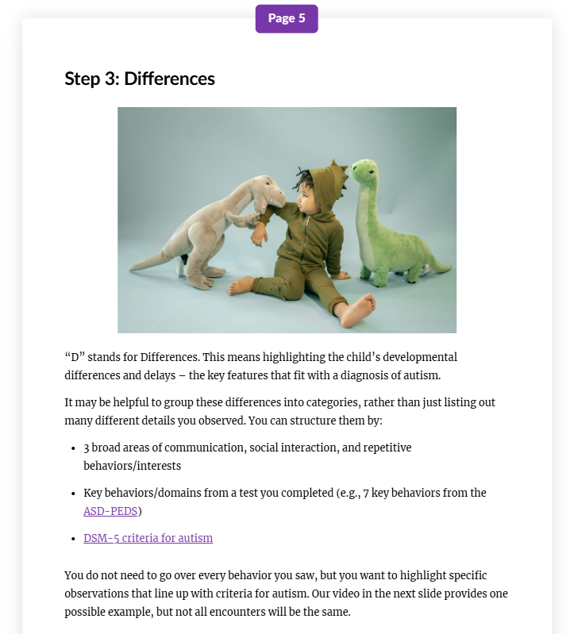
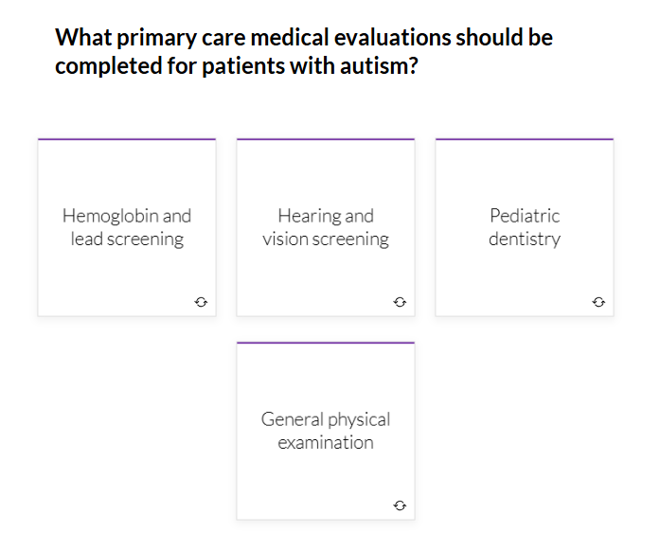
Purposeful Micro-Learning
Respect for time constraints and situations where learners might need to access/complete specific parts quickly
Focused, concise learning content structured in short, easily digestible “bursts” (each lasting a few minutes at a time)
Each individual part/element has a clear purpose to support overall goals for learning
One “step” of the diagnosis process
One “step” of the post-diagnostic visit
Notes:
Consideration of adults having various demands and busy schedules
Emphasize that things are structured in easily digestible steps/chunks (with each only taking a few minutes at a time) and a lot of resources are fit into a realistic overall training time
Each part and element fits together to serve overall purpose (not “busy work” or waste of time)

Slide 35
Principles of Adult Learning (Knowles et al., 2015)
Relevance and Utility
Self-Direction
Active Engagement
Purposeful Micro-Learning
Integration with Knowledge and Experience
Goal-Oriented Structure

Slide 36
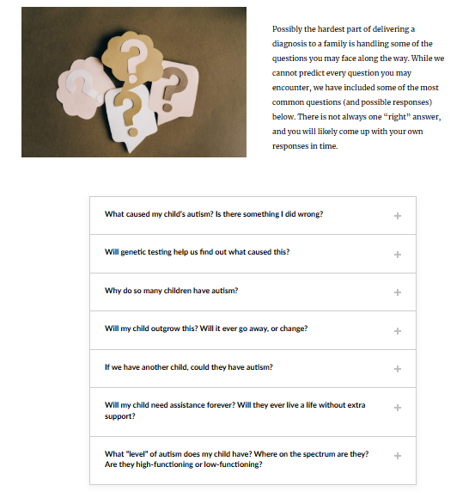
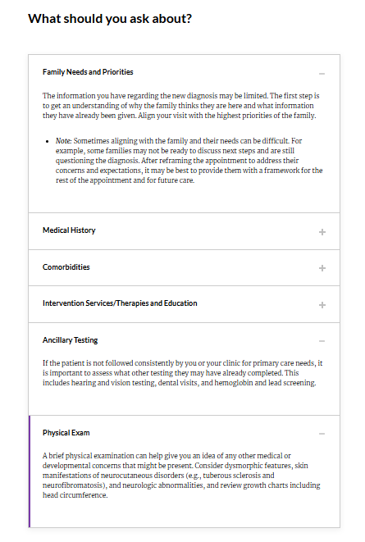
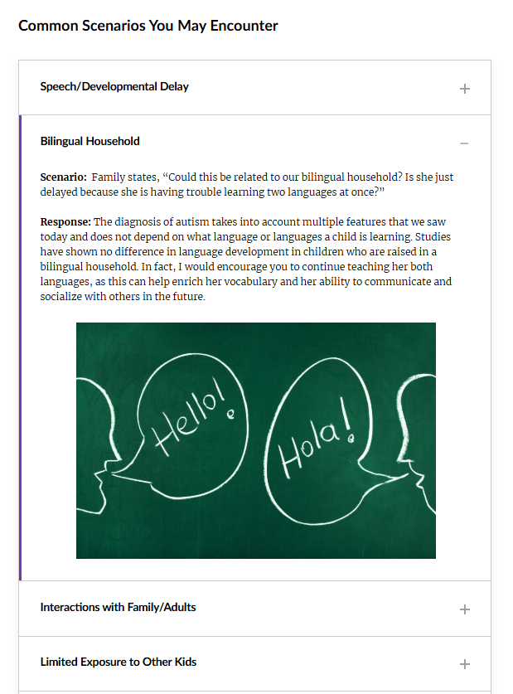
Integration with Knowledge and Experience
Building on prior knowledge and experience (e.g., obtaining medical history, physical exam, referenced medical workup/labs)
Designed to be true to life → common clinical scenarios, unique considerations that are likely to be relevant to providers (e.g., cultural/family factors)
  Immediate value in current clinical roles/settings (even for residents who are not going into DBP or primary care)
Specific autism-related considerations for hx/exam
FAQs from caregivers
Situations they may encounter
Notes:
References/add-ons to pieces learners are already familiar with/used to completing (e.g., obtaining a history, physical exam, ordering labs) – but highlighting specific things to consider relevant to the topic
Purposeful inclusion of “true to life” situations/scenarios clinicians are likely to face in real world
Bc of this, immediate value/relevance, which also increases effectiveness as we’ve discussed already

Slide 37
Principles of Adult Learning (Knowles et al., 2015)
Relevance and Utility
Self-Direction
Active Engagement
Purposeful Micro-Learning
Integration with Knowledge and Experience
Goal-Oriented Structure

Slide 38
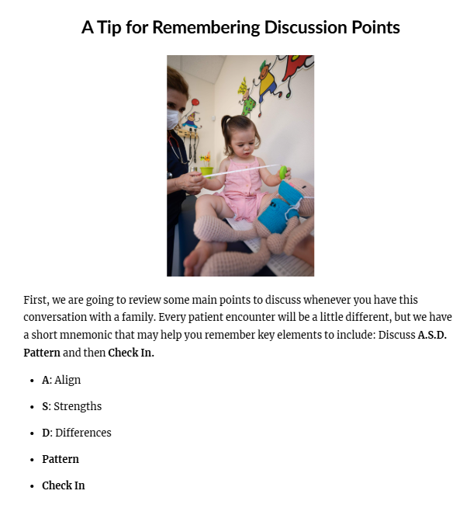
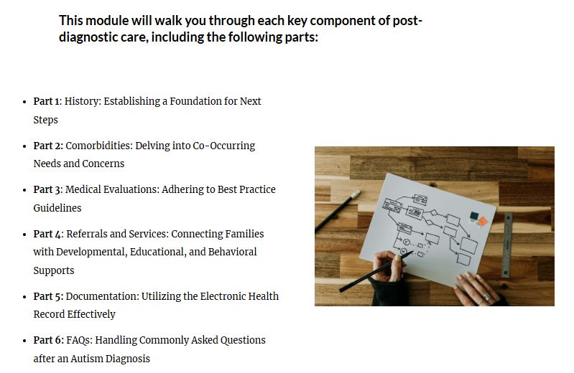
Goal-Oriented Structure
Goal-driven with clear learning objectives
Structured/organized into clear parts
Notes:
Very clear learning objectives (in the titles)
Structure/organization toward those goals (e.g., components of visit, structure for conversations with key elements)

Slide 39
Practical Considerations
Availability/Scheduling
Considering synchronous vs. asynchronous
Scheduling during a certain block/rotation with ample time
Identifying times that might be conducive to sharing content (e.g., conference, clinical corners)
Resources
Learning/LMS platforms
Apps/programs (e.g., Articulate Rise, Microsoft Sway and Office, Canva)
Technology and materials
Incentives
Credit/CME
Requiring completion (e.g., as part of DBP rotation or another program)
Access (making content readily usable)
Embedding within continuity clinic or other clinic/training programs
Embedding educational prompts and clinical “pearls” within EHR
Putting content online and considering how easy it is to get to (e.g., login, steps to access)

Slide 40
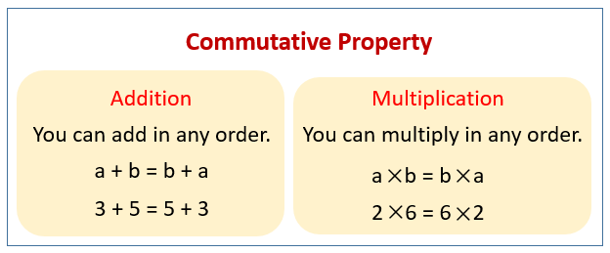
Focus and Source Material
Effectiveness
Practicality
“Vehicle”
“Vehicles” or forms your content may take:
Presentation
Tip sheet/handout
Video
Module
Activity
???
Notes:
Once you’ve identified your focus and source material, getting clear on these 2 areas (effectiveness and practicality) help you determine “vehicle” for content (e.g., presentation, tip sheet/handout, video, module, activity, other).
And the commutative property of addition applies, aka depending on your preference and your situation, you can start with whichever of these makes the most sense first and they will add up the same in either order ☺

Slide 41
Action Planning #3:
Structuring Content for
Effectiveness and Practicality
  Effectiveness: Pick one principle of adult learning → Come up with one idea to go with it
  Practicality: Consider the following factors:
      Availability/Scheduling
      Resources (e.g., platforms, apps, tech, materials)
      Incentives (e.g., credit/CME, requirements)
      Access (making readily usable)
  Considering the above, select the best “vehicle” for your content
Notes:
***STEPS FOR US:
Adapt action plan sheet to have boxes with the principles of adult learning
Update action plan with practicality question
Considering both effectiveness and practicality, select the best “vehicle” for content (e.g., presentation, tip sheet/handout, video, module, activity, other with line) – options to select from??

Slide 42
Promoting Practical Application

Slide 43
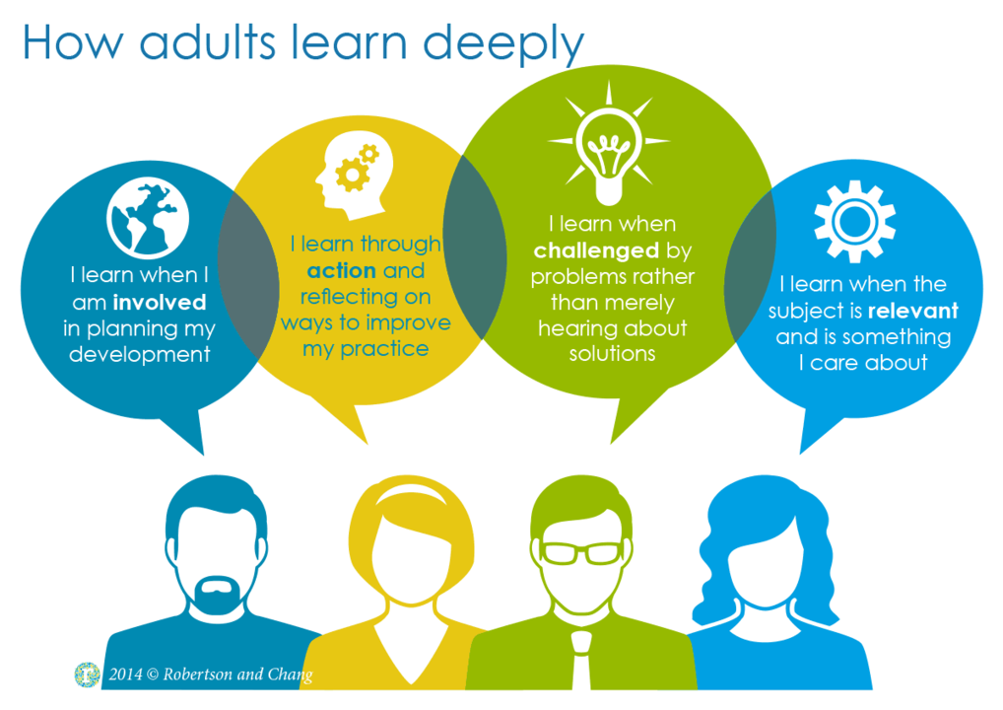
“Hands-On” Learning
Adults learn best when they “do” → link content to hands-on components
Provide opportunities to practice in a controlled, safe space with timely feedback
Provide supports that facilitate “doing” (e.g., structure and materials that set them up for success)
Notes:
As Jeff just mentioned when reviewing principles of adult learning, important to not just teach educational content/concepts, but to make sure we’re explicitly ensuring that learners are putting the content into practice in some way.

Slide 44
What We Created
A simulated clinical encounter to give residents practice with applying strategies from our diagnosis module
EHR-embedded supports to facilitate clinical use of post-diagnostic care strategies (including sample scripts, SmartSet, and SmartPhrases)
Notes:
As we briefly showed in our introduction videos, we developed:

Slide 45
Simulation Overview
Our goal:
Give learners (residents) practice with providing an autism diagnosis based on the framework from the module
Features:
Tied to educational module (encouraging application of included structure/strategies)
Standardized and “true-to-life”
  Each resident reviews the same materials, including video clip and screening/assessment data
  (M-CHAT-R/F, ASD-PEDS) familiar to residents from continuity clinic and shadowing during DBP rotation
  Conversation is strategically designed to include specific comments/questions from the “caregiver” (actor), including commonly encountered reactions and questions
    Limitation: No child present – less realistic, but in line with our focus and overall goal (how to structure conversation and responses first vs. managing distractions/challenges)
Notes:
(can flip back and forth with visuals on next slide to point out)

Slide 46
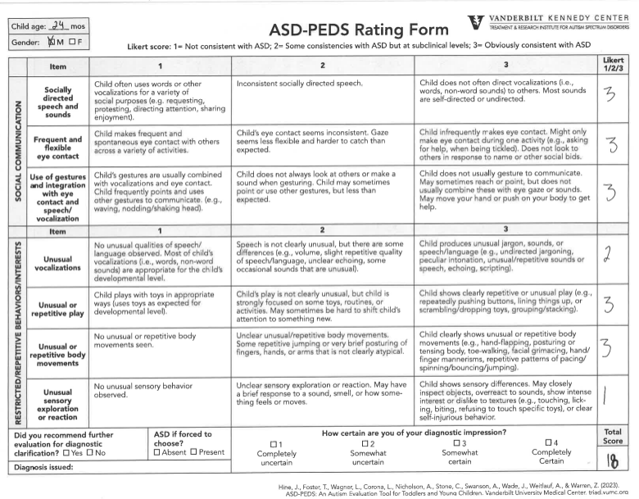
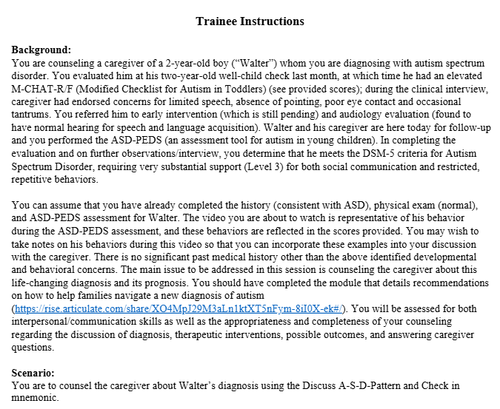
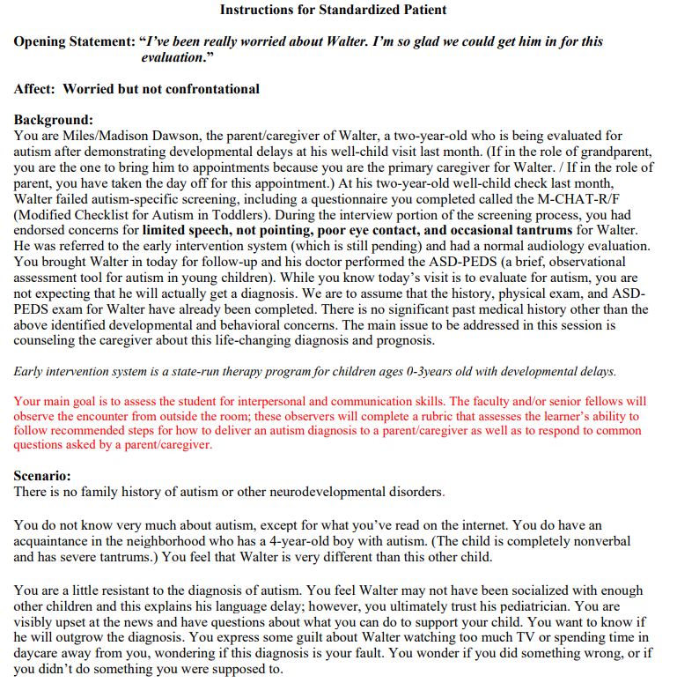
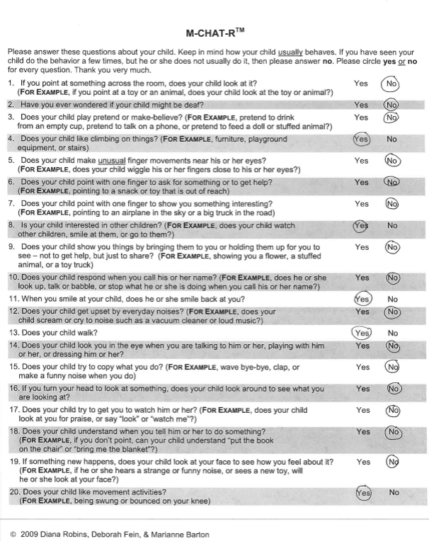
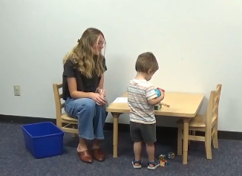
Standardized & Realistic Materials
Instructions for learners
Mock assessment video & data
Instructions for actors

Slide 47
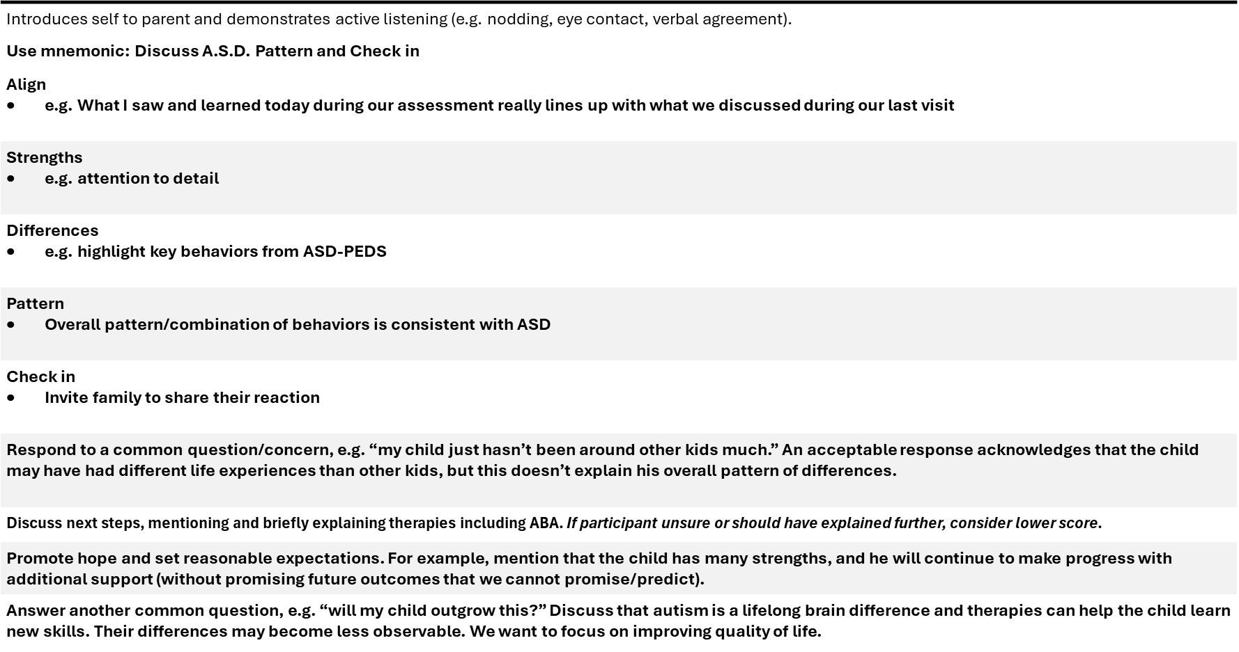
Individualized Evaluation and Feedback
  Feedback on performance (strengths and suggestions) from preceptor​
    Performance ratings based on rubric​
    Written feedback from standardized patient/actor in their role​

Slide 48

Considerations for Getting Started
Content:
  What will your learner practice?
  What structure or content will you use to guide and prepare them?
Standardization:
  What standardized materials do you need to create? (e.g., case scenario, actor instructions, supplemental materials)
  How can you strategically design the scenario to probe specific skills? (e.g., specific questions or situations)
Realistic/“True-to-Life” Elements:
  What elements can you approximate from real-life clinical scenarios? (e.g., visit structure, typical procedures)
  What instructions/training can you give to your actor(s) to make sure their performance is authentic?
  Is there anything that isn’t feasible to recreate? What is your primary goal and what is most important to recreate?
Evaluation:
  How will you measure performance and give feedback to your learners? (e.g., ratings, virtually vs. in person, written vs. oral, from preceptor vs. actor)
  How will you evaluate and refine the learning activity? (e.g., using feedback regarding value/acceptability)
Logistics:
  Do you have access to a simulation center, or is there another way you can utilize role play/practice without one?
  Who will participate and when?
Notes:
- Logistics: other ways can be low-tech and low-resource

Slide 49
Follow-Up Care Overview
Our goal:
Educate providers and support real-life implementation of standard of care following a new autism diagnosis
Features:
Tied to educational module (encouraging application of included best practices)
Standardized and readily accessible
  Clinical note template structured with quick pick lists for reviewing key domains/concerns
  Embedded provider learning tips throughout
  Scripts to guide provider discussions on less familiar topics (e.g., recommended genetic testing)
  Common orders organized in a standard SmartSet
  SmartPhrases to familiarize providers and families with resources and community supports related to different common concerns
Notes:
(can flip back and forth with visuals after this to point out)

Slide 50
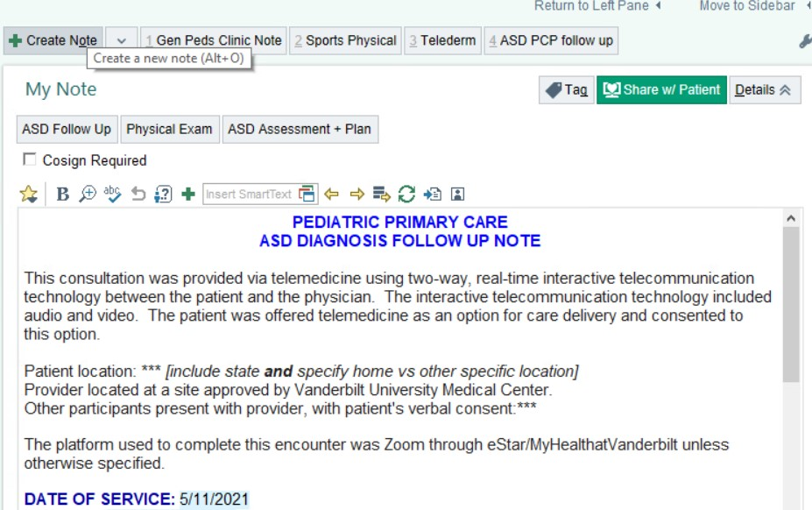
Standardized & Accessible Supports:
Clinical note template (general structure)

Slide 51
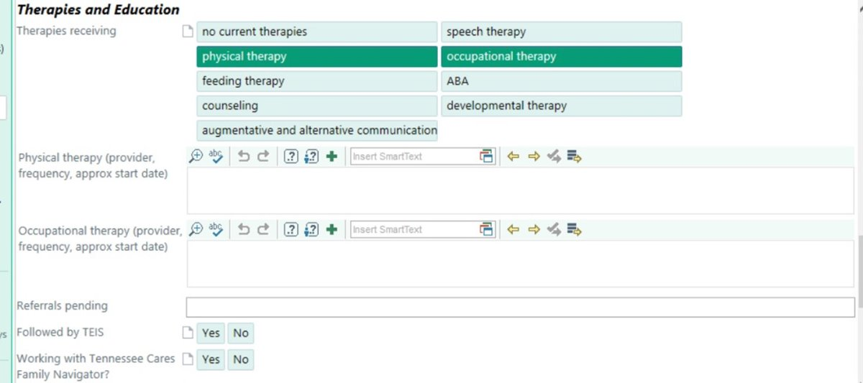
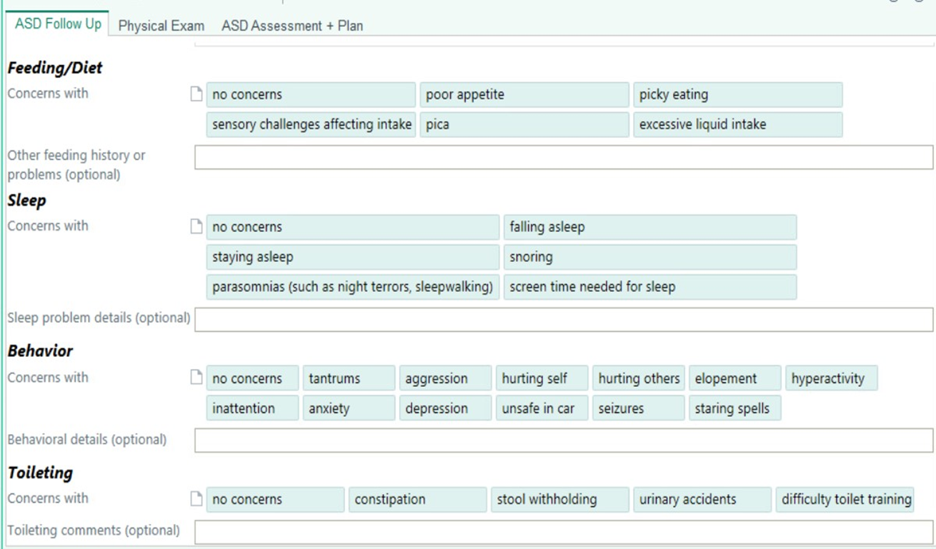
Standardized & Accessible Supports:
Quick pick lists for reviewing key domains and concerns

Slide 52
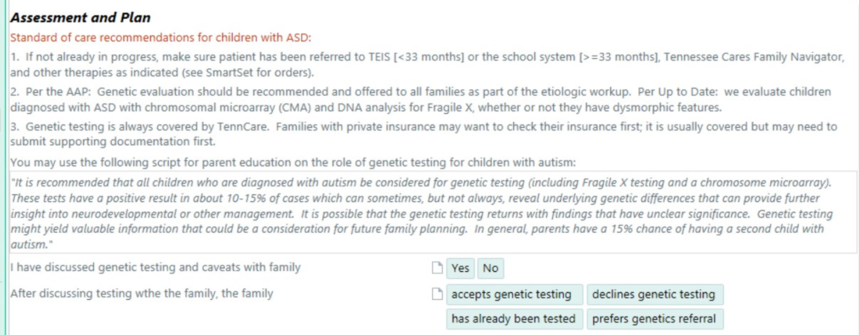
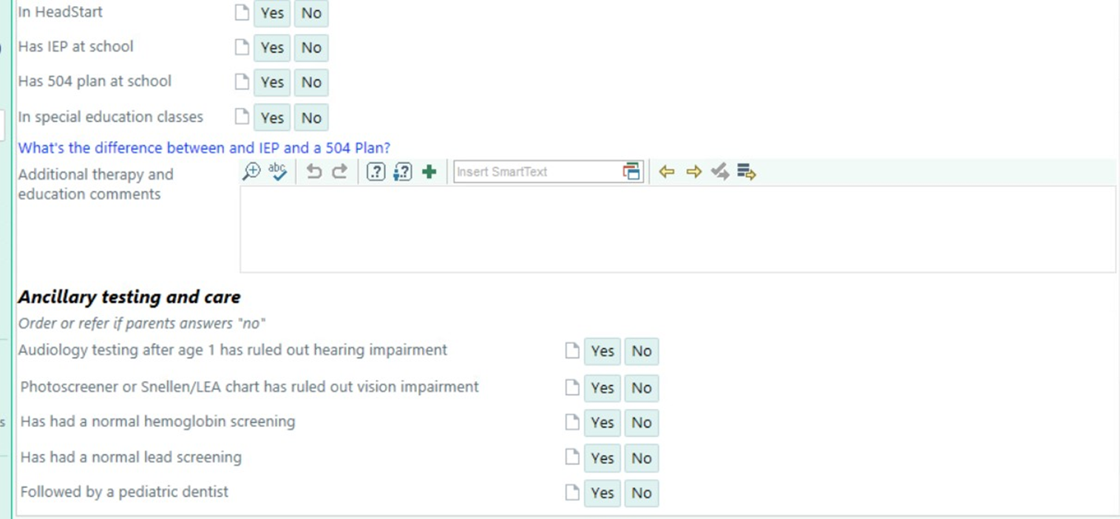
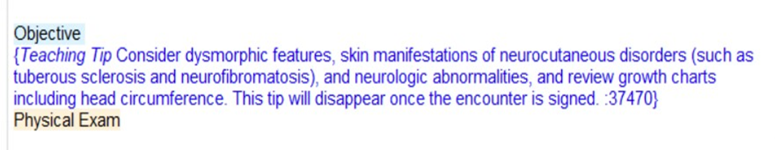
Standardized & Accessible Supports:
Provider teaching prompts and scripts throughout

Slide 53
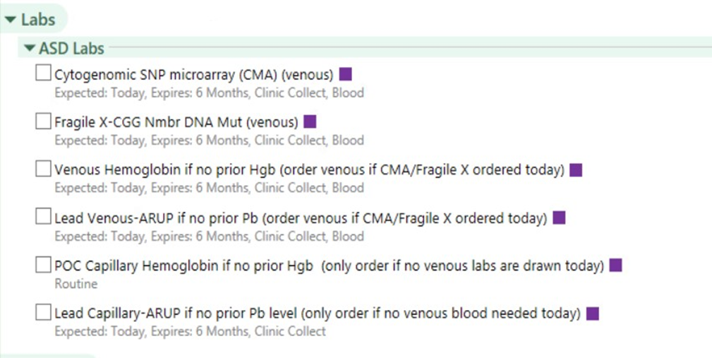



Standardized & Accessible Supports:
Common orders and resource phrases easily accessed in SmartSet

Slide 54


Dissemination & Provider Education
Created standard visit type and shared/educated via multiple avenues:
  Demonstrated template and SmartSet use to providers via clinical corners, clinical huddles, our “Handy Dandy Vandy” Primary Care Clinic Manual, resident didactics, and fliers in workrooms
  Also embedded video models within the post-diagnostic module itself
Notes:
*Don’t need to go into detail about paper, but just mention

Slide 55
Considerations for Getting Started
Content:
  What practice behaviors do you want to promote?
  What structure or content will you use to guide and equip others? Would it be helpful to collaborate/consult with others?
Standardization:
  What standardized materials do you need to create? (e.g., visit/note templates, tip sheets, patient education materials)
  Are there any less practiced topics/skills that need additional scaffolding and support? (e.g., learning tips, scripts)
Readily Accessible/Embedded Elements:
  How can supports be embedded within existing clinical flows and systems? (e.g., EHR, continuity clinic)
  Are there pieces that can organized and compiled together for ease of use? (e.g., orders, resource lists, recommendations)
Evaluation:
  How will you track and measure utilization, increased competence, and practice change?
  How will you evaluate and refine your materials and supports? (e.g., using feedback regarding value/acceptability)
Logistics:
  What type of build will your EHR support? Are there other ways you can provide standardized, accessible support?
  Who will use these supports, and how/when/where will you teach them?
Notes:
In our case:
Content: Developed based on standard of care recommendations from AAP, Up to Date, and recommendations from Developmental Medicine colleagues; Pulled from existing resources of community partners and national advocacy and education organizations to build our resource phrases
Logistics: other ways can be low-tech

Slide 56
Action Planning #4:
Promoting Practical Application
  How will you encourage learners to apply what they’ve learned?
      Practice (role play, simulation)
      Real-life clinical work
  What is ONE first step you can take to get this started?
Notes:
Example steps: e.g., script or template, communicating with other training directors about simulation resources

Slide 57
Measuring Learning Outcomes

Slide 58


Measured Outcomes
What?
Provider confidence (pre/post modules) in key practice areas involved in autism-specific care:
  Discussing concerns for autism with families of children 3 and under
  Identifying autism characteristics/likelihood in children 3 and under
  Communicating with families and providing feedback about autism diagnosis (e.g., reasons for decision, psychoeducation, trajectory)
  Counseling families about recommendations/referrals for services/therapies (e.g., ABA, PT, OT, SLP, feeding therapies)
  Counseling families about and managing autism-related concerns (e.g., sleep, toileting, behavioral concerns)
How?
REDCap surveys

Slide 59

Measured Outcomes
What?
Provider performance/skills in:
  Discussing autism diagnosis
  Addressing caregiver questions
  Counseling families about recommended next steps
How?
Observing behavior and grading rubric

Slide 60



Measured Outcomes
What?
Social validity and feedback on resources and training activities from providers
Social validity and feedback on PCP-led visits from families
How?
REDCap surveys
Surveys for learners
Surveys for caregivers

Slide 61
Measured Outcomes
What?
System-level data:
  Latency between referral, evaluation, and follow-up visit
  Completion rate of autism-specific follow-up for newly diagnosed patients
  Provider use of template and implementation supports via the electronic health record (EHR)
How?
EHR audits

Slide 62
Action Planning #5:
Measuring Learning Outcomes
  What do you want your learners to learn? What is ONE thing you will measure?
  How can you collect this data?

Slide 63
Wrap-Up /
Getting Started

Slide 64
Action Planning #6:
Wrap-Up / Getting Started
  Identify ONE practical step you can take after this workshop
  What is your biggest takeaway OR what are you most excited about?
Notes:
ex. email to inquire about learning platforms at your institution, use our module in your own curriculum
Share at table and/or large group sharing if time

Slide 65
Resource Toolkit & Questions

Slide 66


Thank you!
https://triad.vumc.org/provider-portal
tori.foster@vumc.org
https://triad.vumc.org/provider-training

