Slide 1
Learning With and From Each Other: Cultivating Interprofessional Collaboration for Trainees at Multiple Levels
Elizabeth W. Barnhardt, DO, MAEd, Dawn Allain, MS, LGC, Kruti Acharya, MD, Steph Weber, PsyD, MPH, Linda Solamen, MD, Rylee Duncan BS

Slide 2
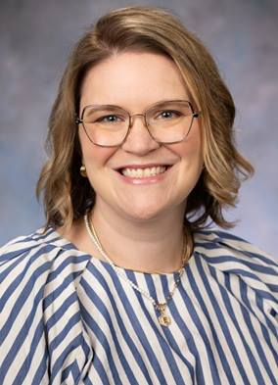





Our Team
Elizabeth W. Barnhardt, DO, MAEd
Director of Training, LEND at OSU
Director of Competency in Interprofessional Collaboration for OSUCOM
Dawn Allain, MS, LGC
LEND Faculty Member
IPE Champion for Genetic Counseling at OSU
Kruti Acharya, MD
Director, Illinois LEND
Rylee Duncan, BS
Graduate student in IDD Psychology program at OSU, Former OSU LEND Trainee
Steph Weber, PsyD, MPH
Associate Director/Training Director at CCHMC LEND
Linda Solamen, MD
DBP at UT Houston, former OSU LEND Trainee

Slide 3
Disclosures
The authors have no relevant disclosures and will not discuss off label use or investigational use in this presentation.

Slide 4

Learning Objectives
Review interprofessional education and collaboration as an emerging area of interest in medical education and the potential impact on workforce shortages
Discuss simulation as an appropriate methodology for the instruction of interprofessional skills
Identify opportunities for simulation in Developmental and Behavioral Pediatrics and review sample learning activities.
Recognize practical barriers to interprofessional education and simulation
Describe best practices for the development of simulation activities such as standardized patient encounters, case-based discussions.
Construct outline of potential learning activity to foster skills in interprofessional collaboration at their own institution

Slide 5
Agenda
Introduction - Why is this important?
Warm-Up Activity: “The Tower Challenge”
Small Group Brainstorming
Overview of Case-Based Interprofessional Collaboration Curriculum at OSU, Illinois, and Cincinnati Children’s LEND programs
Simulation using cases from LEND curriculum
Conclusion and Wrap-up

Slide 6
Why does interprofessional education (IPE) and interprofessional collaboration in DBP matter?

Slide 7
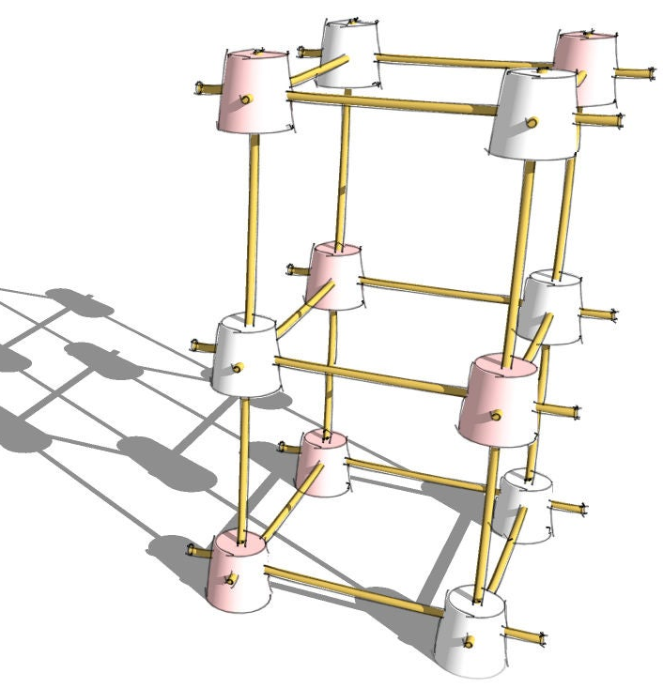
The Tower Challenge
Goal: Build the tallest free-standing tower using spaghetti and marshmallows
Instructions:
  Divide into teams of 4-6 people
  Each participant receives a role card with a constraint
  Work collaboratively to complete the challenges, honoring your constraint throughout the task
  After 10 minutes, we’ll compare towers and reflect on teamwork
Collaboration is key– no one can build alone!

Slide 8
The Tower Challenge
Role Constraint
Pediatrician | Can only talk but not touch the materials.
Psychologist | Can give suggestions but cannot initiate action unless asked.
Speech-Language Pathologist | Must repeat every instruction before it is acted upon.
Occupational Therapist | Can use their hands but must keep their eyes closed.
Social Worker | Can move materials but can’t make any decisions independently.
Educator | Can only use one hand but can suggest strategies.

Slide 9
The Tower Challenge
Discussion:
What were the biggest challenges in working as a team?
How did you overcome communication barriers?
Which strategies helped ensure collaboration?
How does this activity mirror real-life interprofessional teamwork?
Key Takeaways:
Each role has unique contributions and limitations— no one can complete the task alone.
Effective communication is key, especially when roles have constraints.
Interprofessional teamwork requires trust, patience, and adaptability.
Collaboration, not competition, leads to the best results in patient care.

Slide 10
BackgrounD

Slide 11
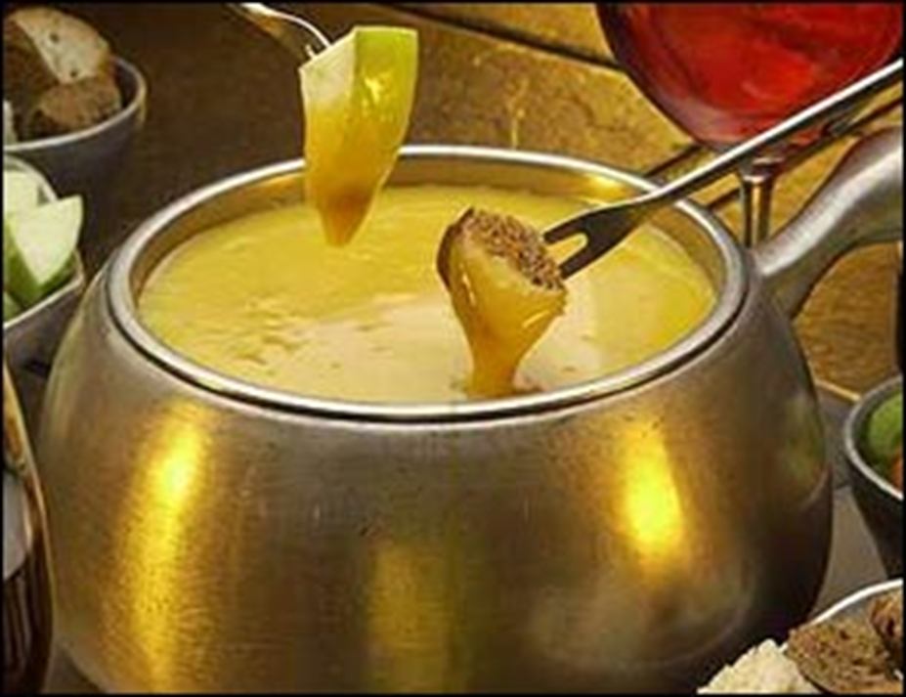


Transdisciplinary
Interdisciplinary/ Interprofessional
Multidisciplinary

Slide 12

Interprofessional Education in Medical Education
Interprofessional Education (IPE): occasions when learners from two or more professions learn with, from, and about each other to improve collaboration and health outcomes
1970s: influenced by World Health Organization’s advocacy for team-based care as a solution to fragmented healthcare system
1999: Institute of Medicine (IOM) report exposed issues in healthcare quality, shifted attention to safety, teamwork, communication
2003: New IOM report explicitly called for health professionals to be educated in interprofessional teams
2009: formation of the Interprofessional Education Collaborative
2010s: Necessary domain of competency for many health professionals
Today: foundational for achieving “quadruple aim”: improving patient outcomes, enhancing patient experience, reducing cost, and improving provider well-being

Slide 13
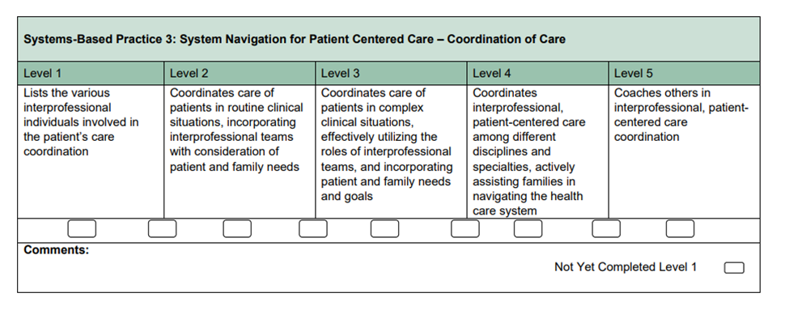
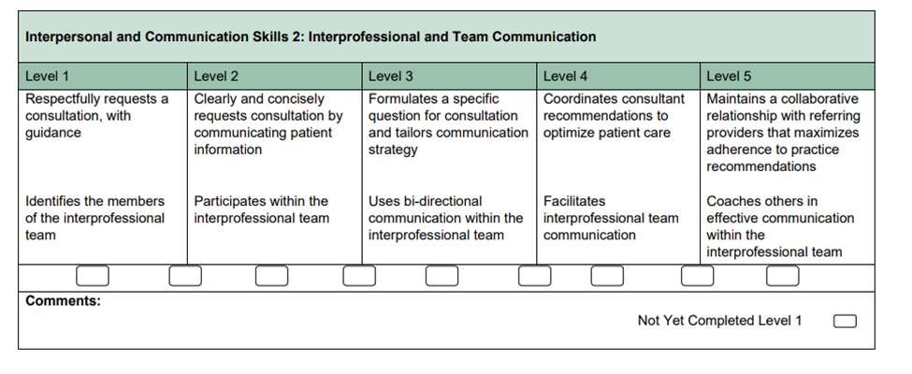
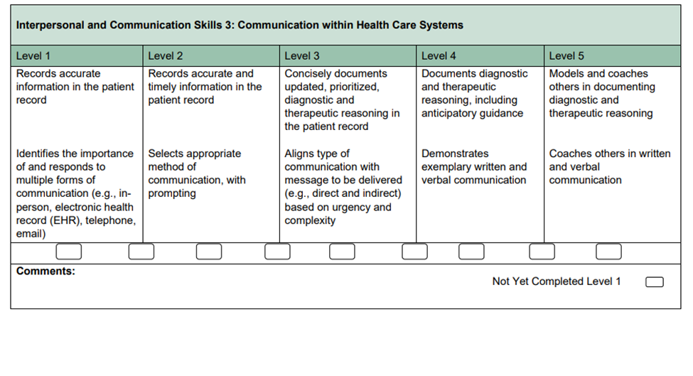
DBP ACGME Milestones and IPE
Notes:
Similar milestones exist for pediatric trainees

Slide 14

Why IPC Matters in DBP
Developmental and behavioral care is complex, must navigate multiple systems
IPC improves diagnostic clarity and intervention outcomes, reduces disparities (Reeves et al., 2017; Johnson et al., 2024; Jadotte et al., 2019)
Reduces burnout and moral distress (but bad collaboration may do the opposite) (Fantus et al., 2024; Antonsdottir et al., 2022)
How often do you formally teach IPC?
Notes:
Reeves, S., Pelone, F., Harrison, R., Goldman, J., & Zwarenstein, M. (2017). Interprofessional collaboration to improve professional practice and healthcare outcomes. The Cochrane database of systematic reviews, 6(6), CD000072. https://doi.org/10.1002/14651858.CD000072.pub3
.Johnson, K., Martin, P., McDonald, D., & McGrail, M. (2025). Interprofessional education and collaborative practice with practicing radiographers: A mixed methods scoping review. Radiography (London, England : 1995), 31(1), 434–441. https://doi.org/10.1016/j.radi.2025.01.001
Jadotte, Y. T., Gayen, S., Chase, S. M., Passannante, M., & Holly, C. (2019). Interprofessional Collaboration and Patient Health Outcomes in Urban Disadvantaged Settings: A Grounded Theory Study. Health, Interprofessional Practice and Education, 3(4), 1185. https://doi.org/10.7710/1185
Fantus S, Cole R, Usset TJ, Hawkins LE. Multi-professional perspectives to reduce moral distress: A qualitative investigation. Nursing Ethics. 2024;31(8):1513-1523. doi:10.1177/09697330241230519
Antonsdottir, I., Rushton, C. H., Nelson, K. E., Heinze, K. E., Swoboda, S. M., & Hanson, G. C. (2022). Burnout and moral resilience in interdisciplinary healthcare professionals. Journal of clinical nursing, 31(1-2), 196–208. https://doi.org/10.1111/jocn.15896

Slide 15
We are already doing it!
Within SDBP
Leadership Education in Neurodevelopmental Disabilities training programs and University Centers for Excellence in Developmental Disabilities
Extension for Community Healthcare Outcomes programs
Clinical practice and research
Pair and Share: When do your learners interact with other disciplines?

Slide 16
IPC as a Workforce Solution
DBP faces workforce shortages
IPC allows task-sharing, expands capacity
Reduces burden and burnout
Pair and Share: How could stronger IPC improve care or reduce stress in your setting?
Notes:
Emphasize IPC as a tool for resilience and efficiency

Slide 17
Challenges to Interprofessional Education and Practice
Scheduling barriers
Lack of interprofessional faculty/Faculty Development
Role confusion
Curriculum overload
Inadequate Compensation
Time
Communication barriers (e.g. differences in terminology across disciplines)
Varied knowledge and skills (e.g. differences in prior experience and training)
Notes:
Maybe do poll?

Slide 18
Best Practices in Interprofessional Facilitation
Preparation
Model collaborative behavior
Introductions
Build psychological safety
Questioning
Structure questions and inclusive statement that promote a team approach. Ex: “what can we all do to help this patient?” or “Can you help us to understand xyz?”
Use questions that reveal the roles of others. Ex: “How would a physical therapist assess this concern?”
Ask presenting students/faculty to explain something
Feedback
Highlight similarities/differences in way each discipline approaches problems
Offer intentional feedback on team dynamics
Any other ideas?
Notes:
Model collaborative behavior as faculty.
https://www.rushu.rush.edu/sites/default/files/_Rush%20PDFs%20and%20Files/interprofessional-case-presentations.pdf
Clarify professional roles.
Build psychological safety for team learning.
Offer intentional feedback on team dynamics.

Slide 19
Practice | Example for Students/Residents/Fellows
Role Clarity | Have students/residents/fellows map out team member responsibilities in a complex case.
Modeling | Narrate your own decision-making in team meetings/patient visits.
Feedback on Collaboration | Debrief not just the diagnosis, but the process of team discussion.
Notes:
“Which of these best practices do you already use? Which could you try next?” Take 2-3 answers aloud.

Slide 20
Teaching IPC using Simulation
Safe space to practice teamwork and conflict resolution.
Assess clinical AND team-based skills.
Can be delivered virtually using video-based scenarios, online role-play or virtual reality

Slide 21
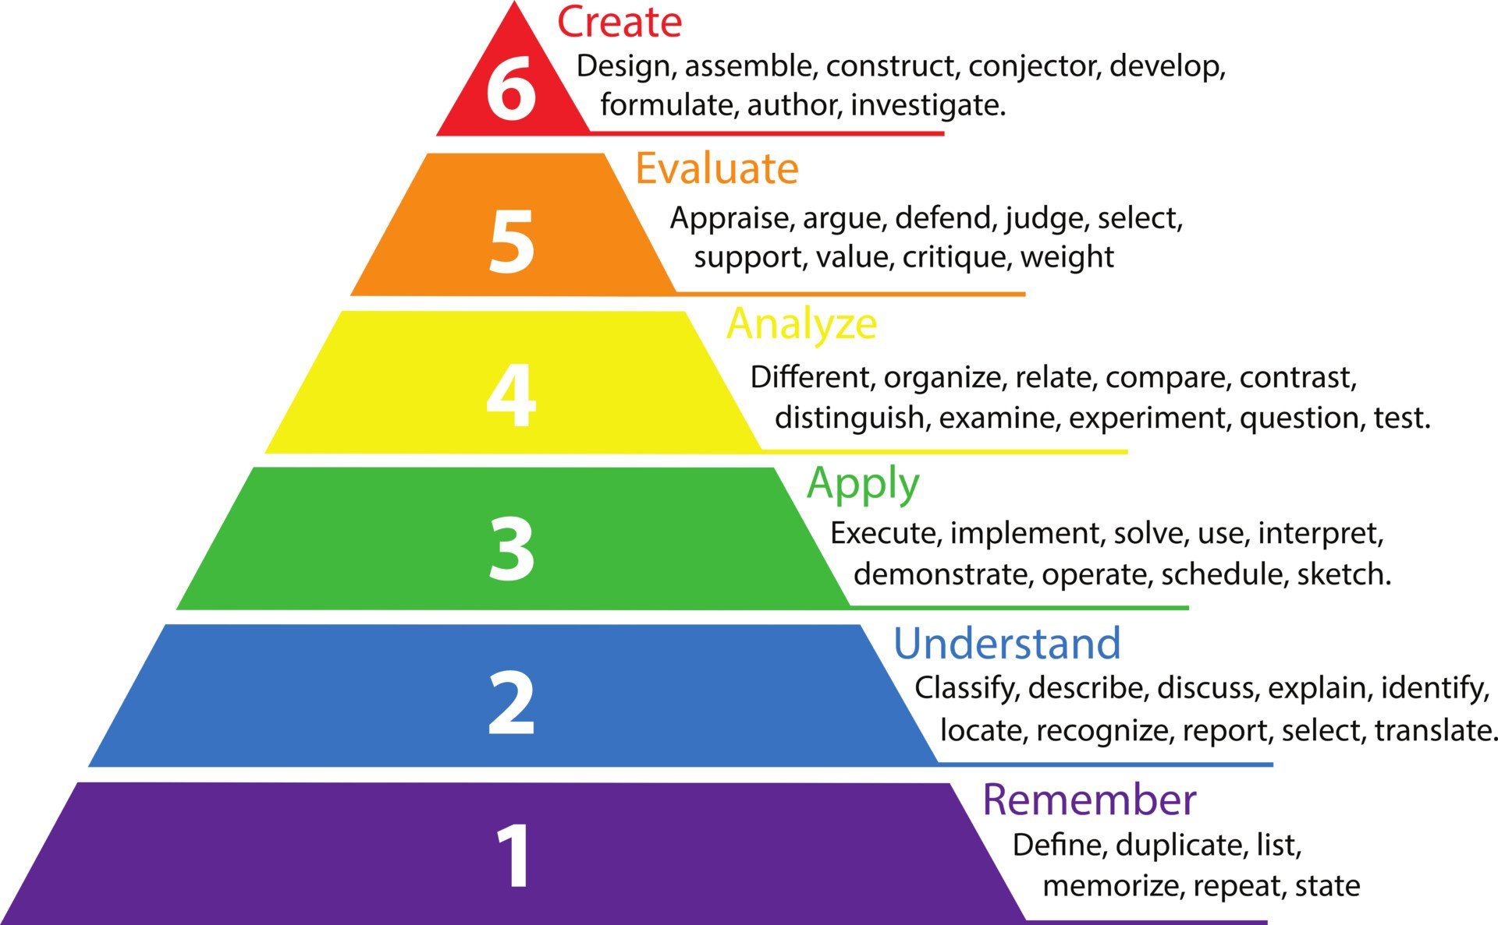
Simulation Design
Consider using artificial intelligence
Use SMART Template and Bloom’s Taxonomy to aid in activity creation
  S: Specific
  M: Measurable
  A: Achievable
  R: Relevant
  T: Timely
Resources for design:
  Harrington Et al., 2022
  Texas Tech Faculty Simulation page

Slide 22
Example activity
Virtual team standardized patient autism assessment created during the pandemic (Barnhardt et al., 2024)
Pre-Experience: 12 disciplines reviewed clinic notes from their discipline
Pre-SP Discussion: Disciplines met to discuss their individual findings and create a plan for delivery of feedback
SP: Trainees met with mother of a child being diagnosed with autism to give feedback on diagnosis and deliver treatment recommendations
Post-Experience: Small-Group debriefing sessions
Assessments: Faculty observation tool – McMaster-Ottawa Scale, participants completed the Interprofessional Education Perception Scale and the Attitudes Towards Healthcare Teams Scale, SPs assessed interprofessional competencies

Slide 23
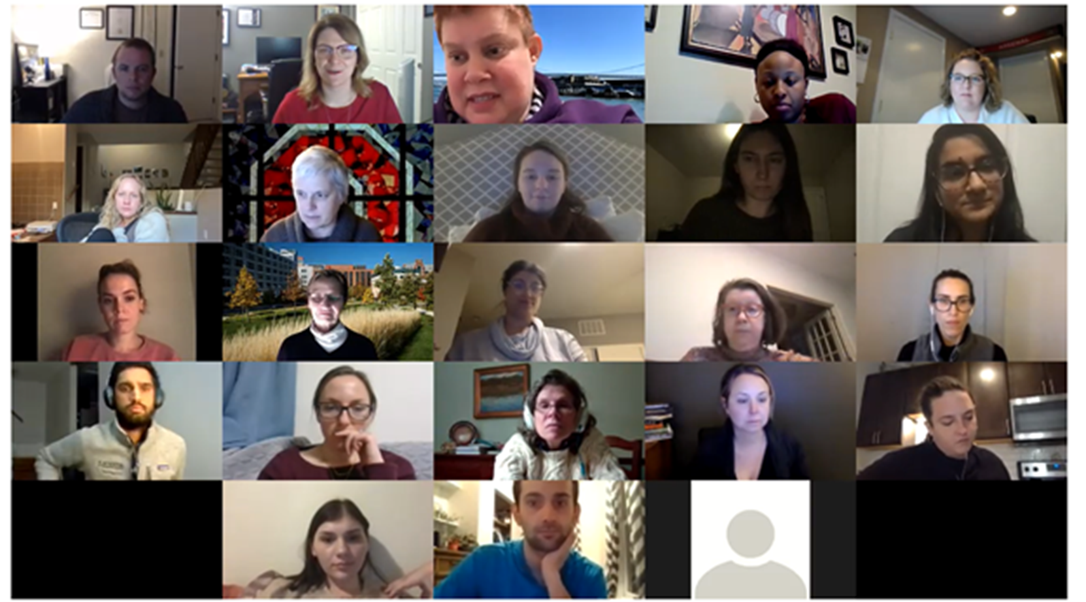

Slide 24
IPE and IPC are ripe for scholarly activity!
DBP is complex - additional research needed to discuss how multi-system care impacts our patients
Implementation of IPC in DBP varies across settings - which structures are best?
Limited longitudinal and outcomes-based data
Measurement gaps
Link to workforce well-being
Notes:
nterprofessional collaboration holds significant potential to transform healthcare delivery, provider well-being, and patient outcomes. However, current research is fragmented, discipline-specific, and lacks scalability across contexts. To fully realize the promise of IPC, increased research is needed to develop standardized models, evaluate long-term impacts, and ensure equity and effectiveness across diverse care environments.
Evolving Complexity of Care
Modern healthcare involves increasingly complex, chronic, and multi-system conditions that require the expertise of diverse disciplines. Research is needed to identify how IPC can be optimized across these varying clinical environments.
Inconsistent Implementation Across Settings
While IPC models have shown promise, their application varies widely across institutions and systems. More research is needed to determine which IPC structures and strategies are most effective in different settings (e.g., inpatient vs. outpatient, rural vs. urban).
Limited Longitudinal and Outcomes-Based Data
Many existing studies on IPC are short-term, descriptive, or qualitative. There is a need for longitudinal, outcomes-driven research to evaluate sustained impact on clinical metrics, provider well-being, and health equity.
Measurement Gaps
There is no universally adopted framework for assessing IPC effectiveness. Research should explore and refine tools to evaluate communication quality, team function, patient outcomes, and system-level performance.
Link to Workforce Well-Being
With rising levels of burnout and moral distress, particularly post-pandemic, research should further explore how IPC can buffer these stressors and support workforce retention and resilience.

Slide 25

Assessment And Evaluation Methods
Who is being evaluated?
Who do you want to do the assessment?
What do you want to assess?
Does assessment need to be open access/free?
National Center for Interprofessional Practice and Education Assessment and Evaluation Tools

Slide 26
Who could you evaluate?
Individuals
Ex: Students Perceptions of Interprofessional Clinical Education Revised (SPICE-R)
Teams
Ex: Assessment of INterprofessional Team Collaboration Scale (AITCS)
Organizations
Ex: Perception of Interprofessional Collaboration Model Questionnaire (PINCOM-Q)
Notes:
The PINCOM-Q is designed to assess perceptions of interprofessional collaboration on the individual, group, and organizational levels for professionals in the domain of mental health care for children and adolescents. Specifically, the tool measures individual motivation, role expectations, personality style, and professional power; group leadership, coping, communication, and social support; and organizational culture, goal/aims, domain, and environment in a 48-item self-report questionnaire

Slide 27
Who could complete assessment?
Self-report (e.g. survey, questionnaire, self-rating)
Ex: Interprofessional Collaborative Competencies Attainment Scale
Observer-based (e.g. rubric, 360 degree feedback)
McMaster Ottawa Teams Observed STructured Clinical Encounter

Slide 28
What do you want to assess?
Perceptions/experiences of working relationships/teamwork
Behaviors/skills
Attitudes, values, beliefs regarding IPC/IPE and other professions
Organizational environment/culture
Satisfaction with training
Patient-level factors (health status, experience of care/satisfaction)
Organizational outcomes of care
Population health

Slide 29
Opportunities for local and national involvement with IPE and IPC
Required for medical schools/many other health professions→increased opportunities for visibility!
National organizations dedicated to IPE/IPC
  National Academies of Practice
  American Interprofessional Health Collaborative
Journals dedicated to IPE/IPC
  Journal of Interprofessional Education and Practice
  Journal of Interprofessional Care
  Focus in many Med Ed journals, profession-specific journals (Ex: Medical Teacher, Academic Medicine)

Slide 30
Small Group Brainstorming
Reflect on the following prompts:
At your home institution…
How do DBP learners develop interprofessional collaboration skills?
Are there specific workshops, conferences or methods that you like more than others?
How are these curricular elements assessed?

Slide 31
Sample Learning activity: Interprofessional Case-Based Simulation series

Slide 32
Overview
This project aimed to pilot a case-based exercise to improve interprofessional competence of graduate-level trainees when treating individuals with intellectual and developmental disabilities (IDD/DD) across the lifespan.
Joint effort between LEND programs at The Ohio State University, University of Illinois-Chicago and Cincinnati Children’s Hospital
Pilot project in 2024-2025 academic year
Developed 4 interactive and collaborative case-based scenarios
  Social Determinants of Health
  School-Age
  Transition-age
  Sexuality
Cases drafted by trainees participating in Leadership Project, reviewed by Disability Experience Expert Panel
Aligned with LEND core competencies
Increasing complexity throughout academic year

Slide 33
Activity Structure
No pre-work
Virtual format (e.g. Zoom)
3 sessions per case, goal of 6-10 trainees per small group
1 facilitator per small group
1 technical support person

Slide 34
Assessment and Evaluation of Curriculum
Prior to Case #1
Attitudes Towards Healthcare Teams Survey
After each case
Interprofessional Collaborative Competency Attainment Scale
20-item scale using retrospective pre- and post- model to evaluate trainees’ interprofessional competence
After Case #4
Attitudes Towards Healthcare Teams Survey
Feedback collected after each case

Slide 35
Results

Slide 36
Key Takeaways and Next Steps
Trainees valued this method of learning in low stakes environment
Even when groups not diverse, discussions were collaborative and rich
Virtual format did not limit collaboration
This activity is easy to implement and facilitate!
Submitting to Journal of Interprofessional Education and Practice as Curricular Resource
Implementing for all LEND trainees in 2025-2026 academic year

Slide 37
Simulation Exercise
Each group will read and review sample cases and will assign themselves a role on the interprofessional team
Recommended timeline
  10 minutes discussing the case
  10 minutes in reflection
    How could this model of virtual, case-based simulation be utilized in your educational environment?

Slide 38
Conclusion and Wrap-up
Share 1-2 takeaways with members of your team
Share your ideas you developed on handout

Slide 39
Contact Information
Elizabeth Barnhardt: Elizabeth.Barnhardt@nationwidechildrens.org
Linda Solamen: lsolamen@gmail.com
Rylee Duncan: Rylee.Duncan@osumc.edu
Dawn Allain: Dawn.Allain@osumc.edu
Kruti Acharya: acharyak@uic.edu
Steph Weber: Stephanie.Weber@cchmc.org
If other LEND programs would be interested in having their trainees participate in this activity let us know!

Slide 40
Resources for Educators
Ohio State Interprofessional Library Guide
National Center for Interprofessional Practice and Education Assessment and Evaluation Resources
Texas Tech University Simulation Resource Page

Slide 41
References
Antonsdottir, I., Rushton, C. H., Nelson, K. E., Heinze, K. E., Swoboda, S. M., & Hanson, G. C. (2022). Burnout and moral resilience in interdisciplinary healthcare professionals. Journal of clinical nursing, 31(1-2), 196-208.Barnhardt, E. W., Gonzalez, A., Rabidoux, P., & Allain, D. C. (2024). Assessment of Interprofessional Competence of Leadership Education in Neurodevelopmental and Related Disabilities Trainees through a Virtual Standardized Patient Encounter. Maternal and child health journal, 28(1), 44–51. https://doi.org/10.1007/s10995-023-03798-y
Fantus, S., Cole, R., Usset, T. J., & Hawkins, L. E. (2024). Multi-professional perspectives to reduce moral distress: A qualitative investigation. Nursing ethics, 31(8), 1513-1523.
Harrington DW, Simon LV. Designing a Simulation Scenario. [Updated 2022 Sep 26]. In: StatPearls [Internet]. Treasure Island (FL): StatPearls Publishing; 2025 Jan-. Available from: https://www.ncbi.nlm.nih.gov/books/NBK547670/
Jadotte, Y. T., Gayen, S., Chase, S. M., Passannante, M., & Holly, C. (2019). Interprofessional collaboration and patient health outcomes in urban disadvantaged settings: A grounded theory study. Health, Interprofessional Practice and Education, 3(4).
Johnson, K., Martin, P., McDonald, D., & McGrail, M. (2025). Interprofessional education and collaborative practice with practicing radiographers: A mixed methods scoping review. Radiography.
Reeves, S., Pelone, F., Harrison, R., Goldman, J., & Zwarenstein, M. (2017). Interprofessional collaboration to improve professional practice and healthcare outcomes. The Cochrane database of systematic reviews, 6(6), CD000072. https://doi.org/10.1002/14651858.CD000072.pub3

