Slide 1
Mentoring Community Pediatric Clinicians to Manage Developmental and Behavioral Conditions: A Multiformat Curriculum Using Project ECHO® to Deliver Best Practices in the Primary Care Setting
SDBP Teaching Workshop
September 19, 2025

Slide 2

Disclosures
We have no relevant financial relationships to disclose
We will not discuss off label use or investigational use in this presentation

Slide 3
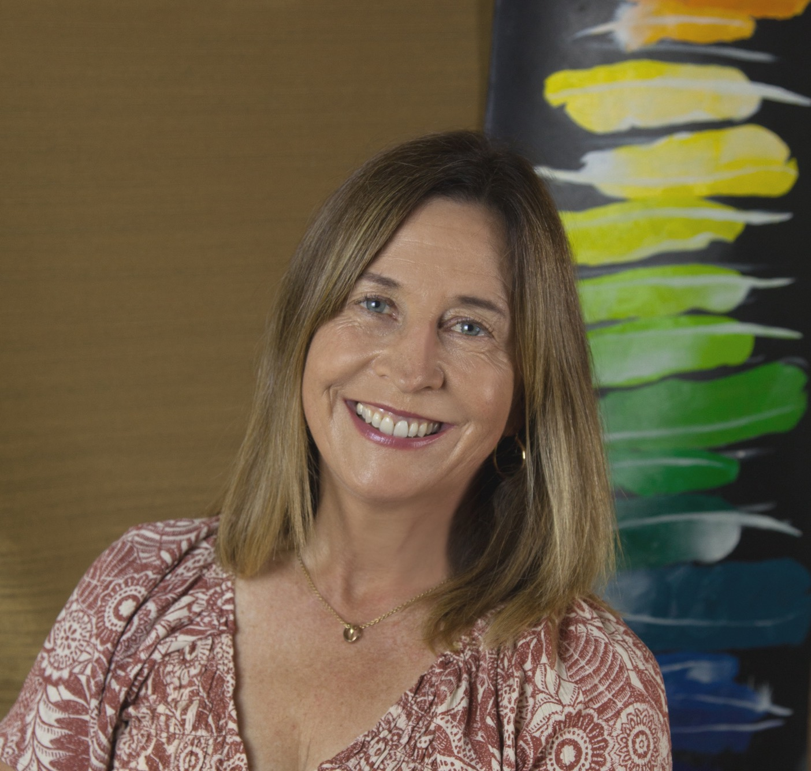
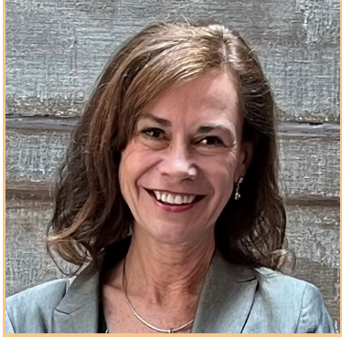
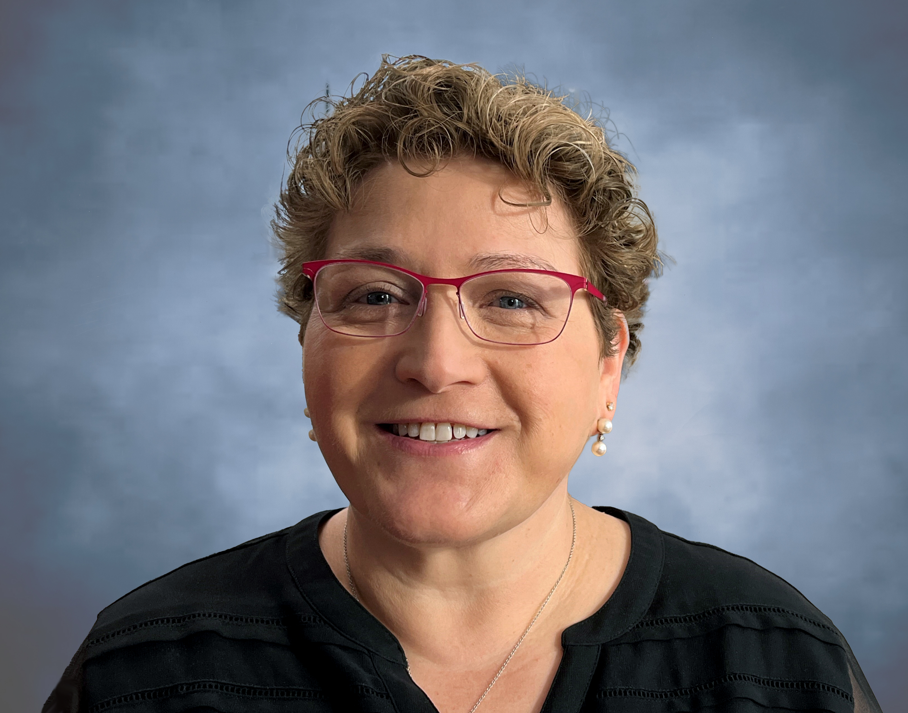

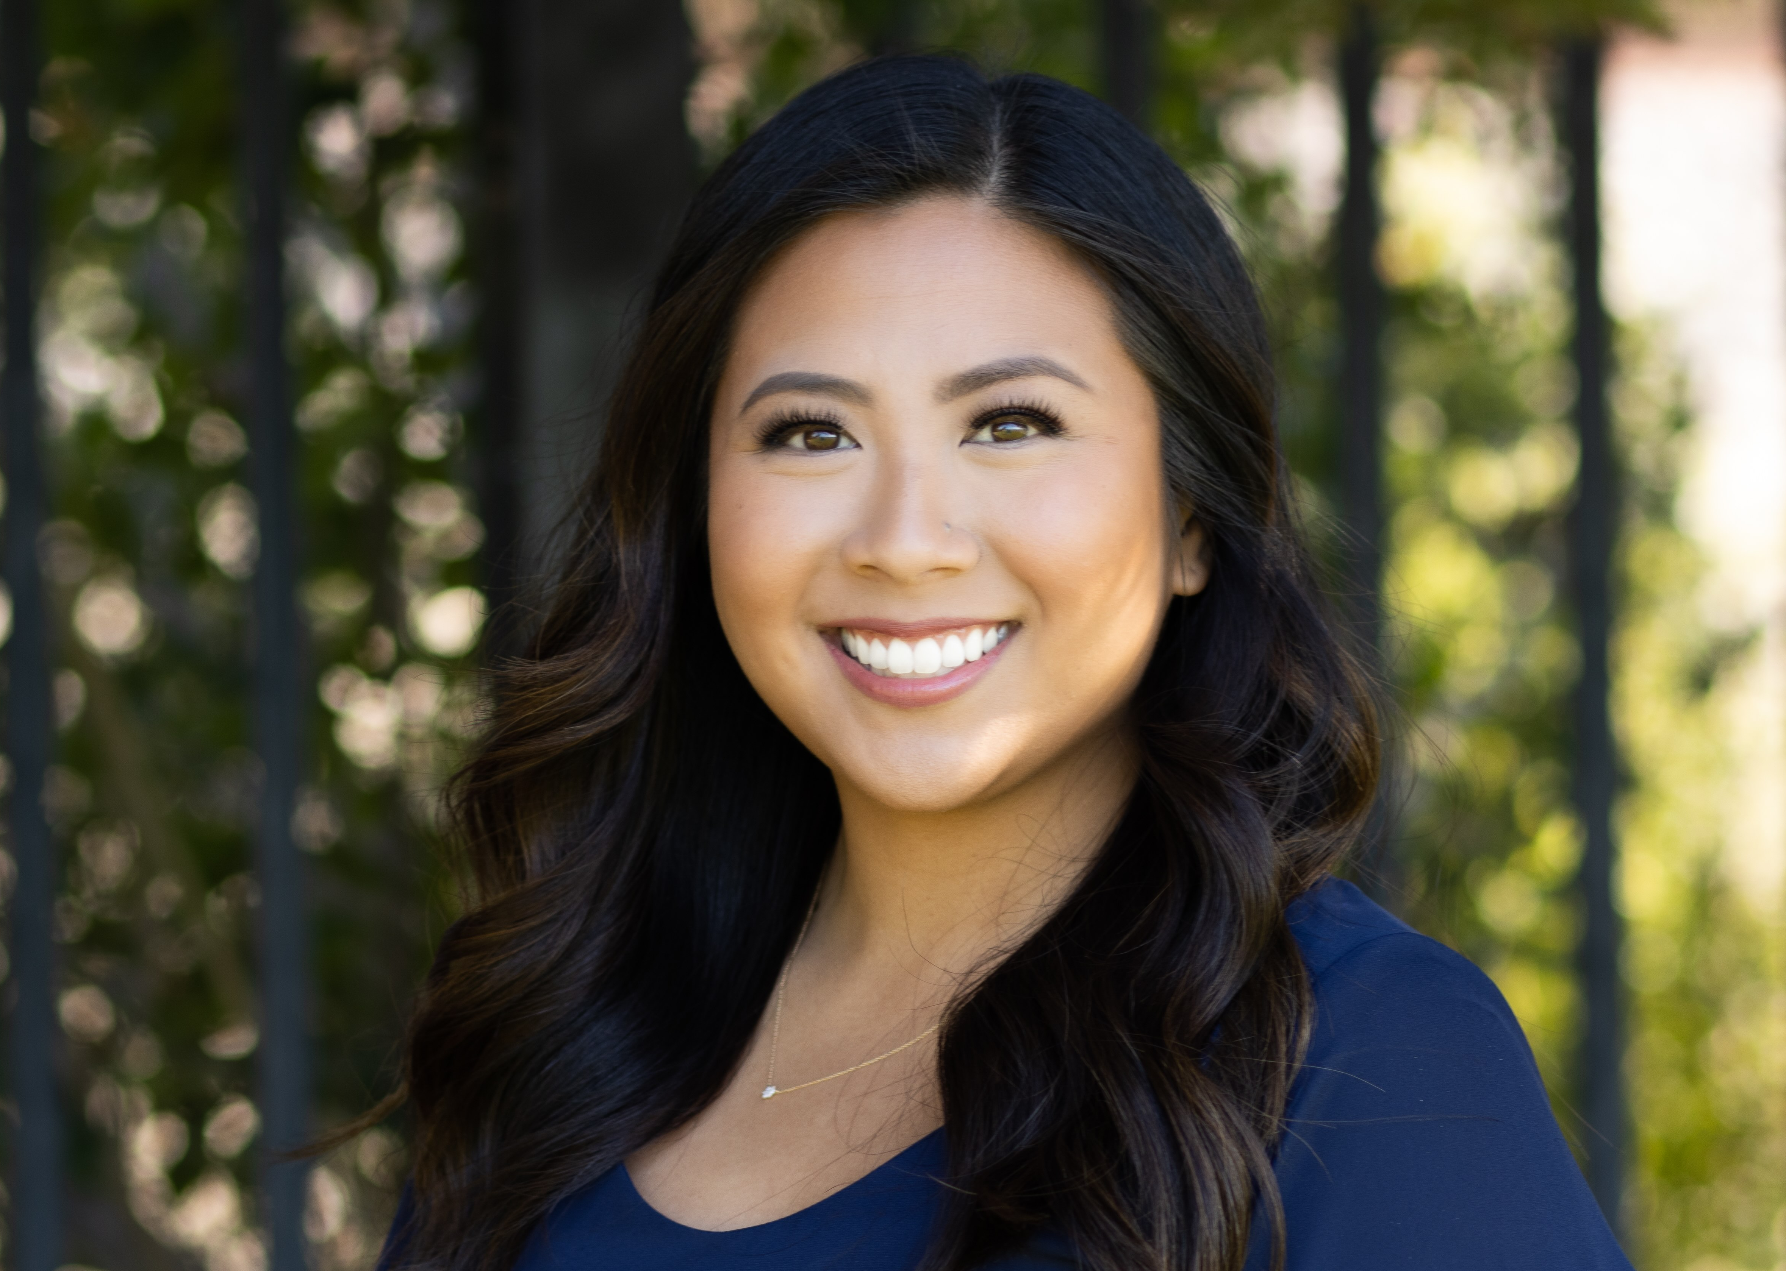
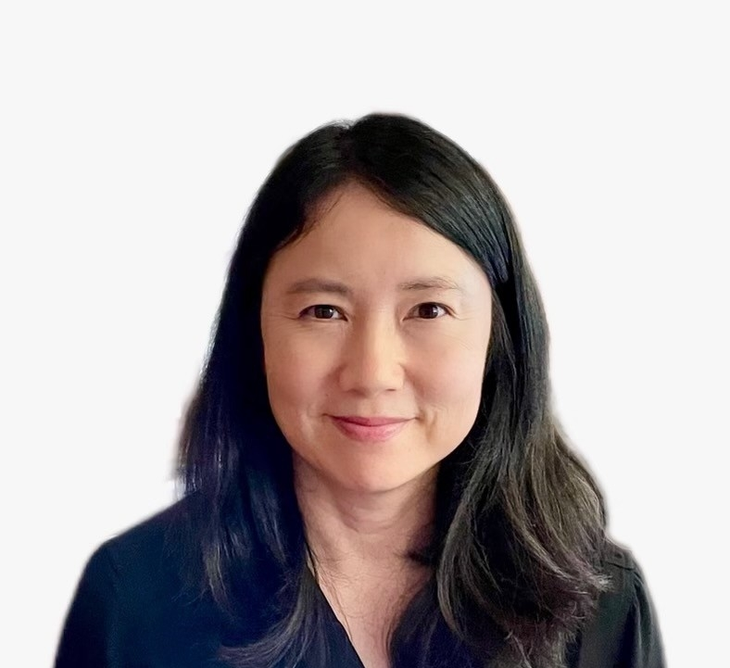
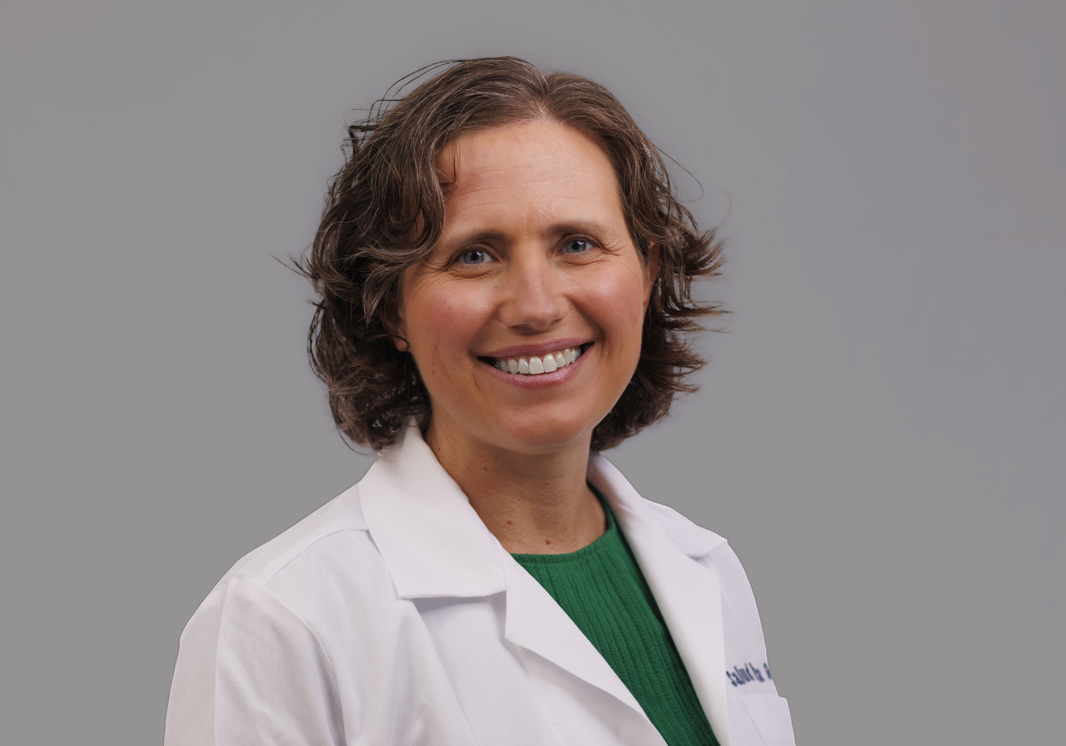
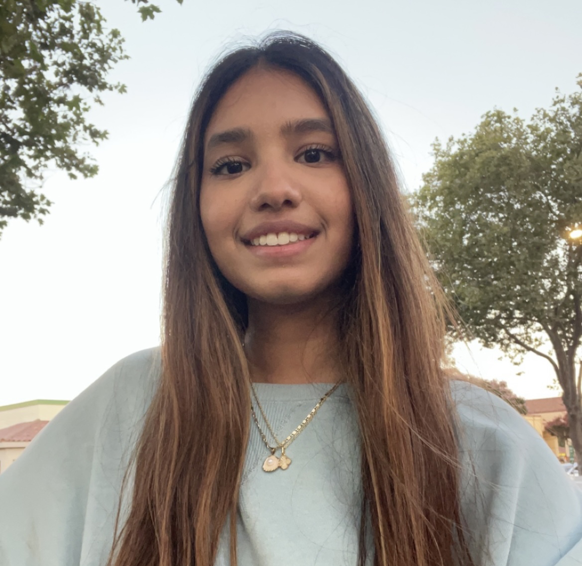

Introductions
Christina Buysse, MD
Stanford University School of Medicine
Barbara Bentley, PsyD, MS Ed, Stanford Children’s Health
Linda Baer MSPH, CHCP
Boston University Chobanian & Avedisian School of Medicine
Nadine Ciara Tan Macaraeg MPA
Stanford University
Ingrid Lin, MD
Stanford University School of Medicine
Devon Francis, MD
Salud Para La Gente
Veda Nair

Slide 4


Land Acknowledgement
Our presenters represent institutions that sit on the ancestral lands of the Muwekma Ohlone, Naumkeag, Massachusett, and Pawtucket people.
These land were and continue to be of great importance to the indigenous people of these regions. Consistent with our values of community and inclusion, we have a responsibility to acknowledge, honor and make visible our institutions’ relationships to Native peoples.

Slide 5
Learning Objectives
Describe an innovative multiformat curriculum designed to prepare primary care pediatrics clinicians to manage developmental and behavioral conditions in the medical home
Assemble a toolkit to create a Project ECHO® program and use an outcomes framework developed by Moore et. Al. to plan and assess the program
Design a unique curriculum that incorporates Project ECHO® to mentor learners in your unique training topic of interest

Slide 6

Stanford DBP Mini-Fellowship

Slide 7
Why create a Mini-Fellowship?
Developmental and behavioral (DB), learning, and mental health (MH) problems are common, affecting approximately 25-40% of children, adolescents, and young adults.
Primary care pediatrics clinicians report high moral distress when they feel that they cannot provide the care their patients need to address mental health and DB issues
The specialty clinician workforce supporting the care of children with these conditions is scattered across disciplines and in short supply.

Slide 8
DBP Workforce Shortage
Developmental-Behavioral Pediatrics (DBP) clinicians cares for children with complex and severe DBP problems.
There are fewer than 800 DB pediatricians in the country, with a ratio of 1 DBP/100,000 children requiring their care.
Recent American Board of Pediatrics workforce modeling suggests that even in best case training scenarios, this ratio will not improve by 2040.
Since 2023, the Maternal Child Health Bureau has required a training of 5 DBP “Mini-Fellowships” as part of the Fellowship T77 grant

Slide 9
Primary Care Clinicians (PCCs) are the front line for DB care!
Not every developmental or behavioral condition is complex and severe.
The literature shows that early intervention (for conditions such as speech and language delay, autism spectrum disorder, behavioral dysregulation) leads to better long-term outcomes for children and less struggle and frustration for their families.
PCCs can identify clear signs and symptoms to facilitate referrals for services.
PCCs regularly manage ongoing care for children with DB conditions.

Slide 10
Stanford DBP Mini-Fellowship Goals
Create a community of practice among learners to support each other during and after the mini-fellowship
Engage learners using a multi-modal training approach
Teach didactic knowledge, communication skills, hands-on procedural skills, diagnostic discernment, and clinical management protocols for specific DB conditions
Provide direct support to learners during real patient care in their current clinical practice through direct coaching
By the end of the Mini-Fellowship, trainees will independently convene DB Clinics in their own pediatric clinic sites using evidence-based approaches to diagnose and manage care of DB conditions within their scope of practice

Slide 11

Target Audience: Primary Care Pediatric Clinicians Goal: Empower PCCs to care for patients with DB concerns in their own clinics Learning Strategies: Live interactive workshops, asynchronous self-directed learning modules, live virtual “ECHO” sessions, and in-clinic coaching Timing: Longitudinal program from July 1, 2024-June 30, 2026 Hours: 300+ cumulative hours per participant

Slide 12
Stanford DBP Mini-Fellowship Community
8 Mini-Fellows
6 PCCs from Federally-Qualified Health Centers whose clinics receive a small stipend to buy out time for their participation. Coaching occurs in their home clinics to support implementation of new clinic patterns.
2 Bonus Mini-Fellows – PCCs who regularly attend ECHOs and in person workshops
They requested hands on in-clinic training and their in-clinic coaching occurs in Stanford DBP clinics
10 “ECHO-only” attendees
PCCs from as far away as India, Washington State, Chicago, Southern California, and Arizona
Hub Team
DBP clinicians in our division
Content Expert Special Guests
Stanford DBP Fellows
Stanford residents on DBP rotation join intermittently

Slide 13




Mini-Fellowship Components
We deliver curricular content through 4 complementary learning formats over the course of our longitudinal cohort-based 2 year mini-fellowship
Canvas Coursework
ECHO Sessions
Every month, learners read and/or view 5 hours of curated content on a Canvas classroom
platform. Flipped classroom learning is linked to and precedes the ECHO.
Monthly ECHO sessions bring together our mini-fellows and ECHO-only learners to move through a planned curriculum and discuss learners’ real cases
.
In-Person Workshops
In Clinic Coaching
Every 6 months we provide a full day intensive hands-on
skills—building workshop
We push into our learners’ clinics to coach them as they care for children with DB needs. “Bonus” mini-fellows join us in Stanford DBP clinics.
.

Slide 14






Mini-Fellowship Road Map
STEP 1
STEP 2
STEP 3
STEP 4
STEP 5
STEP 6
Planning Year
Create Canvas Course and content
Build/Deliver the ECHO
In Person Workshops
In-Clinic Coaching
Evaluation
Feedback surveys after ECHOs and Workshops
Pre/post knowledge and confidence questions
Tracking number of clinics/patients/assess-ments/diagnoses/referrals
Qualitative research will be done after mini-fellowships are completed
ECHOs require organization and preparation. Once templates are built, hub team meets regularly to create content, collect/review learners’ cases, and summarize ECHO content
We spent a year building a hub team, creating a curriculum, planning best learning formats, and recruiting Mini-Fellows
Building a Canvas Course has allowed us to keep track of participation and provide learners with asynchronous online content
Create curriculum
In-person workshops introduce skills (e.g. Capute, RITA-T, motivational interviewing) and build community
Longitudinal In-Clinic Coaching sessions allow for practice of skills and individualized support to PCCs and administrators/staff to bring DB care to each unique clinic

Slide 15
What is Project ECHO® and How Do You Measure Its Outcomes?
Linda G. Baer, MSPH, CHCP
Associate Director, Boston University Chobanian & Avedisian School of Medicine, Center for Continuing Education
Chief Operating Officer, ECHO Diabetes Action Network

Slide 16

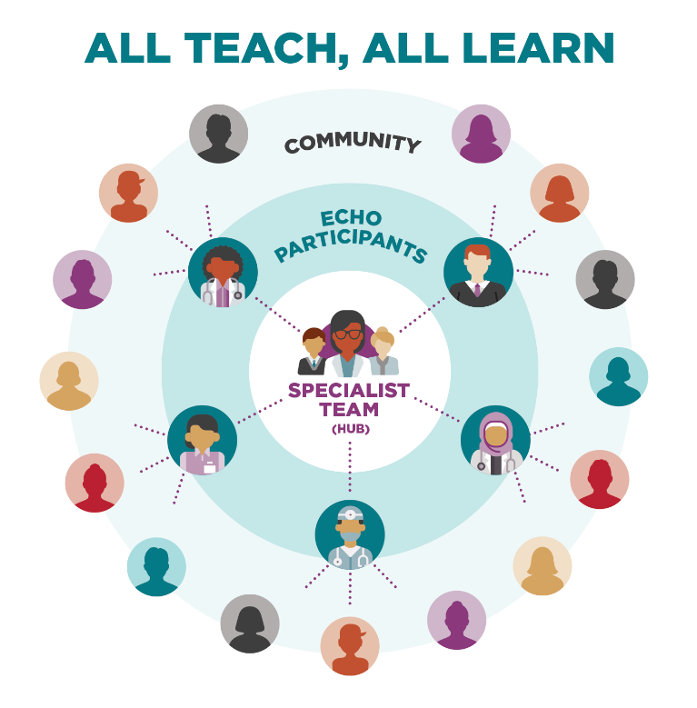
What is Project ECHO®? (Extension for Community Healthcare Outcomes)
Project ECHO Mission: To democratize implementation of best practices for healthcare and education to underserved people all over the world
Founded in 2003 by Dr. Sanjeev Arora at UNM to address Hepatitis C in New Mexico
The heart of the ECHO Model® is its hub-and-learner knowledge-sharing networks
Led by expert teams who use multi-point videoconferencing to conduct virtual sessions with community clinicians
Community clinicians (doctors, PAs, NPs, nurses, and other clinicians) improve the provision of specialty care to patients in their own communities
Moving knowledge and best practices
instead of patients

Slide 17
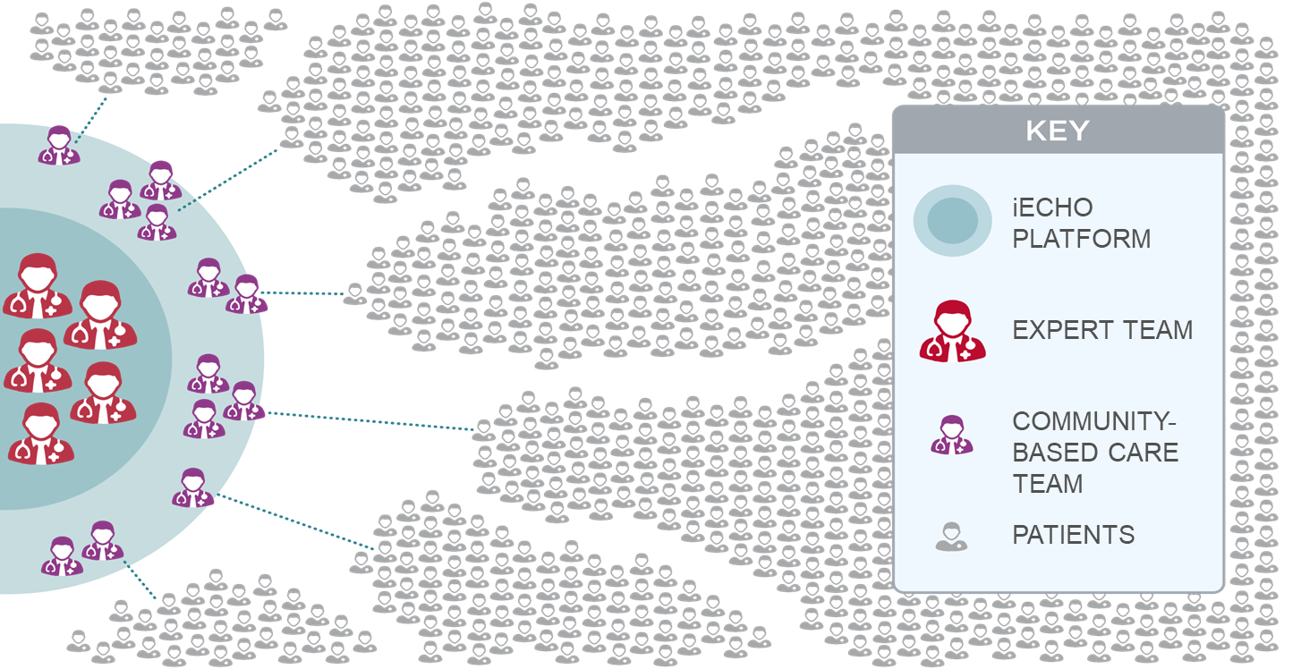
How ECHO Works
Using proven adult learning techniques and interactive video technology, the ECHO Model® connects groups of community clinicians with specialists at centers of excellence in regular real-time collaborative sessions.
Notes:
Cyndi

Slide 18
ECHO Terminology
ECHO®: Extension for Community Healthcare Outcomes
ECHO Institute™: Refers to Project ECHO’s legal entity, faculty and staff as well as headquarters and physical location at UNMHSC in Albuquerque, NM
ECHO Model®: Developed as a platform for both healthcare service delivery and research in 2003.
Demonopolize
Replicate
Hub Team: Core group of faculty experts and support staff who lead and facilitate the ECHO sessions ideally bringing together specialists from multiple focus areas for a robust, holistic approach.
Notes:
Erica

Slide 19
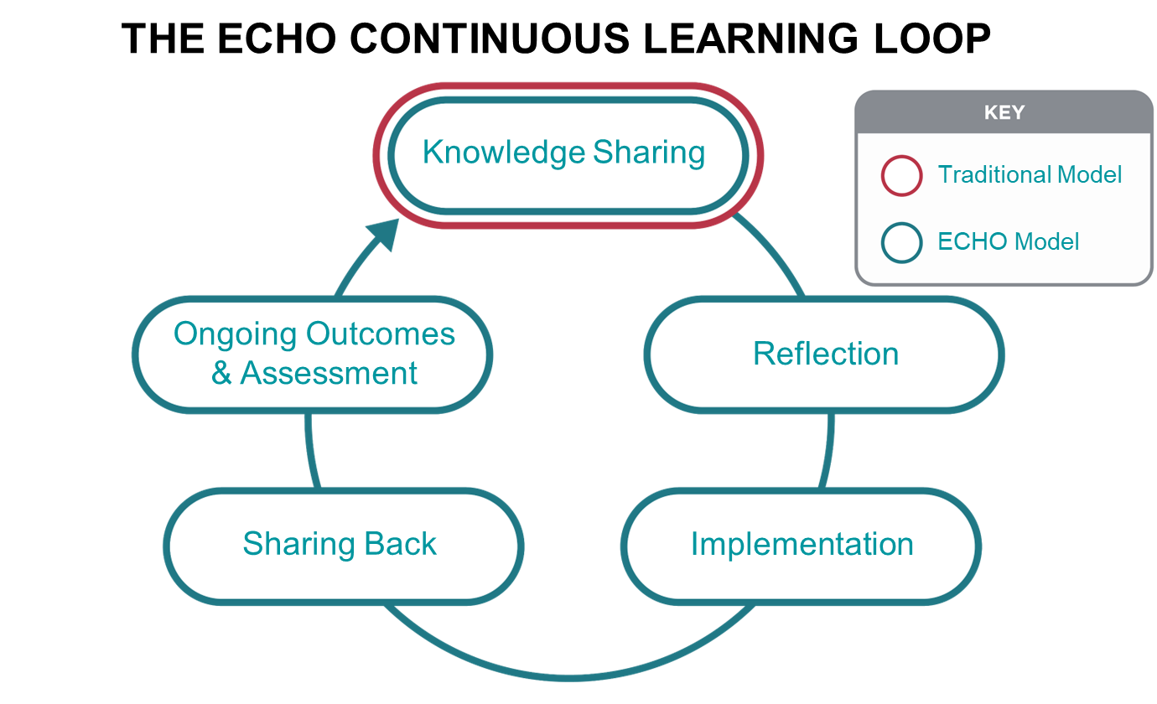
ECHO Learning Loops
Regularly scheduled videoconferencing sessions include subject matter experts and learners who engage in brief lectures, learner presented de-identified cases and mentoring to create learning loops and a community of practice.
Notes:
Erica

Slide 20
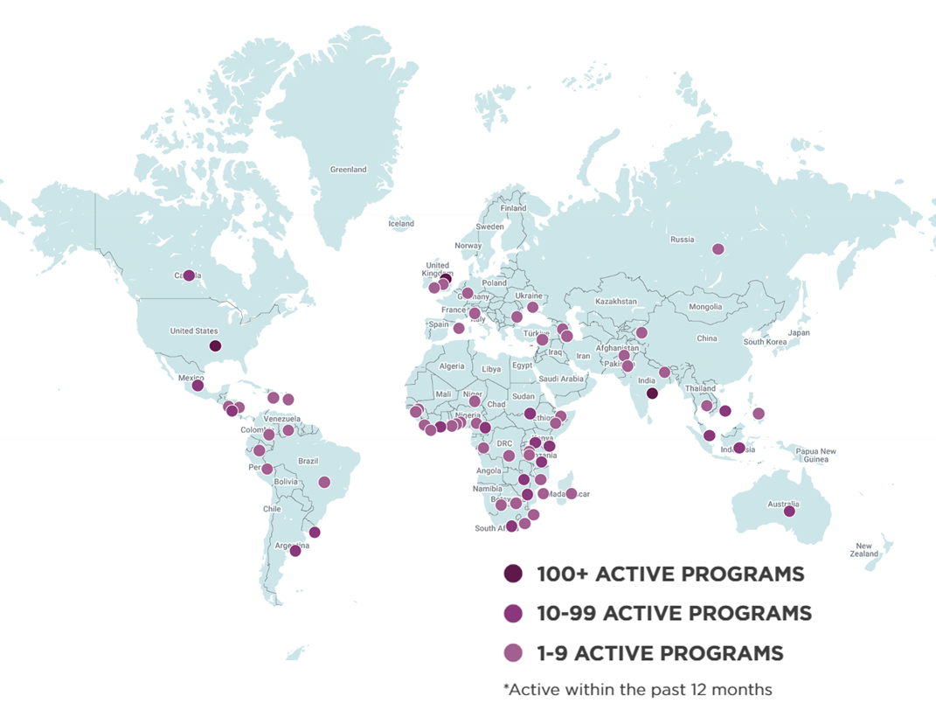
Project ECHO is Global
214 Countries & Areas
Over 1,500 Hubs
Over 8,300 Programs
Over 7.75 million learners
Notes:
Erica

Slide 21
ECHO® vs. Telemedicine
ECHO model is not ‘traditional telemedicine’.
Treating physician retains responsibility for managing the patient.
ECHO Series
ECHO supports community-based teams
Expert hub team
Patients reached with specialty knowledge and expertise
ECHO learners
Specialist manages patient remotely
Traditional Telemedicine

Slide 22
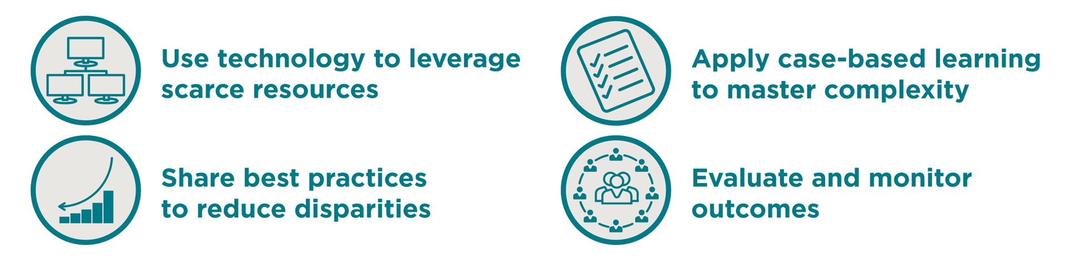
How ECHO Works
The sessions, designed around case-based learning and mentorship, help local clinicians gain the expertise required to provide needed services.
Learners from participating sites gain skills and confidence; specialists learn new approaches for applying their knowledge across diverse cultural and geographical contexts.
As the capacity of the local workforce increases, lives improve.
Notes:
Erica

Slide 23
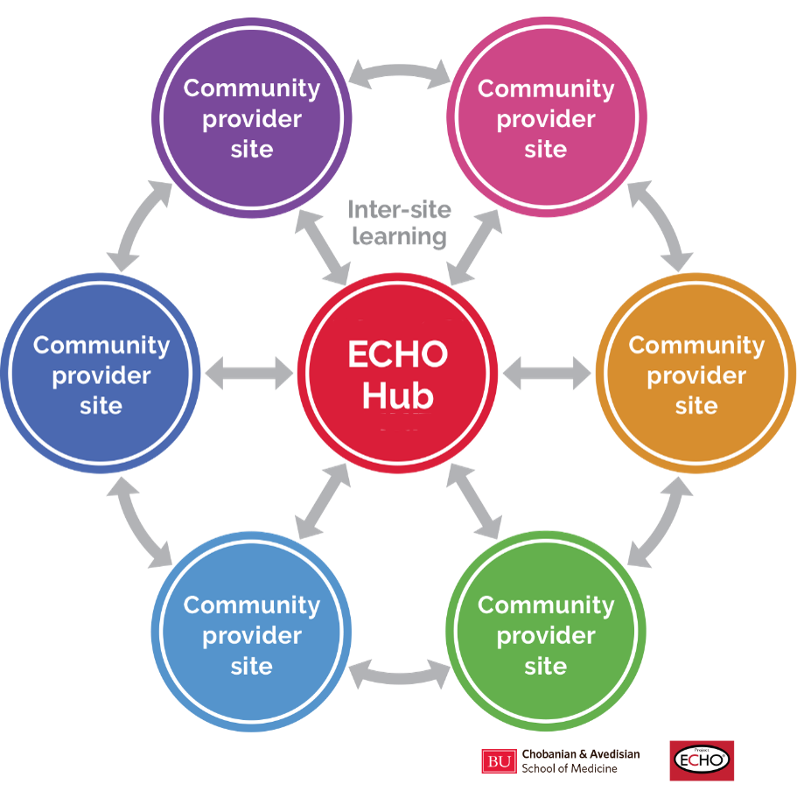
Structure
Hub and participating sites knowledge-sharing networks create a learning loop
Community clinicians learn from specialists
Community clinicians learn from each other
Specialists learn from community clinicians as best practices emerge
Notes:
Erica

Slide 24
ECHO is “All teach, all learn”
When all the principles are applied, a learning community in which “All Teach and All Learn” comes together creating a community of practice.
This includes:
Interactive Components
Guided Practice
Ongoing Mentorship
Peer-to-Peer Learning
Collaborative Problem-Solving
Notes:
Erica

Slide 25
Anatomy of an ECHO Session
Pre-ECHO Countdown
Introductions & Announcements
1-2 hours - Plus prep and de-brief
Weekly, twice monthly, monthly
All sessions include:
Session Prep:15 minutes immediately before the session
Program
Session De-Brief: 15 minutes immediately after the session
Regional & national models
The order of the didactic and case presentations can be adjusted to fit needs
Didactic Presentation & Q&A
Case
Presentation
Clarifying Questions /
Case Discussion
Case Recommendations
Case Summary
Debrief
Notes:
Linda

Slide 26
ECHO Sessions
Encourage participants to commit to presenting a case
Clinical Case Presentation form in REDCap/Qualtrics/etc.: Make sure PHI requirements are followed
Staff and faculty should review forms to remove PHI and alert presenter if necessary
Staff or faculty will create case slide(s) and share them with the facilitator and case presenter
Facilitator meets with case presenter to provide coaching and answer questions
Hub facilitator introduces case presenter
Presenter presents their case with summary of case in PowerPoint
Hub facilitator summarizes case and driving questions
Facilitator first invites participants to ask questions about the case
Facilitator then invites hub faculty to ask questions about the case
Facilitator first asks participants for recommendations
Diagnosis or further screening/testing
Non-pharmacological recommendations
Pharmacological recommendations
Educational approaches
Etc.
Facilitator then asks hub faculty for recommendations
Hub scribe/note-taker provides brief recap of case and major recommendations made
Notes:
Linda

Slide 27
Excellent Faculty are Skilled Facilitators
The main objectives of a good facilitator are to:
Keep the session focused on the subject of discussion
Provide a neutral perspective and manage the process
Move the session along in an efficient and relaxed manner
Help the participants achieve useful educational outcomes
Give the participants a sense of instructive accomplishment, and
Create a safe space where every person feels comfortable speaking
Hub team members who prefer to lecture rather than mentor are not ideal candidates and will need lots of coaching
Select faculty who are highly engaged and love teaching/mentoring
Notes:
Linda

Slide 28
ECHO Agenda
1:00-1:08 pm
1:08-1:11 pm
1:11-1:41 pm
1:41-1:48 pm
1:48- 2:13 pm
2:13- 2:19 pm
2:19-2:26 pm
2:26- 2:51 pm
2:51- 2:57 pm
2:57-3:00 pm
Introductions
Announcements
Didactic Presentation with Q & A
Case 1 Presentation
Case 1 Discussion
Case 1 Summary and Recommendations Review
Case 2 Presentation
Case 2 Discussion
Case 2 Summary and Recommendations Review
Closing Announcements & Evaluation of Session

Slide 29
**Miller GE. The assessment of clinical skills/competence/performance. Acad Med. 1990;65(9)(suppl):S63–S67. doi: 10.1097/00001888-199009000-00045
*Moore DE Jr, Green JS, Gallis HA. Achieving desired results and improved outcomes: integrating planning and assessment throughout learning activities. J Contin Educ Health Prof. 2009 Winter;29(1):1-15. doi: 10.1002/chp.20001.

Slide 30
How might you use an ECHO is your current/future work?
Word Cloud Generation

Slide 31
Let’s do a live (condensed) ECHO!

Slide 32
Rolling introduction slides

Slide 33
Didactic Presentation: “Welcome to the ECHO sessions” 9/19/2025

Slide 34
ECHO Etiquette
We start on time and end on time.
Please remain on mute unless you are speaking.
This is a safe space! Use respectful and appropriate language.
Everything said during the sessions is confidential, both patient stories and our personal responses and questions.
Please participate! We want to hear from everyone.
Avoid...
Disclosing protected health information.
Criticizing/reprimanding each other’s ideas, even if incorrect.
Talking over other people.
Notes:
For us to get the most out of the ECHO experience we’ll be following these tenants of ECHO:
We will do our absolutely utmost to start and end on time
Please keep your cameras on so we can all be engaged with one another
Please stay on mute unless you are speaking to minimize nose distractions
Please know that is a safe space and one of the ways we make that happen is through using respectful and appropriate language and encouraging each other’s thoughts – your participation is crucial! Along those lines we need to avoid criticizing each other’s ideas, even if they are incorrect as well as talking over people.
And remember that we must not disclose protected health information and everything said during the ECHO is confidential, inluding the patient cases and what we all contribute to these sessions

Slide 35
Sample ECHO Agenda
1:00-1:08 pm
1:08-1:11 pm
1:11-1:41 pm
1:41-1:48 pm
1:48- 2:13 pm
2:13- 2:19 pm
2:19-2:26 pm
2:26- 2:51 pm
2:51- 2:57 pm
2:57-3:00 pm
Introductions
Announcements
Didactic Presentation with Q & A
Case 1 Presentation
Case 1 Discussion
Case 1 Summary and Recommendations Review
Case 2 Presentation
Case 2 Discussion
Case 2 Summary and Recommendations Review
Closing Announcements & Evaluation of Session
Notes:
For each session we will begin with introductions of everyone on the ECHO followed by any announcements from the hub team and you all. We’ll then move to a brief didactic presentation with Q & A. The majority of our time – about an hour and 20 minutes - will be spent discussing 2 cases per session.
For each case the participant will spend about 7 minutes presenting the case details and then we will spend 25 minutes discussing it. Finally, we will wrap it up by having a hub team member summarize the case and the recommendations made.
We’ll end the session with closing announcements such as details on next moth’s session, how to get CE credit and having you evaluate the session.

Slide 36
What do we ask of you?
We will host 24 ECHO sessions over the 2-year program. To be eligible for sub-award funding, participants must attend 10/12 ECHO sessions per year.
Try to come on time and ready to participate. We want to hear all of your voices!
Readings, videos, and online content will be curated on your Canvas application to be completed prior to each ECHO session. Learners will self-attest to five hours of monthly preparation in preparation for the ECHO.
Each ECHO participant will be expected to present 8 de-identified cases to the group over the course of the 2 years.
Notes:
What do we need from you?
You’ll need to attend a minimum of 10 of the 12 sessions each year
You’ll need to participate during the sessions
You’ll have 5 hours of self directed learning to complete that you will need to attest to its completion each month
And you’ll present 8 de-identified cases over the 2-year period

Slide 37
ECHO Case Submission Process
Cases will be submitted through Qualtrics through this link: https://tinyurl.com/DBPMini-FellowECHO-Case (you will find in Canvas too).
Please refer to Canvas for the list of assigned cases. (You signed up for these at the workshop last week.) If you are unable to attend a date on which you have been assigned to bring a case, please find a colleague to swap your presentation dates.
Case submissions for the next ECHO are due one week after each ECHO.
Notes:
You’ll submit your cases via a Qualtrics case submission form. You can find the link in Canvas and it is listed here as well
You’ll find the list of assigned cases in Canvas that you signed up for last week.
We still have a number of case slots that need to be filled so please so to Canvas to sign up for those slots
If you are unable to attend, please ask a colleague to swap your presentation dates
Cases are due in Qualtrics for the next ECHO session, one week after the current ECHO session, in other words, 3 weeks prior to the date you are presenting

Slide 38
More Logistics
Please let us know if you are having trouble finding the Zoom links through iECHO.
These are the items that you will be able to find in Canvas:
Self-learning assignments
Case presentation assignments
ECHO case submission link
ECHO didactics and recordings
Case recommendations from the ECHOs
For administration questions, please contact: Nadine Macaraeg: ncmac@stanford.edu

Slide 39
Case Presentation 9/19/2025
Presented by:
Devon Francis, MD
Salud Para La Gente

Slide 40
Case Presenter: Devon Francis, MD Salud Para La Gente
Case Summary: Management of ADHD in the context of other complex medical conditions
Patient identification: 12 year 8-month-old female previously diagnosed with ADHD rising to the 8th grade
Questions for the case:
When should a provider discontinue ADHD meds due to other medical issues?
How should providers support patients with behavior modifications if the patient is unable or unwilling to take medication?
Next steps?

Slide 41
Past Birth, Medical, and Social History
Birth history is non-contributory
No significant medical issues until symptoms of ADHD presented
Cardiac and endocrine concerns emerged with the symptoms of ADHD
There are no significant family history or social stressors contributing to the case presentation

Slide 42
History of present concerns
When patient was in 6th grade (11 years old) she presented with concerns for attention problems at school and at home
Vanderbilts completed confirming clinically significant symptoms of combined-type ADHD
We started methylphenidate 5 mg daily
After 2 weeks, improved focus for homework and chores
At that visit, noted elevated blood pressure (110/69) and murmur (HR 123), 1 pound weight loss, also UTI
Ambulatory BP high at home-referred to Cardiology-confirmed OK to continue methylphenidate until seen
Cardiology evaluation was normal

Slide 43
Follow up Information 6th grade
Well child check 1.5 months later
Persistent elevated BP and HR
2 pounds weight loss
Labs revealed hyperthyroidism-referred to Endocrine
Doing well in school, ADHD medication was effective
Endocrine recommended discontinuation of medication until thyroid was under control

Slide 44
Follow up information 7th grade
Off stimulant meds, patient struggled in school even with a 504 Plan
Patient finally had thyroidectomy this summer

Slide 45
Family strengths and challenges
Strengths:
Family is very consistent in their attendance to medical appointments
and recommendations
Challenges:
Patient and mother struggled the entire school year when she was not
able to take ADHD medication

Slide 46
Questions for ECHO
She is scheduled for WCC next week
How common are comorbid ADHD and hyperthyroidism? Should we be testing all kids with ADHD for hyperthyroidism?
Are there alternative management strategies when a child is not able to take medication to address symptoms of ADHD but continues to struggle at home and at school?
Thoughts about assessment for symptoms of ADHD at the beginning of the new school year?

Slide 47
Thank you!

Slide 48
Let’s plan your ECHO: Small group breakout session

Slide 49
References
American Academy of Child and Adolescent Psychiatry (AACAP) Committee on Collaborative and Integrated Care and AACAP Committee on Quality Issues, Clinical Update: Collaborative Mental Health Care for Children and Adolescents in Pediatric Primary Care. J Am Acad Child Adolesc Psychiatry. 2023;62(2):91-119.
American Academy of Pediatrics. Policy Statement: Patient- and family-centered care coordination: a framework for integrating care for children and youth across multiple systems. Pediatrics. 2014;133(5):e1451-e1460.
Baum RA, Berman BD, Fussell J, et. al., Child Health Needs and the Developmental-Behavioral Pediatrics Workforce Supply: 2020-2040. Pediatrics. 2024; 153, (S2):e2023063678H
Catenaccio E, Rochlin JM, Weitzman C, Augustyn M, Simon HK. Life-time earning potential and workforce distribution in developmental and behavioral pediatrics. Acad Pediatr. 2023;23(3):579–586
Foy JM, Green CM, Earls MF, et al. American Academy of Pediatrics policy statement. Mental health competencies for pediatric practice. Pediatrics. 2019;144(5):e20192757.
Froehlich TE, Spinks-Franklin A, Christakis DA. Ending Developmental-Behavioral Pediatrics Faculty Requirement for Pediatric Residency Programs—Desperate Times Do Not Justify Desperate Actions. JAMA Pediatr. 2023;177(10):999. doi:10.1001/jamapediatrics.2023.2829
Jimenez ME, Martinez Alcaraz E, Williams J, Strom BL. Access to developmental pediatrics evaluations for at-risk children. J Dev Behav Pediatr. 2017;38(3):228–232
Lee CM, Congdon J, Joy C, Sarvet B. Practice-Based Models of Pediatric Mental Health Care. Pediatric Clinics of North America. 2024;71(6):1059-1071. doi:10.1016/j.pcl.2024.07.013
Levy SL, Hill E, Mattern K et. al., Colocated Mental Health/Developmental Care Clinical Pediatrics 2017; 56 (11) 1023-1031
Martin-Herz SP, Buysse CA, DeBattista A, Feldman HM.Colocated Developmental-Behavioral Pediatrics in Primary Care: Improved Outcome Across Settings. J Dev Behav Pediatr. 2020 Jun/Jul;41(5):340-348.
Project ECHO: https://projectecho.unm.edu/
Roberts MD, Christiansen A, O’Hagan B, Jansen E, Augustyn M. Developmentally-Trained Primary Care Clinicians: A Pipeline to Improved Access? J Dev Behav Pediatr. 2023;44(5):e350-e357. doi:10.1097/DBP.0000000000001178
Roizen, NJ, Ruch-Ross, HS, Bauer, NS, et. al., Developmental-Behavioral Pediatrics 13 Years After the First Board Certification: Evolving Subspecialty. J Dev Behav Pediatr. 2021;42: 83-90.
Sohl K, Levinstein L, Greer J, et. al. (ECHO Extension for Community Healthcare Outcomes) Autism STAT: A Diagnostic Accuracy Study of Community-Based Primary Care Diagnosis of Autism Spectrum Disorder. J Dev Behav Pediatr. 2023 04 01;44(3):e177-e184
Weitzman CC, Baum RA, Fussell J, et al. Defining developmental behavioral pediatrics. Pediatrics. 2022;149 (4):e2021054771

Slide 50
Thank You

