Slide 1

Genes, Judgement and Jargon: Practical Genetics for the Non- Geneticist
Kathryn K. Ostermaier, MD, Jamar Borland, MD Rosina Connelly, MD, Johanna Domer, MD, Nikki Gambhir MD, Caitlyn Gold, MD, Holly Harris, MD, Stacey Hudspeth, MSN, Jinsook Huh, MD, Rashida Jawadwala, MBBS, Erica Laber, MD, Steven M. Lazar, MD, Noël Mensah-Bonsu, MD, Sonia Monteiro, MD, Elisa Moran, MD, Janki Patel, DO, Jennifer Swanson-Zamora, MD, Erica Villalobos, MD

Slide 2
Disclosures
We have no financial interests to disclose as pertains to this presentation

Slide 3
Learning Objectives
1. Identify current guidelines for genetic testing and when to refer for genetic evaluation.
2. Interpret the results of common genetic tests (e.g., CMA, Fragile X, Whole Exome Sequencing, and Whole Genome Sequencing).
3. Navigate legal, ethical, and insurance considerations related to genetic testing.
4. Develop effective strategies for discussing genetic results with families, considering health literacy and cultural factors.
5. Apply knowledge through case-based discussions and decision-making exercises.

Slide 4
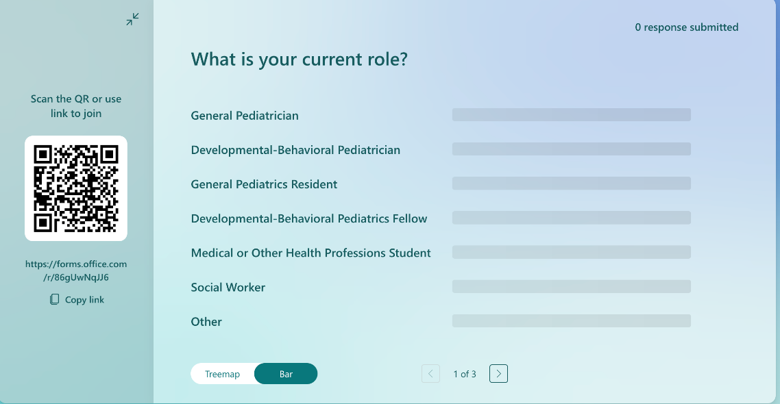
Group Poll: What do you find challenging about genetic testing?

Slide 5
The Alphabet Soup of Genetic Testing

Slide 6
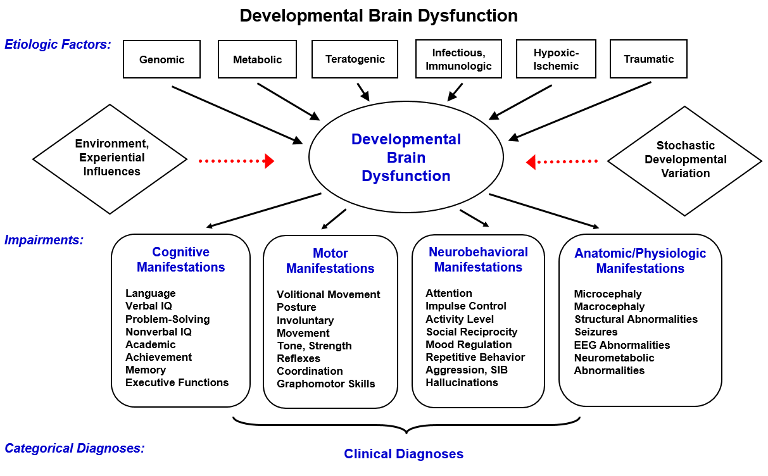

Slide 7
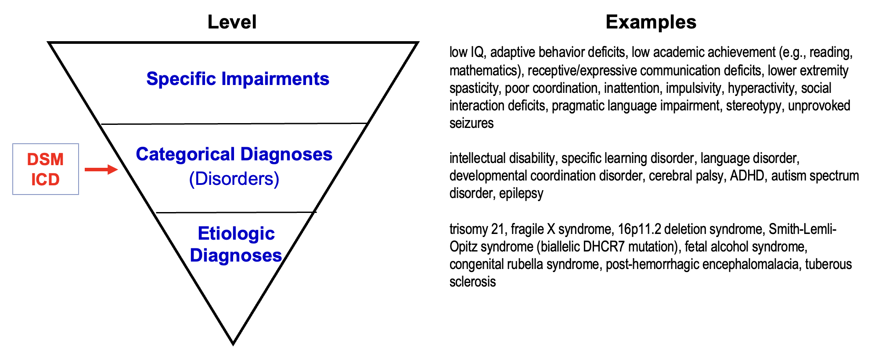
Levels of Diagnosis

Slide 8

Why is Genetic Testing Important?
Neurodevelopmental Disorders are collectively common
>30% can be determined to have a genetic etiology or association
Rate of genetic diagnoses and association is exponentially increasing
Appropriate Genetic Testing is Underutilized

Slide 9
Recommended Genetic Etiologic Workup in Developmental Disabilities
Society Consensus Recommendations
AAN/CNS, AAP, AACAP, ISCA Consortium, ACMG
Variable recommendations of testing specific and broad range testing
Notes:
Consensus statements are a summary of newly available information often based on expert opinion particularly when evidence is still emerging, whereas clinical practice guidelines are developed through systematic review of evidence and provide specific algorithms and guidance for patient care.

Slide 10
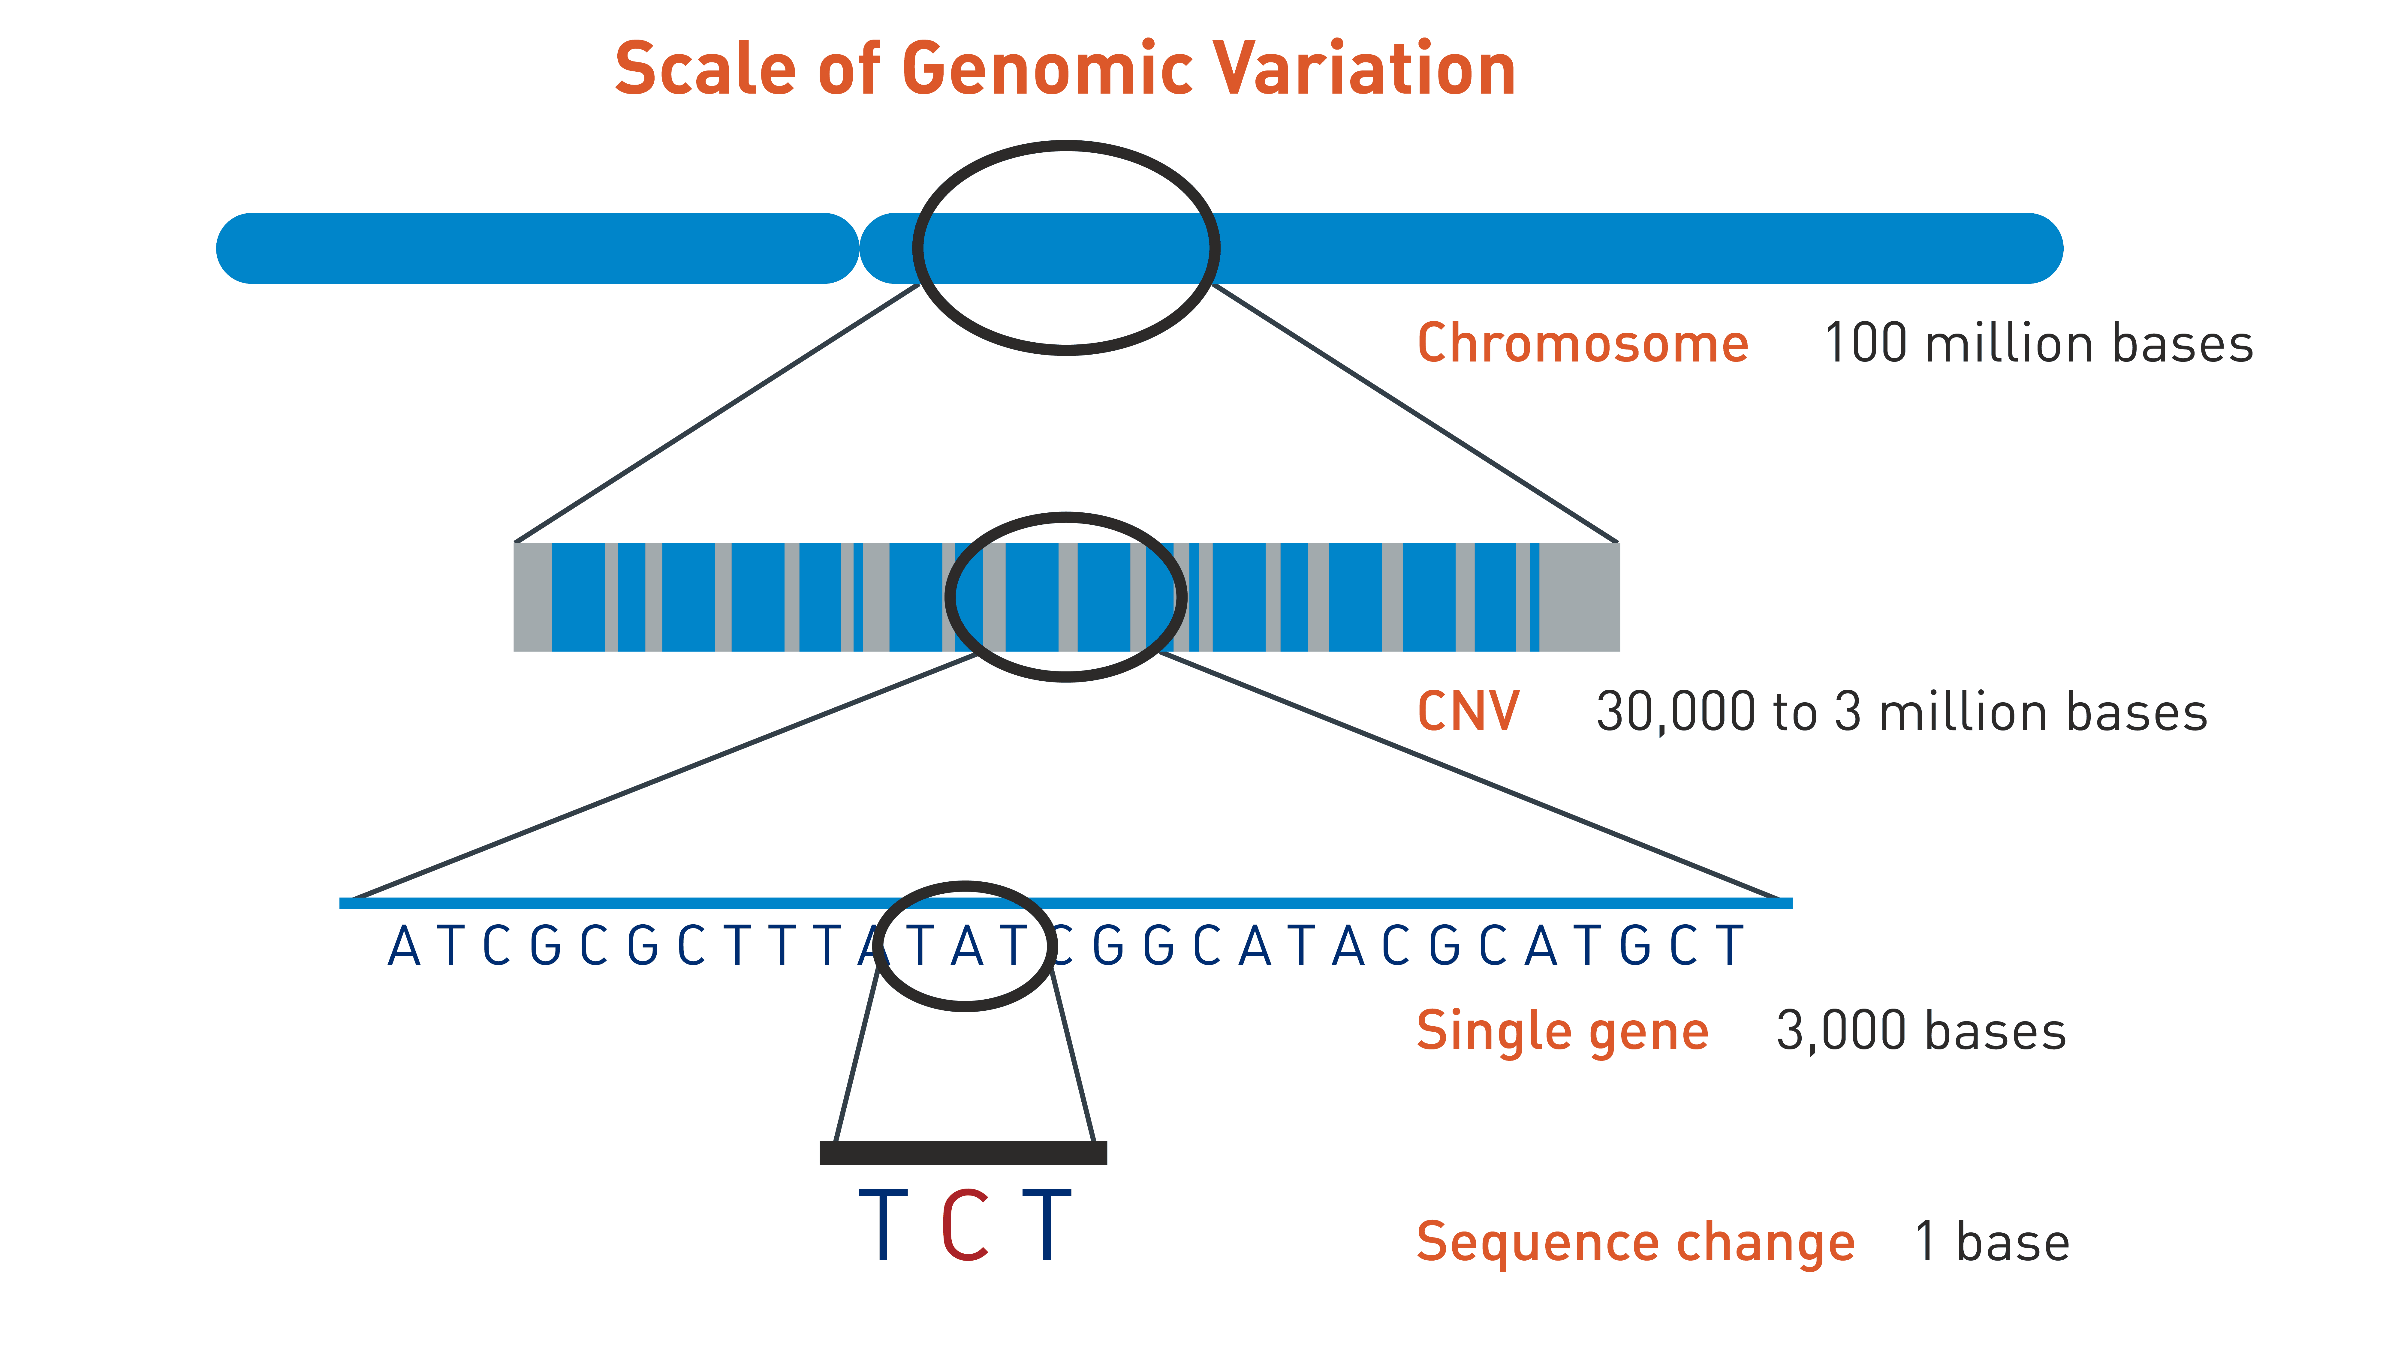
Source: The Jackson Laboratory, URL https://www.jax.org/education-and-learning/clinical-and-continuing-education/cancer-resources/deciding-to-test

Slide 11

Common Types of Genetic Tests
Karyotype
Chromosome Microarray (CMA)
Single Gene Testing
Phenotype-Based Gene Panels
Whole Exome Sequencing
Whole Genome Sequencing
Other Molecular Tests: Trinucleotide Repeat Expansions, Methylation Studies

Slide 12
Let’s Practice!
Small Group Case Discussions

Slide 13
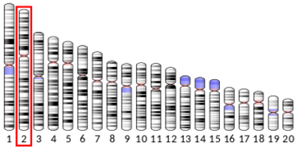

Genetics as a library of instruction manuals

Slide 14
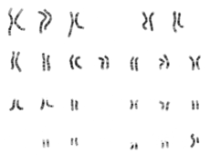

Karyotype
Example Clinical Conditions:
  Trisomy 21/13/18
  Klinefelter Syndrome
  Turner Syndrome
  Unbalanced Translocations
Common Clinical Indications | Pros/Pathology Tested | Cons / Limitations
Specific dysmorphic features History of multiple miscarriages in mother | Trisomies including mosaic Large chromosomal deletions Balanced chromosomal rearrangements, rings | Does not detect microdeletions, microduplications, or single nucleotide variants.

Slide 15
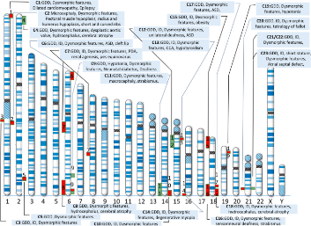

Chromosome
Microarray (CMA)
Example Clinical Conditions:
DiGeorge Syndrome (22q11.2 del syndrome)
17q12 del syndrome
16p11.2 del/dup syndromes
Common Clinical Indications | Pros/Pathology Tested | Cons / Limitations
Dysmorphic features Multiple congenital anomalies Associated developmental delay Nonspecific phenotype | Microdeletions/duplications Single nucleotide polymorphism (SNP) arrays detect regions of homozygosity (ROH) and uniparental disomy (UPD) | Does not detect small deletions or insertions Does not detect balanced rearrangements Variants of unknown significance

Slide 16
CMA and NDDs
4-20%
higher yields with multiple congenital anomalies or syndromic features

Slide 17


Single Gene Testing and Gene Panels
Example Clinical Conditions:
AADC Deficiency
KI1F1A Associated Neurologic Disorder
SCN1A related Dravet Syndrome
XXXXX-related neurodevelopmental disorder
Common Clinical Indications | Pros/Pathology Tested | Cons / Limitations
Limited and variable evaluation of specific phenotypes (e.g., Autism/Intellectual Disability, Cerebral Palsy, Epilepsy, Neuromuscular Disorders) | May have better coverage of specific genes than ES in certain cases Sequencing and copy number variants of limited genes included | Limited number of genes covered, may miss newly described or candidate genes Reanalysis is limited to genes included in original panel

Slide 18
Gene Panels and NDDs
~20%
High variability – population dependent

Slide 19
Exome Sequencing
Example Clinical Conditions:
AADC Deficiency
KI1F1A Associated Neurologic Disorder
SCN1A related Dravet Syndrome
XXXXX-related neurodevelopmental disorder
Common Clinical Indications | Pros/Pathology Tested | Cons / Limitations
Nonspecific phenotype; specific phenotype but possibility of gene discovery | Broad coverage of genes Some laboratories provide CNV calling on reports Medically actionable secondary findings (not related to current phenotype) Higher yield than selective gene panels Reanalysis can be done to include new information, including new gene-disease relationships | Variants of unknown significance Some labs do not provide CNV calling Does not detect tandem repeat expansions

Slide 20
Exome Sequencing and NDDs
~30%
Improved with “trio” and phenotype dependent

Slide 21

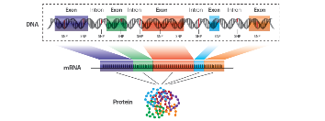
Genome Sequencing
Example Clinical Conditions:
All the above and more!
Promotor region disorders, epigenetic phenomenon
Common Clinical Indications | Pros/Pathology Tested | Cons / Limitations
Nonspecific phenotype; specific phenotype but possibility of novel gene discovery/association | Detect single base pair changes, CNVs and certain repeat expansions Able to detect promotor region and terminal chromosomal pathogenic variants | Insurance coverage Newly available clinically Variants of unknown significance

Slide 22
Genome Sequencing and NDDs
~40%
Highest yield, phenotype drive, improved with “trio”

Slide 23
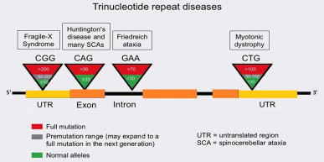
Other Molecular Tests: Trinucleotide Repeat Expansions, Methylation Studies
Example Clinical Conditions:
Angelman/PWS Methylation – imprinting
Hereditary Ataxias
Fragile X Syndrome
Common Clinical Indications | Pros/Pathology Tested | Cons / Limitations
Specific disorder and gene | Specific testing not covered by CMA or WES | Disorder specific testing (i.e. Fragile X Repeat CGG repeats, Angelman/Prader Willi Methylation Analysis)

Slide 24
Fragile X Testing and NDDs
0.4-1.2%
Family history and phenotype

Slide 27
Take Home Points
Etiologic Evaluation should be driven by history and exam
Broad genetic testing including trio genome and trio exome provide the highest yield for the lowest cost
Trio Exome and/or Genome should be offered first line

Slide 28

10 MINUTE BREAK

Slide 29
Ethical, Legal, and Insurance Considerations of Genetic Testing

Slide 30
The Complex Landscape of Genetic Testing
Direct-to-Consumer Genetic Testing (DTC-GT) e.g. 23andMe
Clinical Testing
Research e.g. SPARK
Notes:
Direct-to-Consumer Genetic Testing (DTC-GT)​
Type of At-Home Genetic testing (AH-GT) available to individual without involvement of a healthcare provider​
Order kit off the website of the company, submit saliva sample, then await results
If DTC-GT has medical indications (like risk of cancer) as opposed to nonmedical (wellness, traits, or ancestry testing), the FDA requires regulatory clearance as it is deemed a medical device
The first FDA-authorized DTC genetic test was 23andMe’s Bloom syndrome carrier test in 2015 [3] and 23andMe remains the only company that offers DTC-GT for medical indications.
Types of Services include:
Ancestry Tracing
Health Traits and Predispositions
Examples​
23andMe​
Ancestry​
​
Clinical Genetic Testing
Directly ordered by provider (i.e. primary care provider, geneticist, etc)
Typically follows after initial genetics consultation (thorough history, examination, and counseling)
Numerous options available ranging up to whole genome sequencing, or as appropriate depending on clinical picture and most likely diagnoses
Following completion of testing and release of results, provider will contact patient to discuss results and potential next steps
Research
Example: Simons Foundation Powering Autism Research for Knowledge (SPARK)
Autism Research Genetics testing typically focuses on the diagnosis of autism and typically does not return other health-related results, but participant can opt in to learn this information at registration.
Results are not added to the medical record. Up to participant to share results with a provider.
For SPARK, Participants can also contribute their saliva sample for analysis but not consent to "results return."
Participation in SPARK is free and can connect participants to future research opportunities and/or surveys.
Reference: At Home Genetic Testing Paper ​
DTC-GT versus consumer-directed clinical testing = both types of consumer directed genetic testing. ​
​
Focus DTC-GT​
Can go online to company, order kit, provide saliva sample​
Many don't have counselor or provider​
FDA DTC-GT is set apart from typical clinical genetic testing from a regulatory perspective​
​
​
​
​
​

Slide 31
DTC-GT | Clinical Testing | Research
Pros Eases people into genetic testing who may be hesitant to otherwise in a clinical setting Results are not included in the medical record. Can determine ancestry if service is offered Can potentially identify health risks and genetic predispositions prior to presentation, allowing patients to be proactive | Pros Access to a healthcare provider such as a genetic counselor/physician who can provide additional guidance prior to and post testing Variety of testing options, even up to whole genome Potentially covered by insurance depending on coverage type. Can potentially identify health risks and genetic predispositions prior to presentation, allowing patients to be proactive | Pros Does not cost money to participate typically Results are not included in the medical record Findings can contribute to further knowledge in specific disease/disorder Be notified of future potential studies of interest
Cons Lack of healthcare provider involvement, for example: genetic counselor. Need for clinical validation: results must be repeated in a clinical lab if needed for medical management Not as extensive as clinical genetic testing Out-of-pocket costs Potential misattributed parentage | Cons Requires initial doctor's visit prior to ordering genetic testing Results become part of the medical record Depending on insurance coverage, patient may incur additional costs related to consultation and testing Potential misattributed parentage | Cons Incidental or secondary findings unrelated to neurodevelopmental disorder not provided (have to opt in) Need for additional clinical genetic for medical management Not as extensive as clinical genetic testing Not standard of care to have genetics provider Potential misattributed parentage
Notes:
Reference: https://sparkforautism.org/portal/page/genetic-analysis-faq/ ​
SPARK chooses which genes and DNA regions to look in by using the information and resources provided by groups of experts. These experts have determined which genes have a ‘definitive’ or ‘strong’ association with the following neurodevelopmental conditions:​
Autism​
Intellectual disability​
Epilepsy​
Other autism-like conditions including Rett syndrome and Angelman syndrome​
​
Does SPARK Return Results That Are Not Related to Autism?​
SPARK’s primary focus is genetic causes of autism. If we identify genetic variants in specific genes that are known to increase the risk of certain types of cancer or high cholesterol, we will return these to you. The chance of SPARK identifying such a variant is low, and happens in about 1% of participants, or fewer. SPARK will not return health-related results outside of these specific conditions.​
​
You can tell us at registration whether you would want to learn about this information for yourself and any dependents, or not. It is important to note that this analysis is not comprehensive. If you have any concern about your genetics for these conditions, you should pursue clinical testing, even if you have submitted a sample to SPARK.​
​
What Happens if SPARK Does Not Find a Genetic Change?​
Not everyone in SPARK will hear about genetic changes linked to autism. Based on what we know today, SPARK scientists expect to find a genetic difference that meets the above criteria in 8 to 10 percent of people in the study.​
If we have completed our analysis of your DNA and did not find a genetic difference related to autism, we will tell you in an email.​
Because it is expensive to have a clinical laboratory review and confirm the variants that SPARK finds, we are not able to do this step for results that participants already know about. If you told us about a genetic change when completing SPARK questionnaires, we will look in your DNA for anything additional. If we do not see anything else, you will receive the above email. This does not take away any genetic variation that you already know about.​
Privacy Considerations and your Genetic Information​
We store all sequencing data securely in the SPARK database.​
SPARK scientists may access this data. Other scientists may apply to receive SPARK genetic data and are rigorously screened. Approved scientists must agree to keep the data private and secure.​
Often, the results of the scientific research conducted by approved scientists appear in scientific journals. This information cannot be used to expose an individual’s identity.​
SPARK does not and will never sell data or DNA to anyone.​
​
​
Privacy and Insurance Coverage​
Under the federal Genetic Information Nondiscrimination Act (GINA), having genes linked to autism should not affect your existing health coverage or whether you qualify for health coverage. To learn more, please visit the GINA website.​
​
Results returned to participants are not added to a participant’s medical record and it is your choice whether to share them with your doctors or other individuals.​
​
​

Slide 32
Promoting Equity in Genetic Testing
Access disparities
Ordering test
Follow through
Documentation
Insurance & Costs
Pre-authorization
Increasing odds of test completion
Fears and Cultural considerations
Education and health literacy
Medical Neccesity

Slide 33
Promoting Equity in Genetic Testing
What do providers need to know about insurance coverage and access disparities?
What do providers need to know about ordering genetic testing?
What needs to be in the provider's note to ensure coverage for genetic testing?
How can we increase the likelihood of completion of genetic testing?
Notes:
Insurance coverage and access disparities
- Historically large disparities in genetic testing coverage amongst insurance companies – both Medicaid and commercial insurance plans.
- Updated guidelines have improved ability to get some genetic tests for both commercial and Medicaid plans. Genome sequencing recently added as a Texas Medicaid benefit if criteria are met.
- Genetic testing laboratories have also developed processes to assist with getting genetic testing for Medicaid patients. Still not perfect, many specialized tests still aren't covered, but improved over past few years.
Ordering genetic testing
- Genetic testing can be quite costly.
- Many insurances require pre-authorization or pre-determination for testing.
- Even if approved, still may have high out-of-pocket cost to family depending on their policy.
- Many commercial laboratories now have robust billing teams to assist with pre-authorization and can provide cost estimates. There are also financial assistance plans based on income.
- Consider contacting the genetic testing laboratory to get info re: billing practices and process.
Documentation to ensure coverage
- Must highlight medical necessity by detailing how the genetic testing can change medical management.
- Consider referencing literature on diagnostic yields for testing for particular patient populations, as well as guidelines by ACMG (PMID: 34211152) and the AAP (PMID: 40545261).
- Detail how the test can guide prognosis, recurrence risk counseling, medical recommendations, and reduce additional testing.
- If the insurance policy has specific criteria for coverage, address how your patient meets this criteria.
Increasing likelihood of completion of genetic testing
- Counsel families that genetic testing is optional, but may assist with guiding their child's medical care, as well as inform the risk to other family members or future children.
- Consider caregivers' potential causal beliefs (what they think caused their child's diagnosis) and attitudes toward genetic testing.
- Address potential concern about method of collection (families may assume venipuncture when most testing can be done with buccal sample). Many labs will send buccal swab kit to patient's home with a pre-paid return label for drop-off.

Slide 34
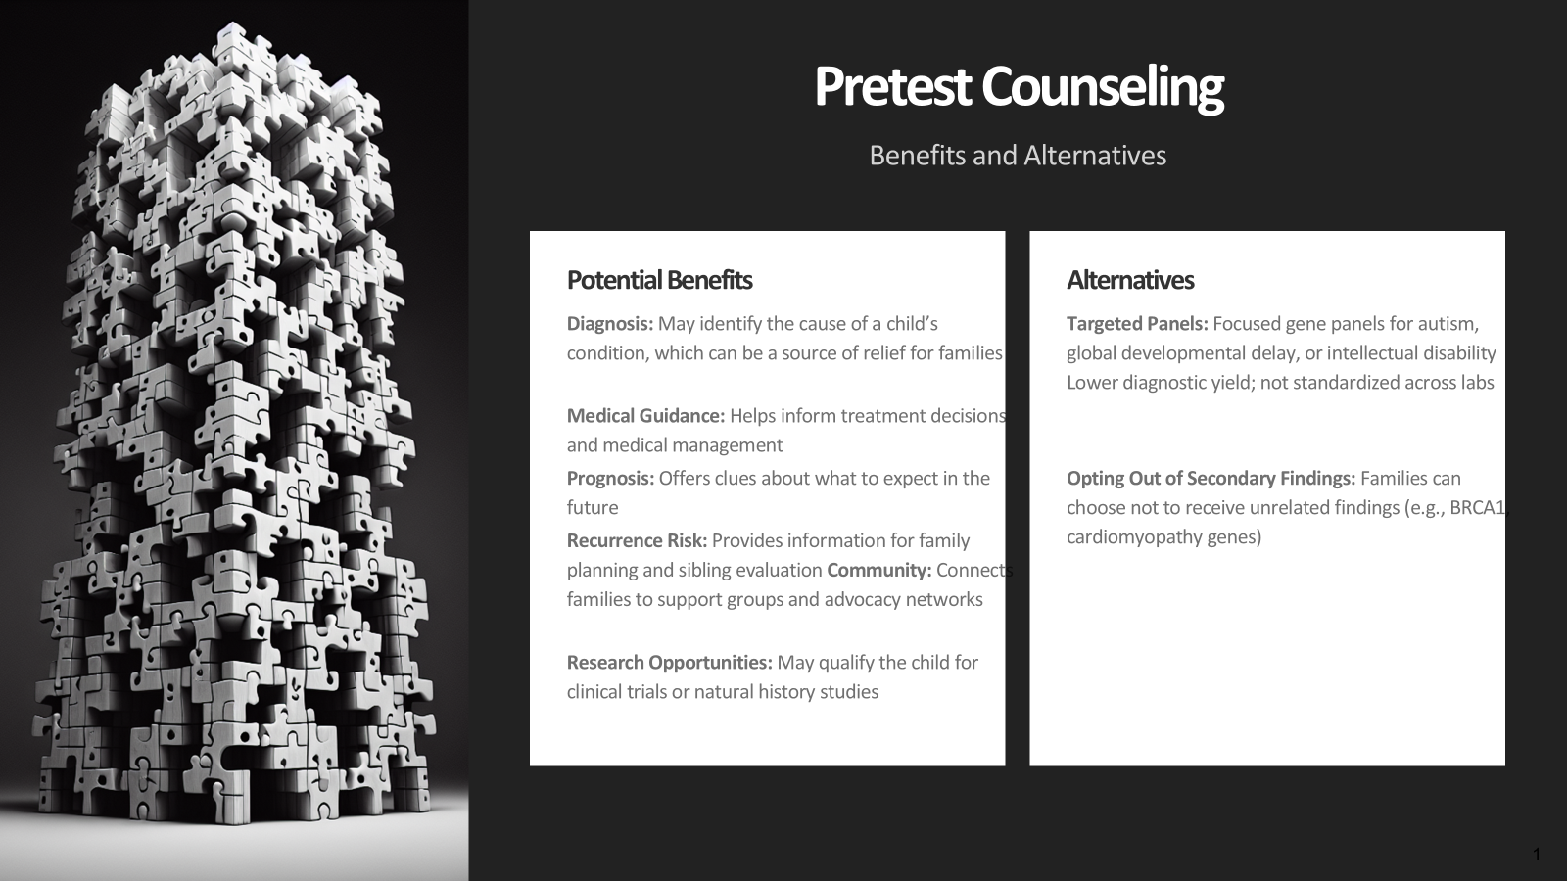
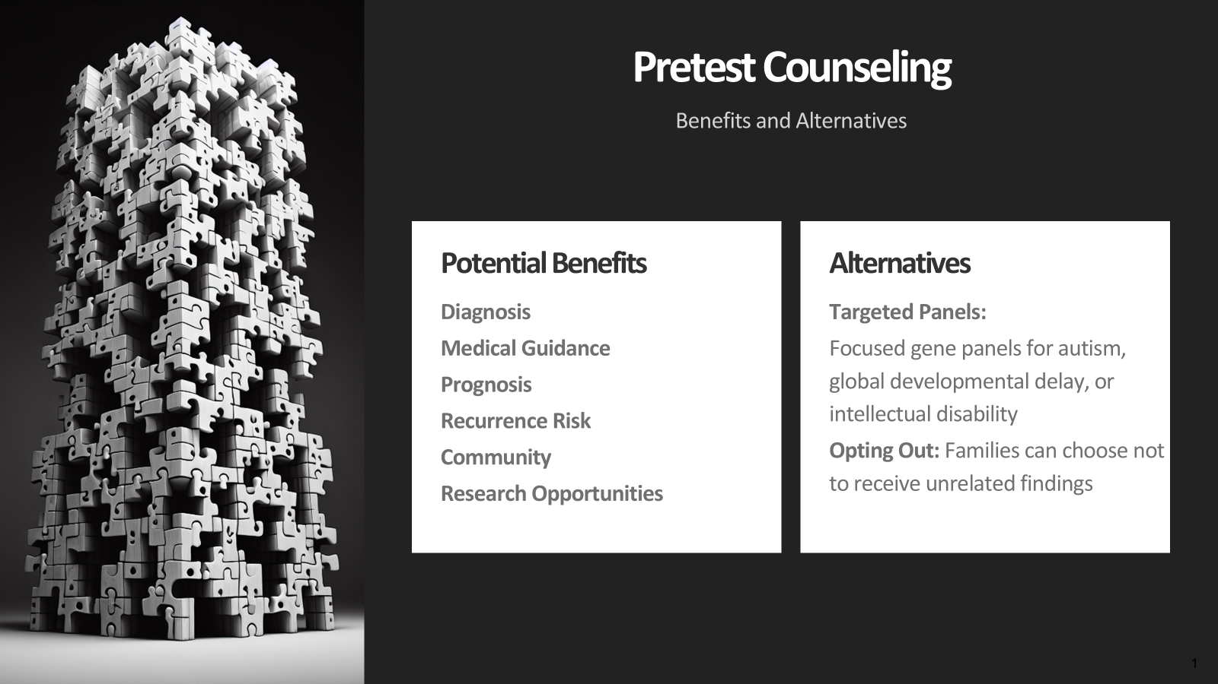
Notes:
Benefits
Finding a genetic cause for individual's condition (relief of knowing the cause, can be positive psychological impact on parents/caregivers)
Guidance for interventions & medical management (this can range from improving access to therapies/services, direct impact on treatment such as for inborn errors of metabolism, or identifying whether a candidate for future treatments such as gene therapy)
Prognosis information
Recurrence risk info (family &individual)
Connections to support groups/networks
Opportunities for participating in research (including clinical trials)
Alternatives
Focused Autism or GDD/ID gene panels (no uniformity across labs, lower diagnostic yield). This is an option for families wanting more targeted testing to avoid VUSs, less well understood genes, secondary or incidental findings. Refer to Geneticist for this (caveat: unknown if Geneticist will support this testing)
Families can opt out of receiving secondary finding results

Slide 35
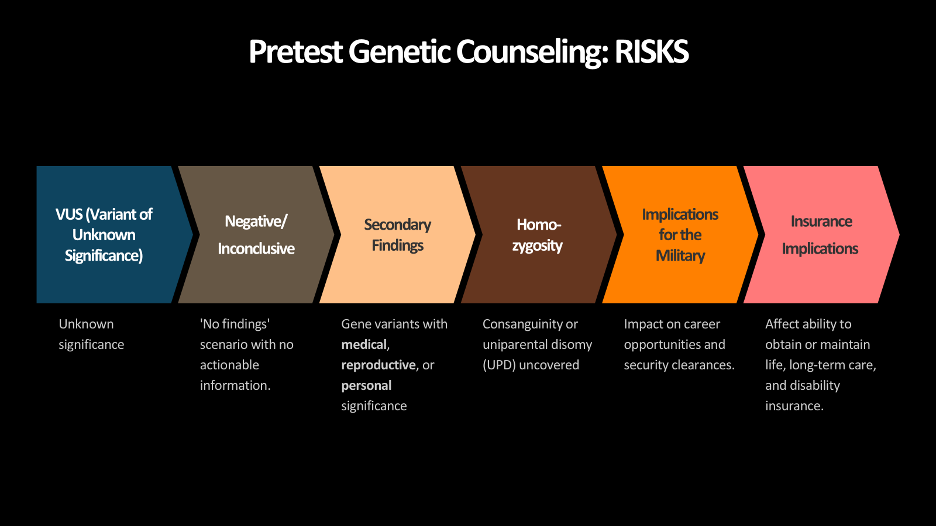
Pretest Counseling
Risks
  VUS (Variant of Unknown Significance)
    Can be a frustrating result
    Over time a VUS may be reinterpreted or reclassified
  Potential for no findings (no result with testing)
  Secondary Findings (gene variant with medical, reproductive, or personal significance)
  Increased regions of homozygosity
  Implications for the military
  Implications for life, long term care, & disability insurance
Notes:
Pretest Counseling: Risks
VUS (Variant of Unknown Significance)
Can be a frustrating result
Over time a VUS may be reinterpreted or reclassified
Potential for no findings (no result with testing)
Secondary Findings (gene variant with medical, reproductive, or personal significance)
Increased regions of homozygosity
Implications for the military
Implications for life, long term care, & disability insurance

Slide 36
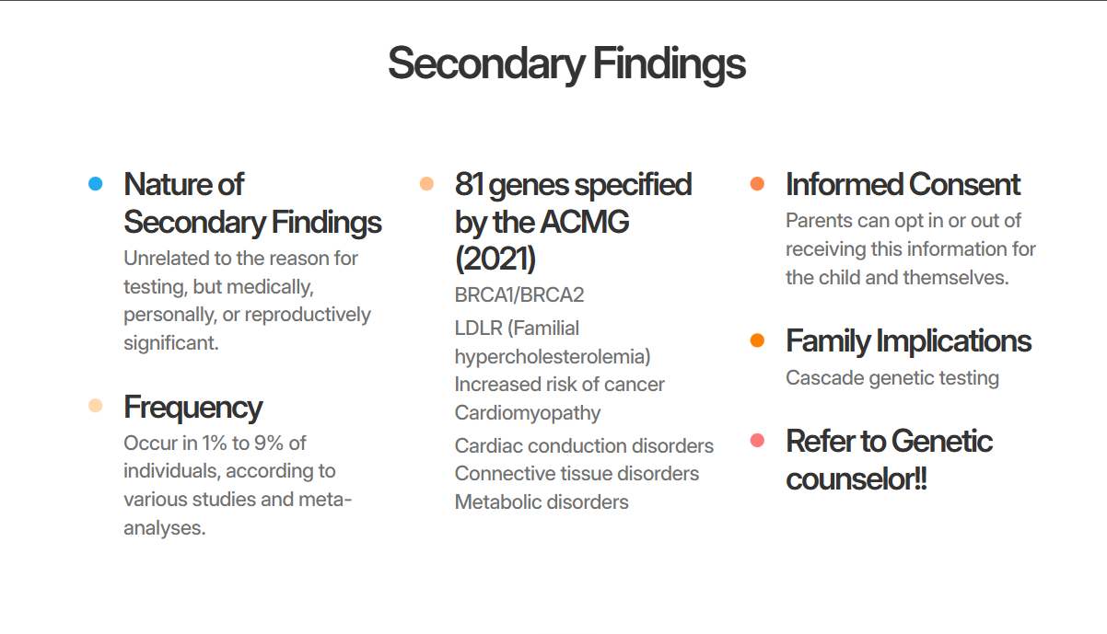
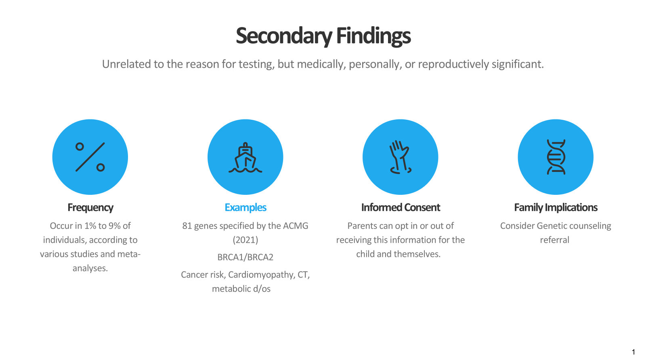
Notes:
What are Secondary findings? (gene variant unrelated to the reason for testing, with medical, reproductive, or personal significance)
Listed are some examples of the types of clinically actionable genes that have been specified by the ACMG
Occurs in 1% - 9% of individuals (various studies and meta-analyses)
As of 2021, ACMG specified 81 genes regarded as clinically actionable
Increased risk of cancer
Cardiomyopathy
Cardiac conduction disorders
Connective tissue disorders
Metabolic disorders
Implications for other family members – either for parents in trio testing or from cascade genetic testing
Identification of carrier status for recessive conditions
Additional Considerations
Secondary findings should be made available to all individuals unless they opt out
Refer to a genetic counselor if secondary findings occur

Slide 37
Yield of Large Regions of Homozygosity (ROH) in making a Genetic Diagnosis
Context ROH | Prevalence | Diagnostic Yield
Consanguineous Population | Postnatal High | 11% diagnoses
Prenatal cohorts | ~0.8% | 60% if ROH found
Developmental cohorts | ~7% (vs. 1.4%) | Enriched ROH in disease
The frequency and size of these ROH, as well as the genetic conditions related to its occurrence:
  varies widely from population to population
  carries important demographic and cultural traits
Notes:
ROH = region/runs of homozygosity
Studies investigating ROH prevalence in different populations imply that the occurrence of these regions seems to be underestimated in the human genome. The frequency and size of these ROH, as well as the genetic conditions related to its occurrence, varies widely from population to population, carrying very important demographic and cultural traits
Prenatal settings (Guangzhou cohort)
Among 5,116 prenatal SNP-array tests, 0.76% (39 cases) had ROH ≥5 Mb; within a small subgroup of consanguineous pregnancies, 100% (4/4) showed ROH
Postnatal testing in consanguineous populations
In a study of 227 individuals from a consanguineous population using chromosomal microarray plus SNP-array, ROH-workups led to a definitive recessive diagnosis in 11% of cases (25/227), boosting the diagnostic yield from 14% (for CNVs alone) to 26% overall
Clinical neurodevelopmental cohort (Brazil)
In 265 patients with developmental delay and congenital anomalies, 7.2% had multiple ROH covering >1% of the genome vs. just 1.4% in controls. Additionally, 1.9% had a single ROH ≥10 Mb
Standard prenatal microarray (6,288 cases)
Large ROH (>10 Mb) were seen in ~0.8% of cases (50/6,288). Over half (59%) of these correlated with ultrasound abnormalities; ~20% indicated uniparental disomy, and ~20% suggested consanguinity
Interpretation:
Consanguineous populations: ROH leads to a diagnosis in about 11% of tested individuals.
Prenatal cohorts: Large ROH are rare (~0.8%), but when present, there’s a high likelihood of significant findings (UPD or recessive risk).
Targeted clinical populations: Neurodevelopmental/complex phenotypes show elevated ROH (~7%), and many overlap with disease-associated variants.
Clinical Takeaways
Context ROH - Prevalence - Diagnostic Yield
Consanguineous - postnatal High ~11% diagnoses
General prenatal settings - ~0.8% ~60% if ROH found
Developmental cohorts ~7% (vs 1.4%) Enriched ROH in disease

Slide 38
Implications of High ROH Findings
Clinical Significance
Presence of ROHs may be because of parental relatedness, chromosomal recombination or rearrangements and provides important clues regarding ancestral homozygosity, consanguinity/familial relationships, uniparental disomy, and autosomal recessive disease
Ethical Implications
Equity and Cultural Sensitivity
Disclosure of unexpected relationships
Informed Consent and Pre-Test Counseling
Privacy and Confidentiality
Autonomy vs. Protection
Mandatory Reporting
Notes:
Presence of ROHs may be because of parental relatedness, chromosomal recombination or rearrangements and provides important clues regarding ancestral homozygosity, consanguinity/familial relationships, uniparental disomy, and autosomal recessive disease
ROH analysis provides clinically actionable insights in a substantial minority—and in select high-risk groups, the diagnostic yield can be quite significant.
Disclosure of unexpected relationships
May suggest parental consanguinity (e.g., first cousins or closer)
Raise concerns about incest, non-paternity, or other sensitive family structures
Clinicians must balance truth-telling with psychological harm and family dynamics
Informed Consent and Pre-Test Counseling
Patients/families may be unaware such information could be revealed
Highlights the need for clear pre-test education about possible incidental findings
Privacy and Confidentiality
Sensitive findings could lead to stigma, family conflict, or social consequences
Autonomy vs. Protection
Parents may decline further testing or counseling, even if risk is high. Providers must respect autonomy while advocating for child’s health and well being
Mandatory Reporting
If findings raise concern for abuse (e.g., incest, minor, IDD, vulnerable)
Requires careful evaluation, context, and legal guidance)
Equity and Cultural Sensitivity
Consanguinity may be common in some communities
Consider closed communities
Avoid pathologizing cultural practices while ensuring appropriate medical follow-up

Slide 39
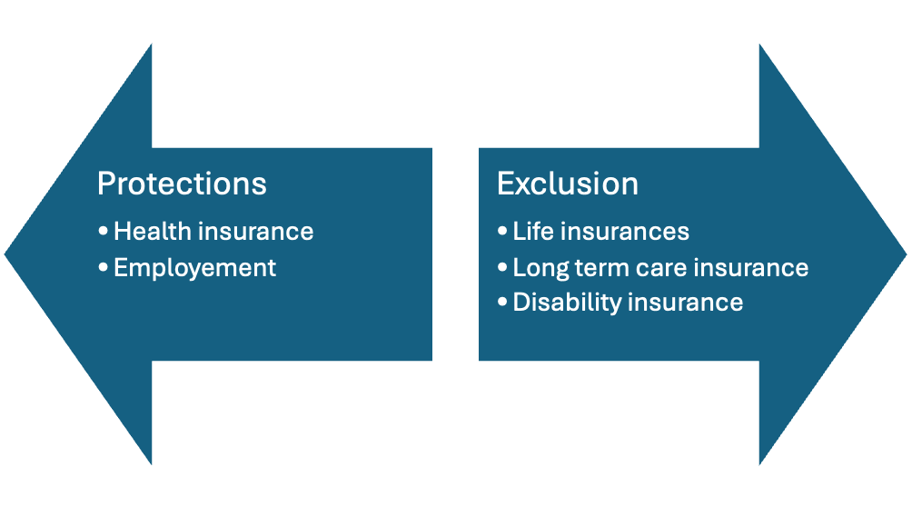
Genetic Information Nondiscrimination Act of 2008 (GINA)
Title I insurance protections includes Medicare, Medicaid and private insurance with limited protections for Tricare.
Title II employee protections do not include employers with less than 15 employees.
Notes:
Cite
Lenartz A, Scherer AM, Uhlmann WR, Suter SM, Anderson Hartley C, Prince AER. The persistent lack of knowledge and misunderstanding of the Genetic Information Nondiscrimination Act (GINA) more than a decade after passage. Genet Med. 2021 Dec;23(12):2324-2334. doi: 10.1038/s41436-021-01268-w. Epub 2021 Aug 16. Erratum in: Genet Med. 2021 Dec;23(12):2471. doi: 10.1038/s41436-021-01305-8. PMID: 34400812; PMCID: PMC8633070.
National Human Genome Research Institute---Genome statue and legislation database--- Janki
Health Insurance (Title I)
GINA prohibits health insurers from discrimination based on the genetic information of enrollees. Specifically, health insurers may not use genetic information to determine if someone is eligible for insurance or to make coverage, underwriting or premium-setting decisions. Furthermore, health insurers may not request or require individuals or their family members to undergo genetic testing or to provide genetic information. As defined in the law, genetic information includes family medical history, manifest disease in family members, and information regarding individuals' and family members' genetic tests. The health insurance protections of GINA extend to private health insurers, Medicare, Medicaid, Federal Employees Health Benefits, and the Veterans Health Administration. For the U.S. Military’s TRICARE insurance program, GINA offers more limited protection. TRICARE may not use genetic information for coverage, underwriting, or premium-setting, but eligibility for TRICARE insurance is contingent upon employment by the U.S. Military, and GINA’s employment protections do not apply to the U.S. Military. The U.S. military is permitted to use genetic and medical information to make employment decisions (see next section on “Employment (Title II)” for more information).
Employment (Title II)
Title II of GINA is implemented by the Equal Employment Opportunity Commission (EEOC) and prevents employers from using genetic information in employment decisions such as hiring, firing, promotions, pay, and job assignments. Furthermore, GINA prohibits employers or other covered entities (employment agencies, labor organizations, joint labor-management training programs, and apprenticeship programs) from requiring or requesting genetic information and/or genetic tests as a condition of employment. The regulations governing implementation of GINA in employment took effect on January 10, 2011.
An important exception to Title II of GINA involves the U.S. Military. The military is permitted to use genetic information to make employment decisions. Note that eligibility for TRICARE insurance is contingent upon employment by the military, and so genetic test results may affect one’s ability to access TRICARE insurance.
Also, importantly, GINA does not apply to employers with fewer than 15 employees.

Slide 40


Military Challenges
GINA protections do not apply
Is allowed to use genetic testing information to make employment decisions
Although GINA offers limited protections for Tricare, insurance eligibility is dependent on employment through the military.
Military does not comply with ADA if disabilities challenge service

Slide 41
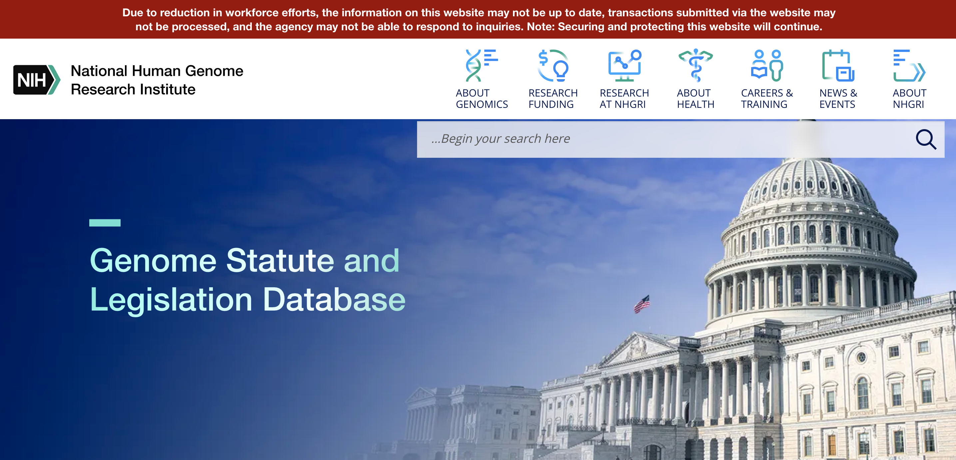
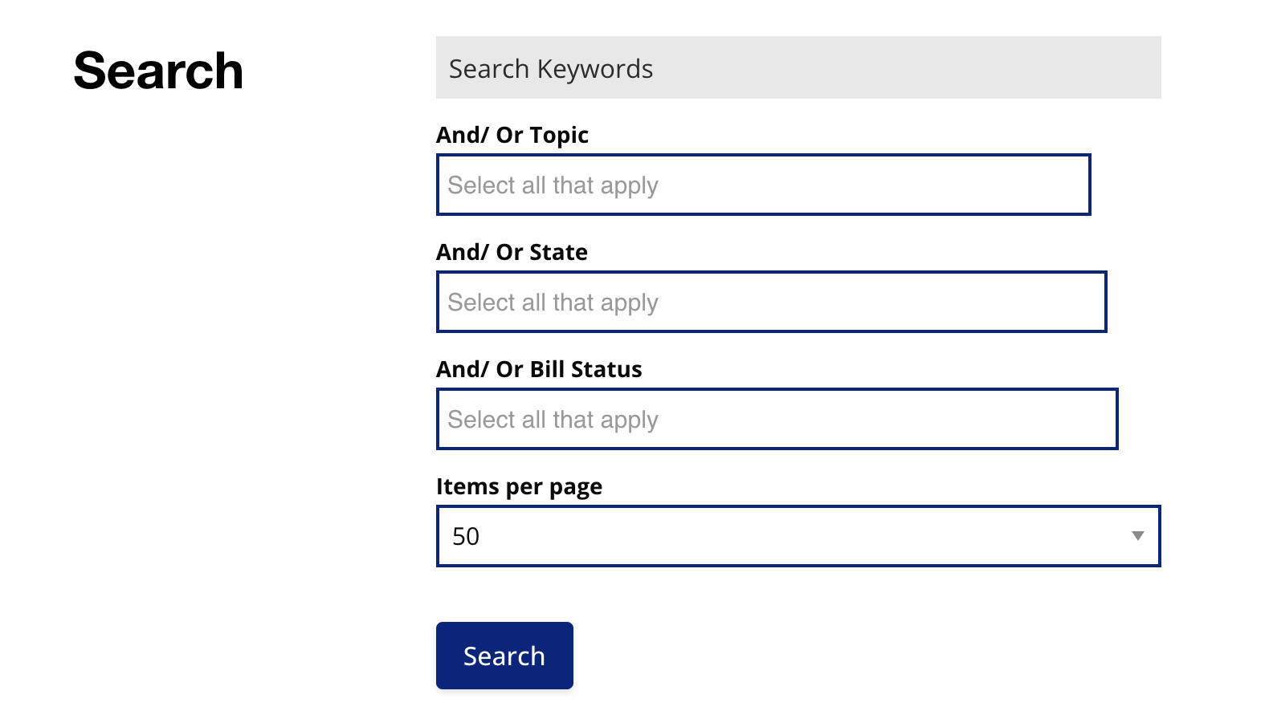
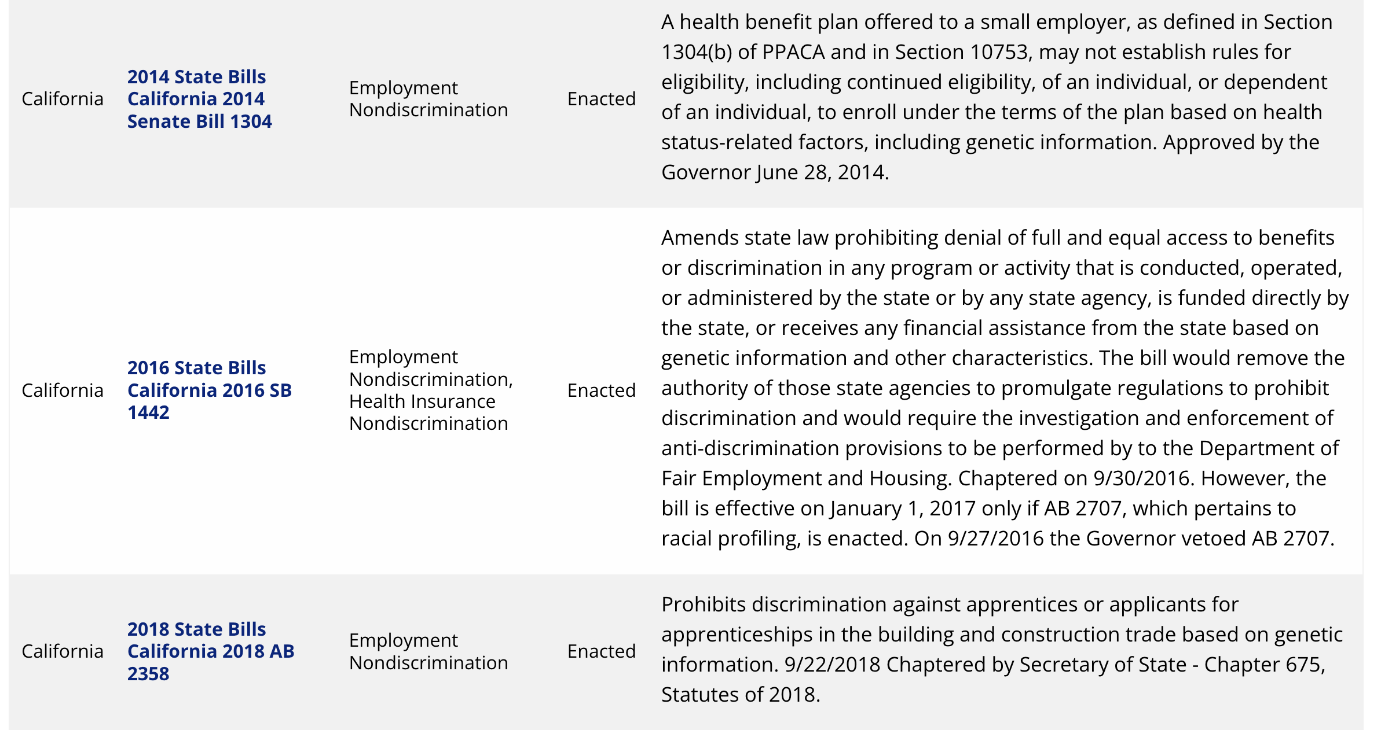
Database of genetically relevant laws per state
GINA is a federal law with different implementations at state level.

Slide 42
ACMG Practice Guideline 2021
Concluding statement: "Exome sequencing/genome sequencing demonstrates clinical utility for the patients and their families with limited evidence for negative outcomes and the ever-increasing emerging evidence of therapeutic benefit"
Notes:
Reminder/summary statement that the benefits outweigh the risks!!

Slide 43
Helpful Websites:
https://www.genome.gov/about-genomics/policy-issues/Genome-Statute-Legislation-Database
https://youtu.be/uvCrZI0FGXY
https://sparkforautism.org/portal/page/genetic-analysis-faq/

Slide 44
Sources
Gonzales PR, Andersen EF, Brown TR, Horner VL, Horwitz J, Rehder CW, Rudy NL, Robin NH, Thorland EC, On Behalf Of The Acmg Laboratory Quality Assurance Committee. Interpretation and reporting of large regions of homozygosity and suspected consanguinity/uniparental disomy, 2021 revision: A technical standard of the American College of Medical Genetics and Genomics (ACMG). Genet Med. 2022 Feb;24(2):255-261. doi: 10.1016/j.gim.2021.10.004. Epub 2021 Dec 3. PMID: 34906464.
Alabdullatif MA, Al Dhaibani MA, Khassawneh MY, El-Hattab AW. Chromosomal microarray in a highly consanguineous population: diagnostic yield, utility of regions of homozygosity, and novel mutations. Clin Genet. 2017 Apr;91(4):616-622. doi: 10.1111/cge.12872. Epub 2016 Oct 11. PMID: 27717089.
Ma D, Ye M, Hu W, Gao H, Wang L, Song Y, Nie R, Hu Z, Guo H. Large regions of homozygosity in prenatal diagnosis. Am J Med Genet A. 2024 Oct;194(10):e63712. doi: 10.1002/ajmg.a.63712. Epub 2024 May 17. PMID: 38757552.
Correia-Costa GR, Sgardioli IC, Santos APD, Araujo TK, Secolin R, Lopes-Cendes I, Gil-da-Silva-Lopes VL, Vieira TP. Increased runs of homozygosity in the autosomal genome of Brazilian individuals with neurodevelopmental delay/intellectual disability and/or multiple congenital anomalies investigated by chromosomal microarray analysis. Genet Mol Biol. 2022 Feb 28;45(1):e20200480. doi: 10.1590/1678-4685-GMB-2020-0480. PMID: 35238326; PMCID: PMC8892458.
Wang JC, Ross L, Mahon LW, Owen R, Hemmat M, Wang BT, El Naggar M, Kopita KA, Randolph LM, Chase JM, Matas Aguilera MJ, Siles JL, Church JA, Hauser N, Shen JJ, Jones MC, Wierenga KJ, Jiang Z, Haddadin M, Boyar FZ, Anguiano A, Strom CM, Sahoo T. Regions of homozygosity identified by oligonucleotide SNP arrays: evaluating the incidence and clinical utility. Eur J Hum Genet. 2015 May;23(5):663-71. doi: 10.1038/ejhg.2014.153. Epub 2014 Aug 13. PMID: 25118026; PMCID: PMC4402629.
Weissman, Scott M., et al. “At-home genetic testing in Pediatrics.” Current Opinion in Pediatrics, vol. 31, no. 6, Dec. 2019, pp. 723–731, https://doi.org/10.1097/mop.0000000000000824.
Lance H. Rodan, Joan Stoler, Emily Chen, Timothy Geleske, Council on Genetics; Genetic Evaluation of the Child With Intellectual Disability or Global Developmental Delay: Clinical Report. Pediatrics July 2025; 156 (1): e2025072219. 10.1542/peds.2025-072219
Manickam K, McClain MR, Demmer LA, Biswas S, Kearney HM, Malinowski J, Massingham LJ, Miller D, Yu TW, Hisama FM; ACMG Board of Directors. Exome and genome sequencing for pediatric patients with congenital anomalies or intellectual disability: an evidence-based clinical guideline of the American College of Medical Genetics and Genomics (ACMG). Genet Med. 2021 Nov;23(11):2029-2037. doi: 10.1038/s41436-021-01242-6. Epub 2021 Jul 1. PMID: 34211152.
Sakyi, G. J., Mire, S. S., Goin-Kochel, R. P., Murali, C. N., & Day, S. X. (2025). Examining parents’ perceptions of their children’s autism and completion of genetic testing. International Journal of Developmental Disabilities, 71(1), 61–71. https://doi.org/10.1080/20473869.2023.2197310
Notes:
Meeting July 23rd notes:
Our group is focusing on the legal ramification

Slide 45
Let’s Practice!
Small Group Case Discussions

Slide 46
10 MINUTE BREAK

Slide 47

Communicating Genetic Information to Families: What did the doctor say??
Division of Developmental Behavioral Pediatrics

Slide 48
Disclosures
We have no relevant financial relationships or conflicts of interest to disclose.

Slide 49
Objectives
Understand how health literacy affects healthcare outcomes
Discuss the universal precautions approach
Learn health literacy strategies for improving communication
Practice using analogies to explain genetic test results

Slide 50
Experience Health Literacy Challenges (Activity)
Read out loud the following paragraph
You have 15 seconds
There will be a test at the end

Slide 51
Health Literacy Challenges = Failure to Communicate
Notes:
Picture of capstan

Slide 52
Health Literacy and Health Outcomes

Slide 53
What is Health Literacy?
“The ability to obtain, process, and understand basic health information and services needed to make appropriate health decisions.”
IOM “A Prescription to End Confusion”
Institute of Medicine. Health Literacy: A Prescription to End Confusion.
Washington, DC: National Academies Press; 2004.

Slide 54
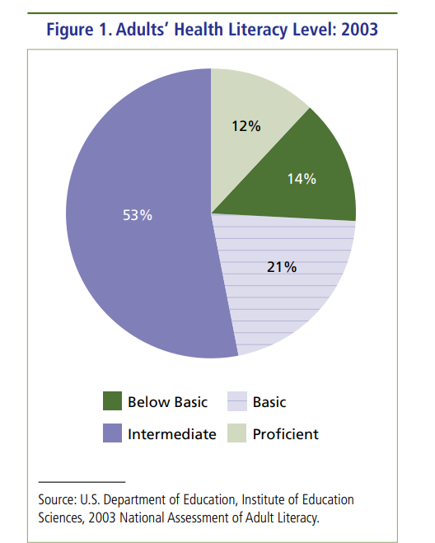
77 Million Adults Have Basic or Below Basic Health Literacy
https://www.ahrq.gov/sites/default/files/wysiwyg/health-literacy/dhhs-2008-issue-brief.pdf

Slide 55
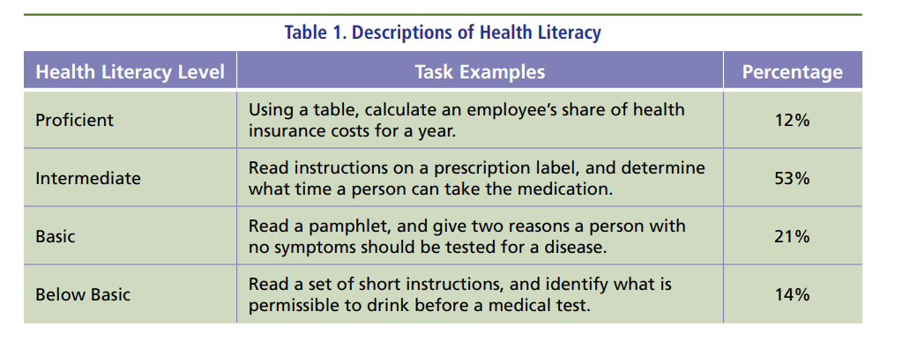
https://www.ahrq.gov/sites/default/files/wysiwyg/health-literacy/dhhs-2008-issue-brief.pdf

Slide 56
Low Health Literacy = Poor Health Outcomes
Hinders communication between patients and healthcare providers
Less understanding of health conditions and related recommendations
Lack of follow through with recommendations
Delays in care
Increases healthcare costs

Slide 57
What Can We Do?
Use the universal precautions approach
Use health literacy strategies to improve communication
Notes:
HL levels become a challenge in the setting of anxiety, uncertainty, new diagnoses, even graduate degree individuals can have difficulties when presented with new information
Anxiety

Slide 58

Universal Precautions Approach:
You can’t tell by looking
Notes:
HL levels become a challenge in the setting of anxiety, uncertainty, new diagnoses, even graduate degree individuals can have difficulties when presented with new information
Anxiety

Slide 59
Health Literacy Strategies for Effective Communication
Communicate clearly
Use visual aids and/or analogies
Check for understanding

Slide 60
Communicate Clearly
Determine the communication goals
Focus on 1-3 main points per conversation
Pause between points
Speak slowly and clearly
Avoid jargon

Slide 61
Instead of: | Try this:
Genetic Information, DNA | Blueprint of the body (book of recipes)
Chromosomes | Tiny packages with instructions (recipes in the book)
Gene | One tiny package inside the chromosome (ingredients)
Genetic Test | Test to see what the blueprint looks like (how the book was printed)
Congenital | Born this way
Hereditary | Runs in families
De Novo | New
Duplication / Deletion | Two copies / Missing
Variant of Unknown Significance | We do not know what this change means yet
Pathogenic Variant | A change that can cause problems
Informed Consent | Let’s talk about the pros and cons
Referral | Send you to another doctor

Slide 62
Use Visual Aids and/or Analogies
A picture is worth a thousand words
Analogies - “Building a bridge between the known and the unknown”

Slide 63
Cook Book Analogy: Trisomy 21
DNA is like a cook book with recipes. Everyone has their own cook book (DNA) with 46 recipes (chromosomes).
Each recipe has two pages, one from the mother and one from the father.
We should have 46 recipes (chromosomes) with two pages each, but sometimes a person can end up with 3 pages in recipe #21 (Trisomy 21).
This extra page (Trisomy 21) can cause health problems in different parts of the body.

Slide 64
Check for Understanding
Teach-Back Method
Encourage patients to ask questions
Notes:
“I want to make sure that I explained myself”
Can you tell me what we talked about?
What questions do you have?
In your own words, what did you get

Slide 65
Health Literacy Strategies
Universal Precautions Approach
Communicate clearly
Use visual aids and/or analogies
Check for understanding

Slide 66
Let’s Practice! Small Group Activity:
Using Analogies

Slide 67
“The single biggest problem in communication is the illusion that it has taken place”
- George Bernard Shaw

Slide 68
References
Connelly, R; Turner, Teri (Eds) Health Literacy and Child Health Outcomes: Promoting Effective Health Communication Strategies to Improve Quality of Care. ISBN 978-3-319-50799-6 http://www.springer.com/us/book/9783319507989
America’s Health Literacy: Why We Need Accessible Health Information. Retrieved from https://www.ahrq.gov/sites/default/files/wysiwyg/health-literacy/dhhs-2008-issue-brief.pdf
Centers for Disease Control and Prevention. (2021, May 21). Talking points about health literacy. Retrieved from https://www.cdc.gov/health-literacy/php/about/tell-others.html?CDC_AAref_Val=https://www.cdc.gov/healthliteracy/shareinteract/TellOthers.htmlhttl
Health Literacy Statistics 2025 By Decisions, Resources, Individuals Retrieved from: https://media.market.us/health-literacy-statistics/
Grace M. Hildenbrand & Evan K. Perrault (2022) The influence of physician use of analogies on patient understanding, Communication Quarterly, 70:5, 495-518, DOI: 10.1080/01463373.2022.2090266
Grace M. Hildenbrand (2021) Healthcare Provider Analogies as Memorable Messages, Journal of Health Communication, 26:11, 764-772, DOI: 10.1080/10810730.2021.2002982

Slide 69
Wrap Up, Large Group Sharing, and Distribution of Toolbox

Slide 70
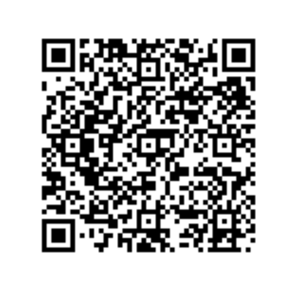
Please give your feedback!!
We deliver Developmental-Behavioral Pediatric and Lifespan Care Education with the assistance of a Health Resources and Services Administration (HRSA) DBP Training Grant
PLEASE HELP us improve the quality of our education and/or document it’s relevance by completing the survey!

