Slide 1



Cerebral Visual Impairment for Developmental Practices
Katherine Burns, MD
Kimberly Litscher, MS
Molly Conn, MS

Slide 2
Disclosures
We have no relevant financial relationships to disclose.​
AND
We will not discuss off label use or investigational use in this presentation.​

Slide 3
Learning Objectives
Attendees will gain knowledge of risk factors for and presentations of CVI
Attendees will become familiar with CVI symptoms and be able to ask screening questions/integrate basic CVI elements into exam
Attendees will better understand the components of functional vision assessments and how to integrate this information into DBP assessments
Attendees will consider the appropriateness of various components of common DBP assessments (ADOS and Bayley) in patients with CVI
Attendees will become familiar with abbreviations and terms associated with CVI

Slide 4
Schedule for Today
Introductions
Overview of CVI
Group review of a functional vision assessment
Experiencing CVI via simulators
Experiencing accessibility
Considering CVI during common developmental assessments

Slide 5
Introductions

Slide 6
Cerebral Visual Impairment
Cortical visual impairment until about 20-25 years ago
Cerebral visual impairment better describes whole brain function
Different than ocular visual impairment

Slide 7
CVI Definition
CVI is a lifelong brain-based visual impairment, caused by damage to or altered function of the brain’s visual pathways or visual processing areas.
  Visual processing occurs in multiple areas in the brain
This damage is not always visible on MRI but can be presumed to be functional
>20% of individuals with CVI have no obvious damage on MRI of brain and on the 2022 Babies Count National Registry of Children with Blindness or Vision Loss, 26% had no known etiology for their vision loss
Needs and symptoms are NOT stable over time
There are genetic causes of CVI, but this is evolving

Slide 8
NIH CVI Working Group Definition
CVI encompasses a spectrum of visual impairments caused by an underlying brain abnormality that affects the development of visual processing pathways and is characterized by deficits in visual function and functional vision.
The visual dysfunction in CVI is greater than expected by any comorbid ocular conditions alone.
The visual dysfunction in CVI may manifest as lower-order or higher-order afferent visual deficits, or both, leading to characteristic behaviors in affected individuals.
Although CVI may be comorbid with other neurodevelopmental disorders, CVI is not primarily a disorder of language, learning, or social communication.
The underlying neurologic insult of the developing brain may go unrecognized or undiagnosed until later in life.
Special Commentary: Cerebral/Cortical Visual Impairment Working Definition
A Report from the National Institutes of Health CVI Workshop
Melinda Y. Chang, MD^{1,2,∗} Melinda.y.wu@gmail.com ∙ Lotfi B. Merabet, OD, PhD^{3,4,∗} for the CVI Working Group

Slide 9
To Meet Criteria for CVI you need 3 things:
Abnormal visual behaviors that cannot be explained by clinical eye exam
  Must have ophthalmology exam and history of neurologic impact or genetic disorder
History of something increasing risk factors including:
  Complex medical history (preterm birth, IUGR, or trauma)
  Genetic conditions that impact neurologic functioning
Presence of unique visual characteristics
****If you strongly suspect CVI, a MRI is recommended****

Slide 10
How Often and Who?
Several studies show that up to 70% of children with Cerebral Palsy have CVI
Best estimates are that 38% percent of people with Down Syndrome have CVI or enough symptoms to warrant further investigation.
CVI is extremely underdiagnosed. Less than 20% of likely U.S. cases are diagnosed.
Basically no specialty “owns” CVI
CVI is common in neurodevelopmental conditions, and complications from premature birth, lack of oxygen, pediatric stroke, and genetic conditions are common causes of CVI.
CVI advocates recommend screening for CVI in ALL children born <30 weeks gestation, Cerebral Palsy, Developmental delay, Traumatic brain injury

Slide 11
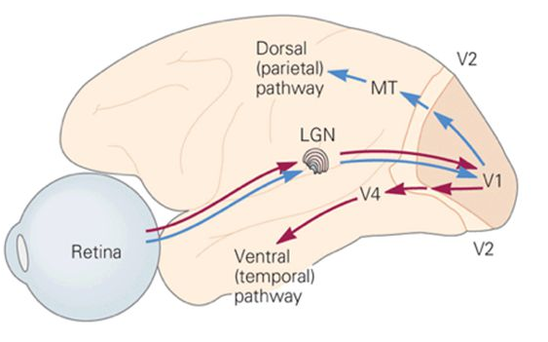
Lateral geniculate nucleus
Notes:
Lateral geniculate nucleus is located in the thalamus

Slide 12
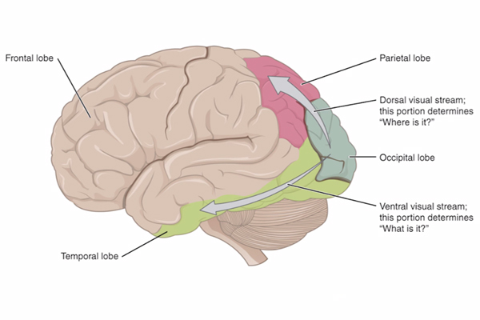

Slide 13
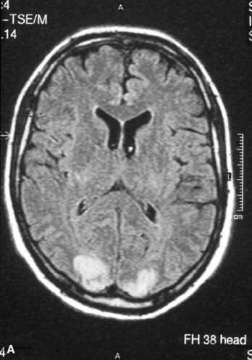

Slide 14
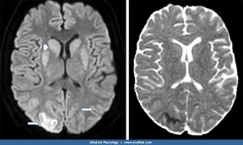

Slide 15
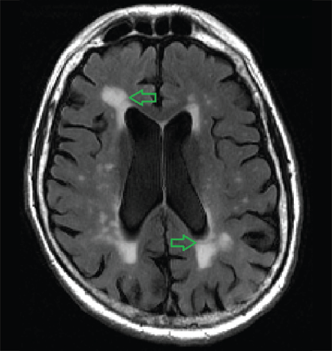
Notes:
plagiocephaly

Slide 16
Visual Development is a Moving Target
Just like autism and social skills, visual maturation is a moving target
A high risk child should be monitored as they develop
If skills plateau or atypical behaviors arise, question if this might be CVI
Functional Vision Assessments at a very young age may not be helpful or specific
BUT if brain injury is documented, early intervention with a Teacher for the Visually Impaired can provide helpful tips, strategies, and guidance as a child grows and develops

Slide 17
Visual Milestones
Birth visually fixate
1-2 months following 90 degrees
4 months following 180 degrees
4-5 months visually guided reach
7-12 months depth perception
24-36 months convergence and focusing as well as binocular vision

Slide 18
Early Symptoms of CVI
Eyes misaligned
Head tilt
Atypical movement of eyes
Atypical visual reflexes
Decreased length of visual attention
Delayed or Atypical Visual latency
Absence of Visually guided reach
Visual field limitations or preferences
Need for movement to visually attend
Early strong color preference

Slide 19
Interview and Exam components
Birth: head tilt
Horizontally following lighted toy 4 months of age
Peripheral visual fields about 4-6 months of age
Head midline and up in crawling
Visually guided object manipulation by 18 months of age
Under/overshooting shape sorters and in/out
Hesitancy at curbs or harsh shadows
Banging shoulders/body into walls or door frames regularly
Stepping on toys

Slide 20
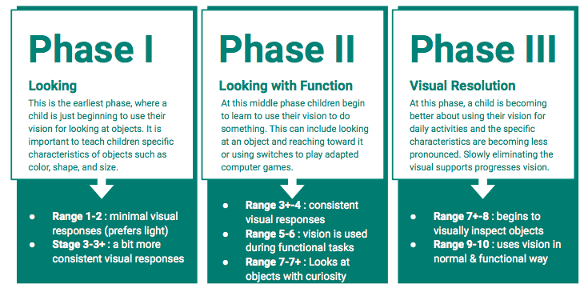

Slide 21
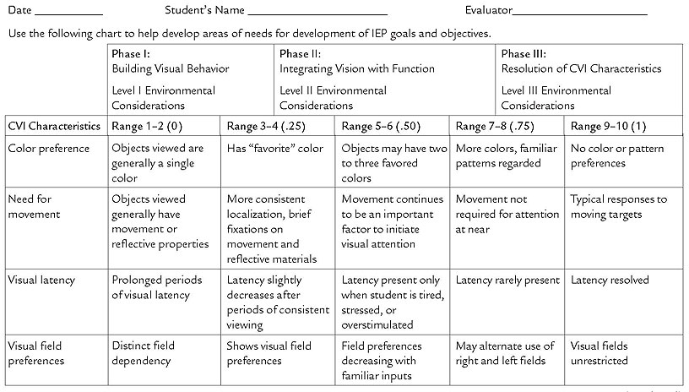

Slide 22
Perkins CVI Protocol
Visual Attention
Visual Recognition
Impact of Clutter/Crowding/Spacing
Visual Field Abilities
Impact of Color
Form Accessibility
Visual Guidance of the Upper Limbs
Visual Guidance of the Lower Limbs
Access to People
Impact of Light
Response Interval
Impact of Motion
Sensory Integration and Impact on Vision
Visual Curiosity
Appearance of the Eyes
Movement of the Eyes
Notes:
Form accessibility – knowing Donald duck is a duck just like a rubber ducky

Slide 23
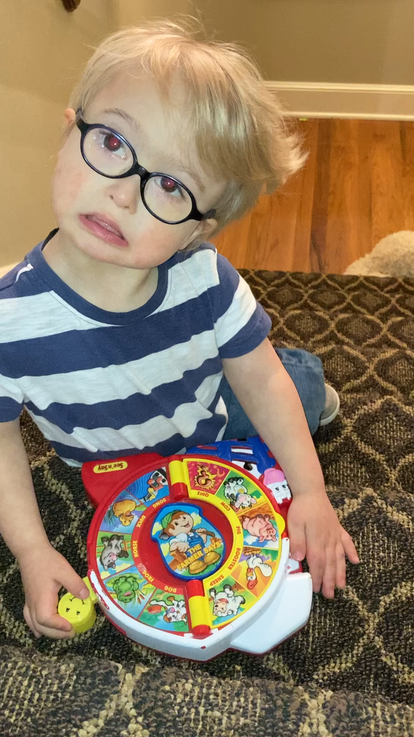
Cannot sustain visual attention to complex toy even though he enjoys and is attending to the toy and its functions

Slide 24
Interventions
Got the diagnosis of CVI (functional vision assessment + Ophthalmology)
Informed school who assigned him a TVI and O&M
Altered his IEP to include visual impairment as a primary diagnosis
Gave therapists each a copy of his functional vision assessment and discussed how to alter therapy
Taped all stairs and edges in our house
Did therapy in the dark with a spot light
Found toys and books he attended to
Found a physical therapist who taught at CCVI for years

Slide 25
Much like autism, people with CVI can have a variety of presentations and functionally impairing symptoms, which are NOT present in all individuals.
Much like autism, symptoms of CVI are not necessarily stable over time and may appear more impairing in novel and overwhelming environments

Slide 26


Slide 27


Slide 28


Slide 29
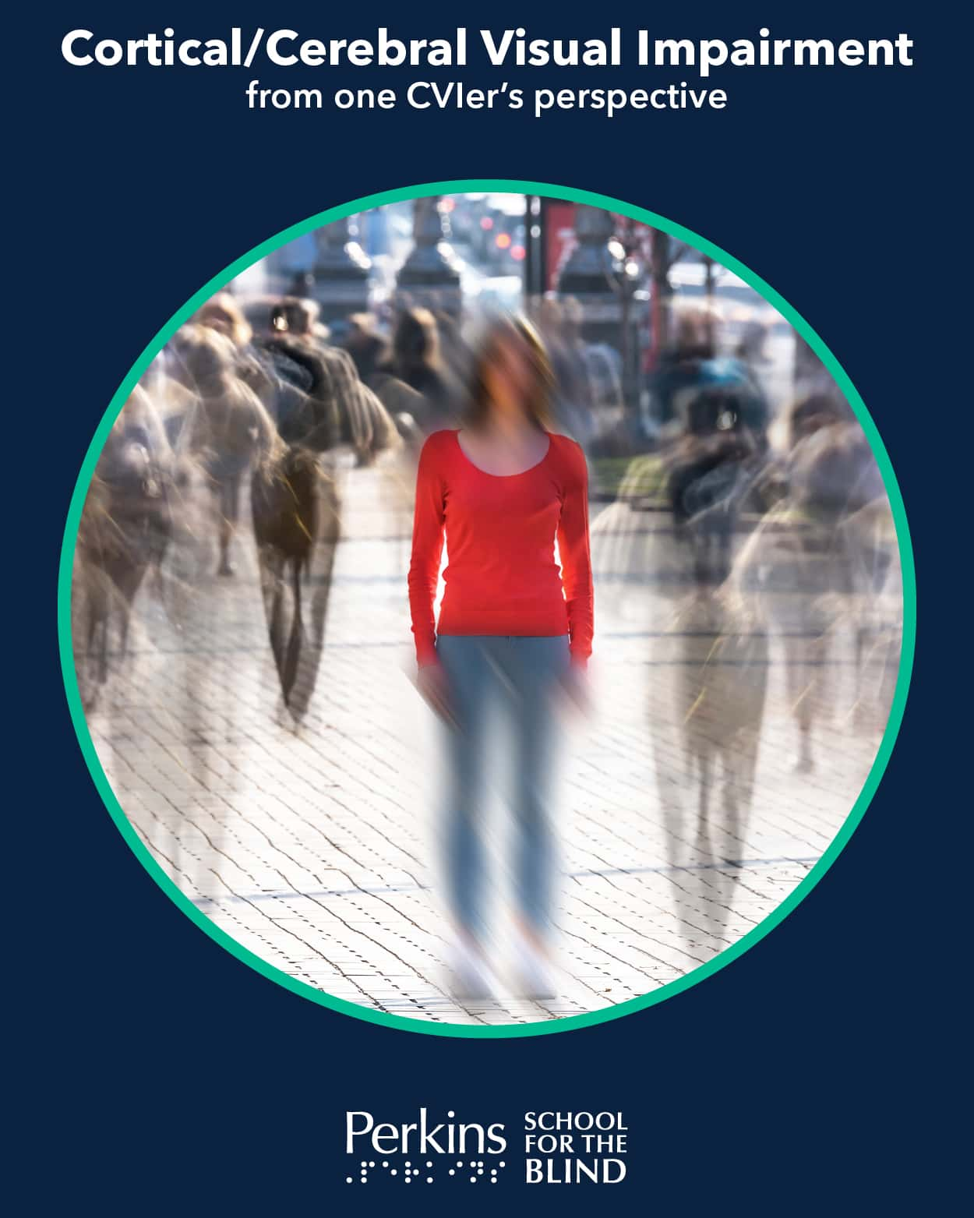

Slide 30
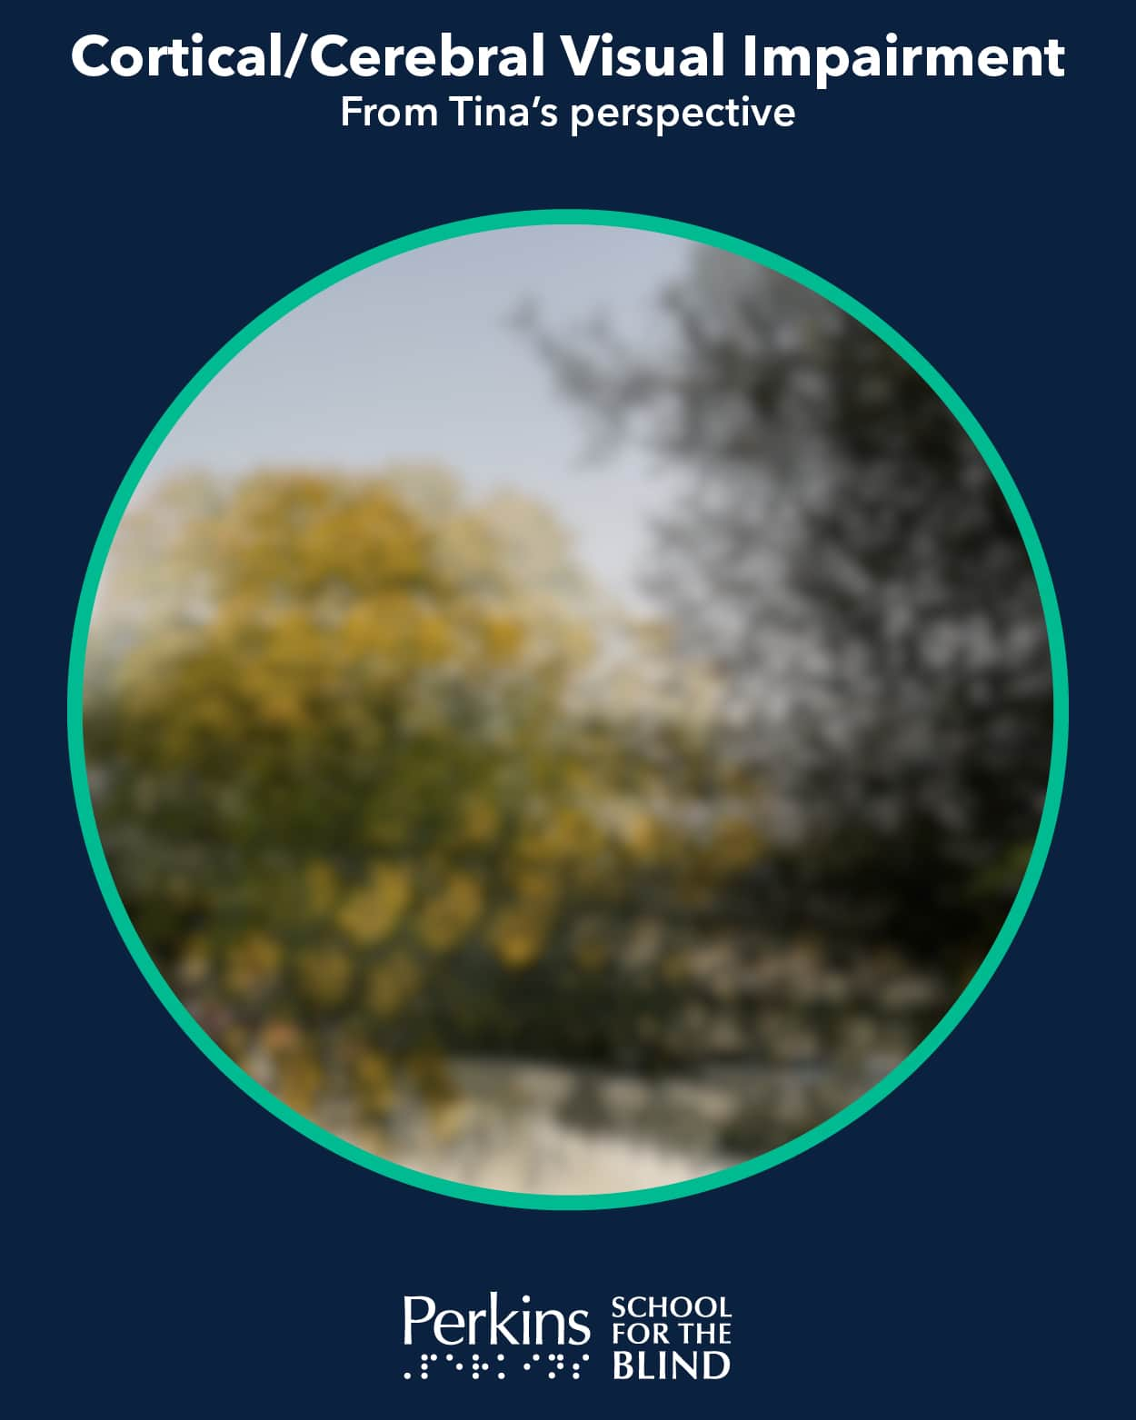

Slide 31


Slide 32
Where to Refer
MUST have eye exam. Preferably within the past year
Assessment depends on your state and local service providers
  Early Intervention
  School related services
Functional Visual Evaluation (Assessment)
Visually impaired children are federally protected (IDEA and 504)
Teacher for Visually Impaired
Orientation and Mobility Specialist
Learning Media Assessment
After Functional Vision Evaluation, may need Ophthalmology or Neurology to diagnose CVI

Slide 33
Questions?

Slide 34
Functional Vision Evaluation (FVE) Questions to Consider
The goal is to see the whole child
TVIs will spend hours reviewing the medical record prior to the FVE
Vision affects every area of development and even if a child is developing well, the child may still require direct instruction in specific skills
  Physical therapy – riding a bike, kicking a ball

Slide 35
Functional Vision Evaluation
Focus on Function:
Unlike standard eye exams that diagnose conditions and prescribe treatments, an FVE assesses how a person uses their vision to interact with their environment and people.
Real-World Settings:
It examines vision in various contexts, like familiar and unfamiliar environments, to understand how vision impacts learning, participation, and overall functioning.
Identification of Strengths and Limitations:
The assessment helps identify an individual's visual strengths and limitations in relation to specific tasks, like reading, writing, or navigating.

Slide 36
Functional Vision Evaluation Components
Observation:
Observing the individual's visual behavior in various settings.
Task Analysis:
Examining how the individual approaches and completes specific tasks using their vision.
Use of Assistive Devices:
Determining the effectiveness of assistive devices in supporting visual tasks.
Environmental Considerations:
Assessing how the environment can be adapted to maximize the individual's visual functioning.
Caregiver Report:
Observation in the child’s home environment. Even if their report of function or preference is not observed during the FVE, it is strongly considered during the report writing

Slide 37
Updates or Repeating
Ocular-motor may be considered as the child ages
Full re-evaluation may not be required but is updated annually
More frequently or more thorough evaluation if there are changes in medical condition or other concerns
Learning Media Assessment is a separate standardized assessment appropriate for school age children

Slide 38
Let’s Review some Functional Vision Assessments

Slide 39
Things to Consider
How would you alter your interactions with these children?
What items would you consider altering in a formal assessment such as the ADOS-2 or Bayley?
What providers would you imagine would benefit from reading this?

Slide 40
Experiencing CVI
We have some vision impairment glasses to try
  Overall distortion
  Limited peripheral visual fields
  Central visual loss
  Retinopathy
Please listen to your body and if you feel like these would trigger a migraine or otherwise cause stress, please participate appropriately

Slide 41
Try Items with the Simulator Glasses
Stacking blocks
Stringing blocks
Tracing shapes
Puzzles

Slide 42
Discussion Points
Observe other people at your table performing tasks
What are your initial impressions of experiencing this simulator?
What did you find most surprising about using the simulator?
Was there anything about this experience that felt familiar to you, even without a visual impairment?
How do you think this simulation compares to the realities of living with a visual impairment?
What aspects of the visual impairment felt most impactful in the simulation?

Slide 43
BREAK

Slide 44
Experiencing Accessibility
Ipad
Attribute trays
Contrast
WikiStix

Slide 45
Historically Used Accessibility Devices
Light box
Light box with overlays
Slant Board
Tactile Books
Tactile Worksheets
Work Trays
Spotlights
Enlargement

Slide 46
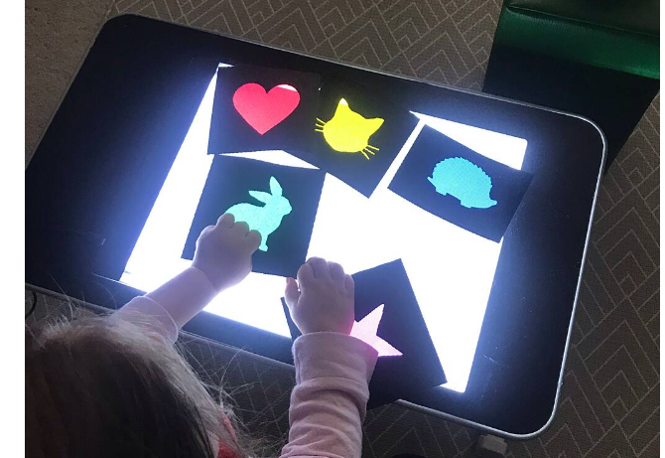

Slide 47
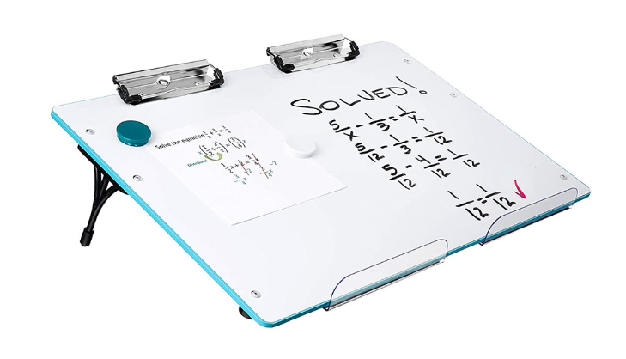

Slide 48


Slide 49
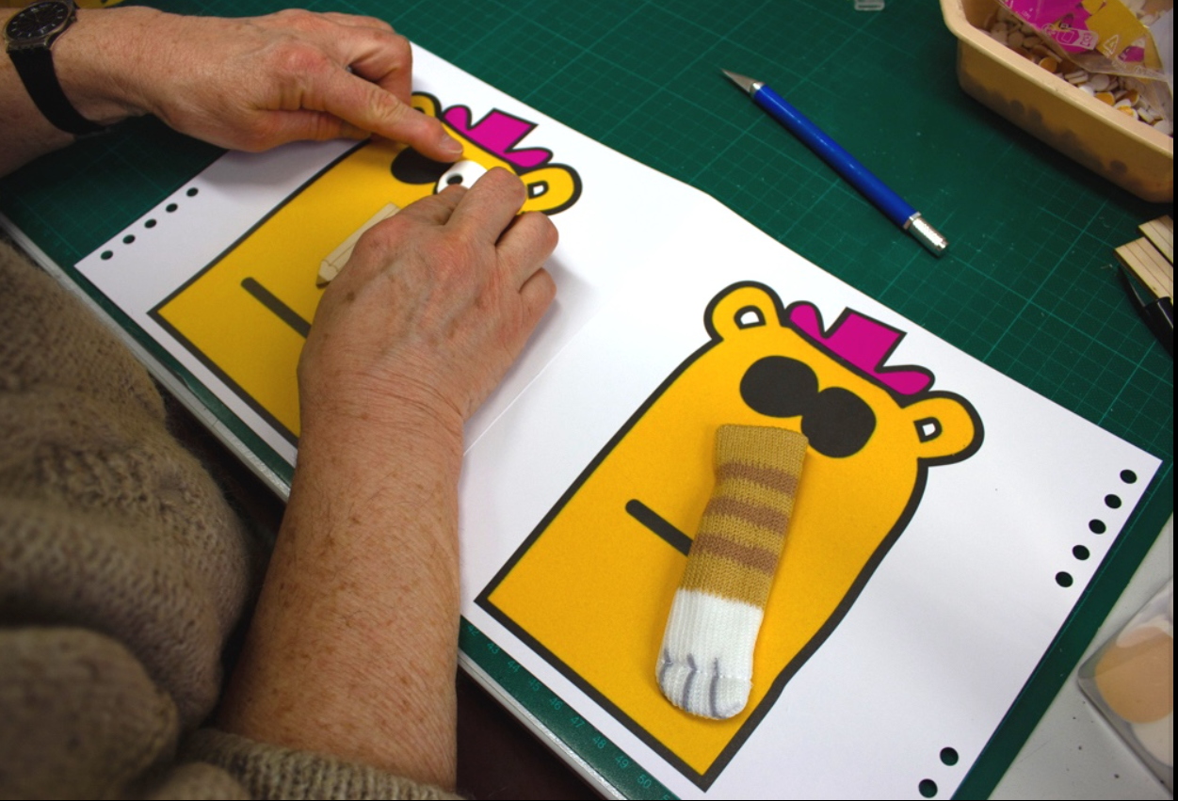

Slide 50


Slide 51
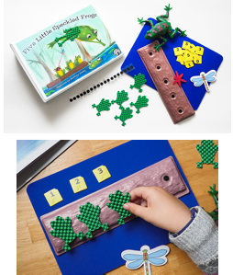

Slide 52
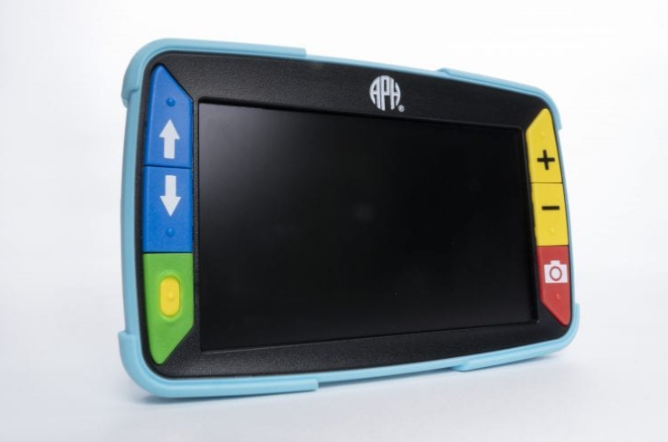

Slide 53
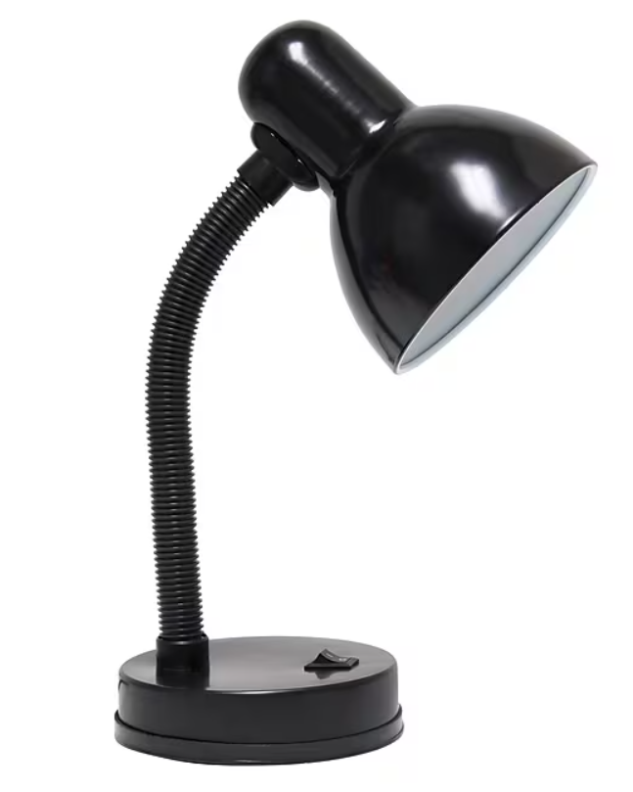

Slide 54
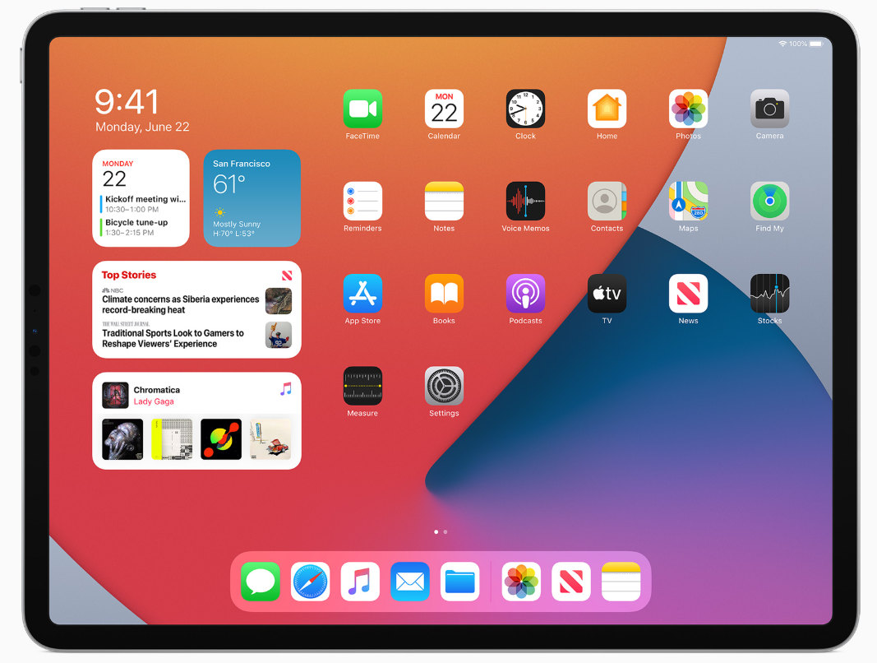

Slide 55
Things to Consider as a Sighted Person
You can have a normal eye report and still have CVI
Visual clutter can be very distracting and a significant limitation to the individual
If kids are positioning themselves or materials in a specific way, that needs to be honored
Typical visual behavior may not be functional for the individual
There are situations which can just be overwhelming and compensation may worsen

Slide 56
Considering CVI During Autism Assessments

Slide 57
CVI and Autism
They can overlap but symptoms also overlap
CVI is specifically related to access to environment and data in the environment
But they are distinct diagnoses
When I write a report of a child with CVI and ASD, I specifically mention that atypical visual behaviors are NOT being considered in the child meeting diagnostic criteria OR clarify that eye contact is within a child’s abilities but child does not make appropriate eye contact in multiple optimal situations
There are no CVI specific ASD diagnostic tools

Slide 58
Questions to ask to Differentiate
Are there ways of adapting the environment which allows the child to optimally perform socially?
Are social stimuli being presented in a manner the child can understand?
What overwhelms your child?
Does the child have decreased visual attention across multiple domains (i.e. not just faces or a busy classroom)
Pattern of development can be very helpful
Do social skills worsen with fatigue?

Slide 59
Considerations on ADOS
Visual complexity
Preference for familiar items
If a functional visual assessment is available for reference, please use this information to present information and tasks in optimal ways
Note the ADOS was altered to accommodate visual deficits, or omit the ADOS but thoroughly document the items in your report
If ADOS observations don’t match reported behaviors, favor the reported behaviors when a child is in a familiar environment

Slide 60
Considerations on the Bayley Scales of Infant Development
Many of the Bayley items are high contrast
Timed items may be more challenging
The Bayley 4 allows many parent-report items, especially in play/communication, which can be helpful

Slide 61
If You Have a Patient with a Dual Diagnosis
Most children with CVI are going to be diagnosed later than peers
  BUT they should already be in services
What is the major impairing diagnosis
If the strategies help, regardless of the exact diagnosis, use the strategies
Many ABA strategies (limited field number) are appropriate for children with CVI

Slide 62
Discussion

Slide 63
References
Melnick, M. D., Tadin, D., & Huxlin, K. R. (2016). Relearning to See in Cortical Blindness. The Neuroscientist : a review journal bringing neurobiology, neurology and psychiatry, 22(2), 199–212. https://doi.org/10.1177/1073858415621035
Fishman, R.S. Gordon Holmes. (1997). The cortical retina, and the wounds of war. Documenta Ophthalmologica 93, 9–28. https://doi.org/10.1007/BF02569044
Dutton, G. & Lueck, A. (2015). Vision and the Brain: Understanding Cerebral Visual Impairment in Children. New York, New York: American Foundation for the Blind Press.
Roman-Lantzy, C. (2018). Cortical Visual Impairment: An Approach to Assessment and Intervention. 2nd ed., New York, NY: AFB Press.
Teach CVI (2017). Tools for educators and health care providers. Retrieved from: https://www.teachcvi.net
Tietjen, M. (2019). The “What’s the Complexity?” Framework. In Roman-Lantzy, Christine. (2019) Cortical Visual Impairment: Advanced Principles (pp. 92-150). Louisville, KY: APH Press

Slide 64
More References
https://www.pathstoliteracy.org/resource/cvi-and-autism-shared-behaviors-not-diagnoses/
https://www.perkins.org
McDowell, N. (2019). Power is Knowledge: empowering parents of children with cerebral visual impairment. Disability & Society 36, 596-617.
Boonstra, F.N., Bosch, D.G., Geldof, C.J., Stellingwerf, C. Porro, G (2022). The multidisciplinary guidelines for diagnosis and referral in cerebral visual impairment. Frontiers in Human Neuroscience 16,
Special Commentary: Cerebral/Cortical Visual Impairment Working Definition: A Report from the National Institutes of Health CVI Workshop Melinda Y. Chang, MD^{1,2,∗} Melinda.y.wu@gmail.com ∙ Lotfi B. Merabet, OD, PhD^{3,4,∗} for the CVI Working Group. In Ophthalmology Volume 131, Issue 12p1359-1365December 2024

